Slide 1

WELCOME TO ONLINE CLASS
CLASS : UKG
SUBJECT : ENGLISH
TOPIC : Unit-VI – “Ch” sound words

Slide 2
LETS READ MORE CH sound words
Chair chess
Chick chips
Chin check
Church chest
Children chop
Watch Match

Slide 3
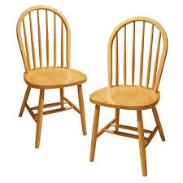
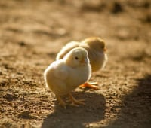
See the picture and write their names
CHAIR
CHICK

Slide 4

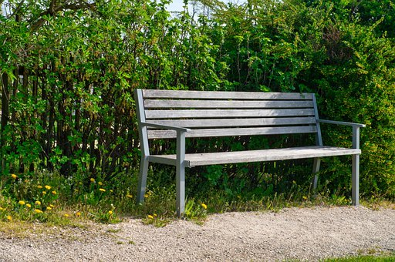

CHIN
BENCH
CHILDREN

Slide 5
CLASS ASSIGNMENT
WRITE ‘CH’ SOUND WORDS IN THE GIVEN BOXES
ch

Slide 6

THANKING YOU
ODM EDUCATIONAL GROUP

