Slide 1


Welcome to the Vertual Class
Social Science
SUBJECT : History CHAPTER NUMBER: 01
CHAPTER NAME : THE RISE OF IN
NATIONALISM IN EUROPE
PPT- 07

Slide 2


LEARNING OUTCOMES
Pupil will be able to:
Identify the location of Germany and Italy on World Map.
Familiarize with the Situation and condition of Germany and Italy during their unification.
Realize the need for their unification.

Slide 3
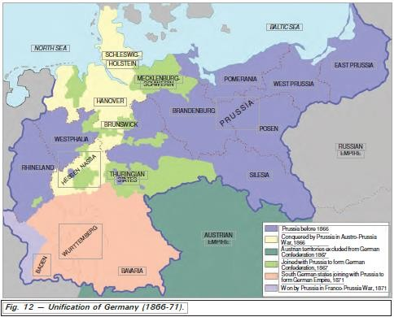

Slide 4
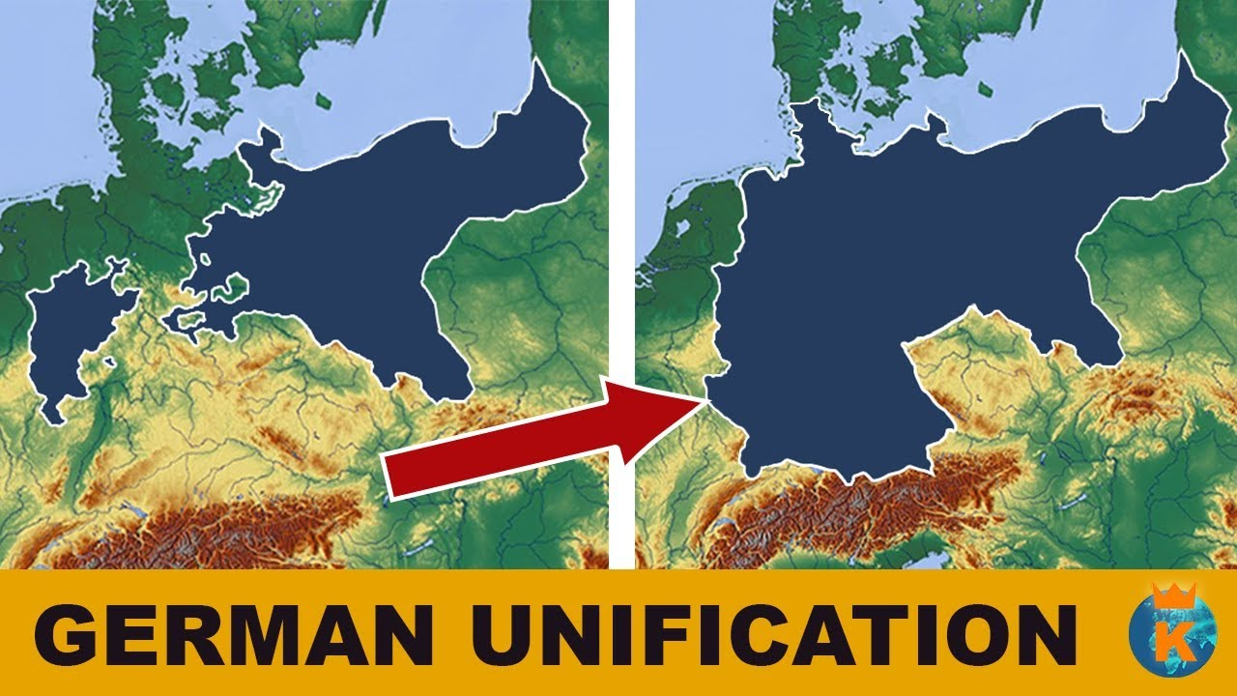

UNIFICATION OF GERMANY
AND ITALY
GERMANY:
  Nationalist feelings were widespread among middle-class Germans
  Prussia took on the leadership of the movement for national unification

Slide 5
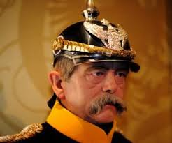
Its Chief Minister, Otto von Bismarch, was the architect of this process.
War with Austria, Denmark ad France – ended in Prussian victory and completed the process of unification.
In January 1871, the Prussian king
,William I, was proclaimed German emperor.

Slide 6
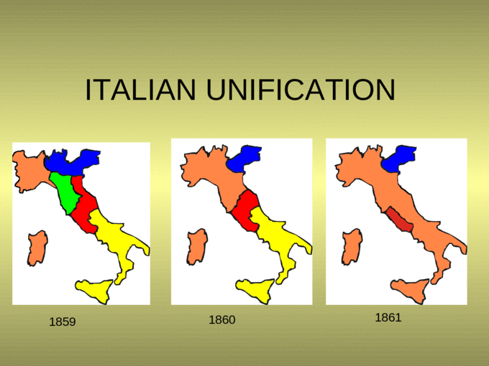
UNIFICATION OF ITALY
Scattered over several dynastic states.
Divided into seven states, of which only one, Sardinia-Piedmont, was ruled by an Italian princely house.
The north was under Austrian Habsburgs, the centre was ruled by the Pope and the southern regions were under the domination not acquired one common form and still had many regional and local variation

Slide 7
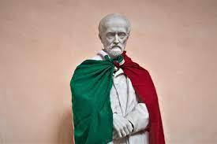
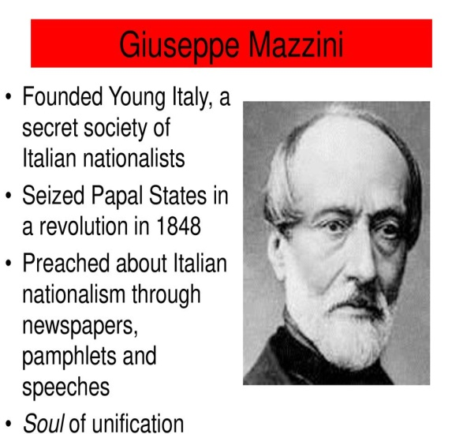
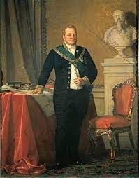
During the 1830s, Giuseppe Mazzini had sought to put together a coherent programme for a unitary Italian Republic.
He had also formed a secret society called Young Italy for the dissemination of his goals.

Slide 8
HOME ASSIGNMENT
Worksheet Q. No: 14

Slide 9
THANKING YOU
ODM EDUCATIONAL GROUP

