Slide 1

WELCOME TO ON LINE CLASS
CLASS-UKG
SUBJECT-MATHS
TOPIC-BACKWARD NUMBERS
(NOTEBOOK WORK)

Slide 2

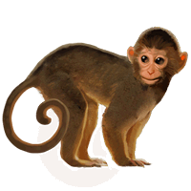
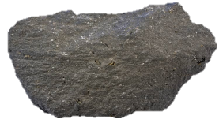
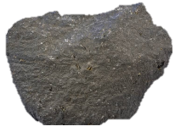
COUNT BACKWARD FROM 10 TO 1 AND HELP THE MONKEY TO CROSS THE RIVER
1
2
3
4
5
6
7
8
9
10

Slide 3
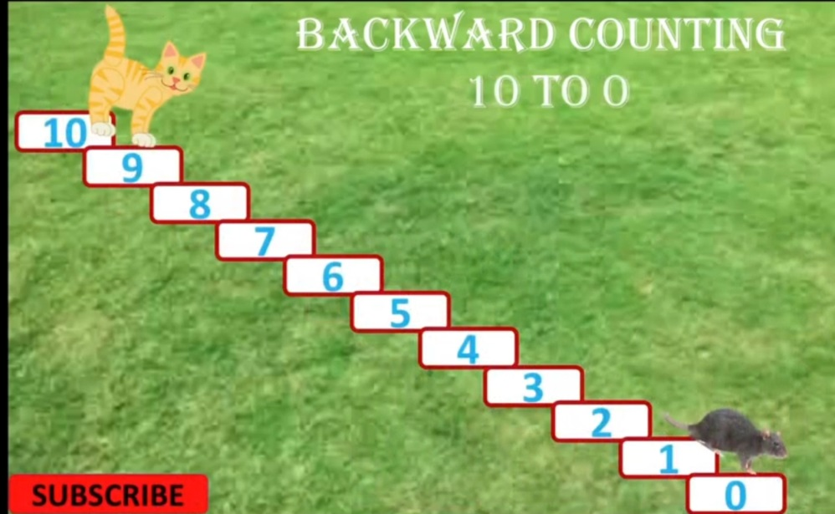
10
9
8
7
6
5
4
3
2
1
0

Slide 4
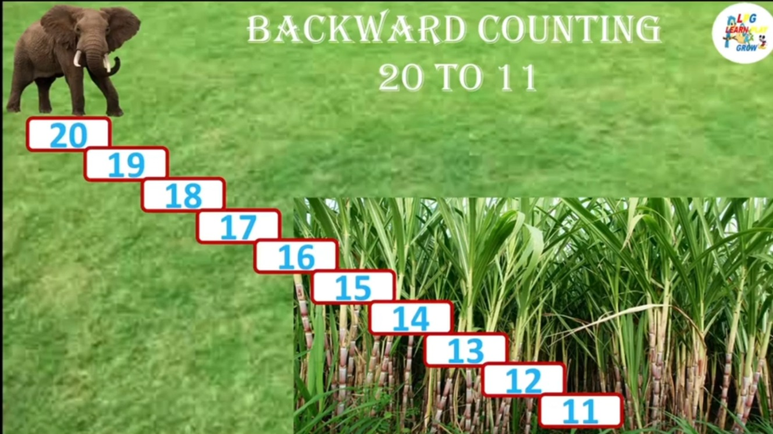
20
19
18
17
16
15
14
13
12
11

Slide 5
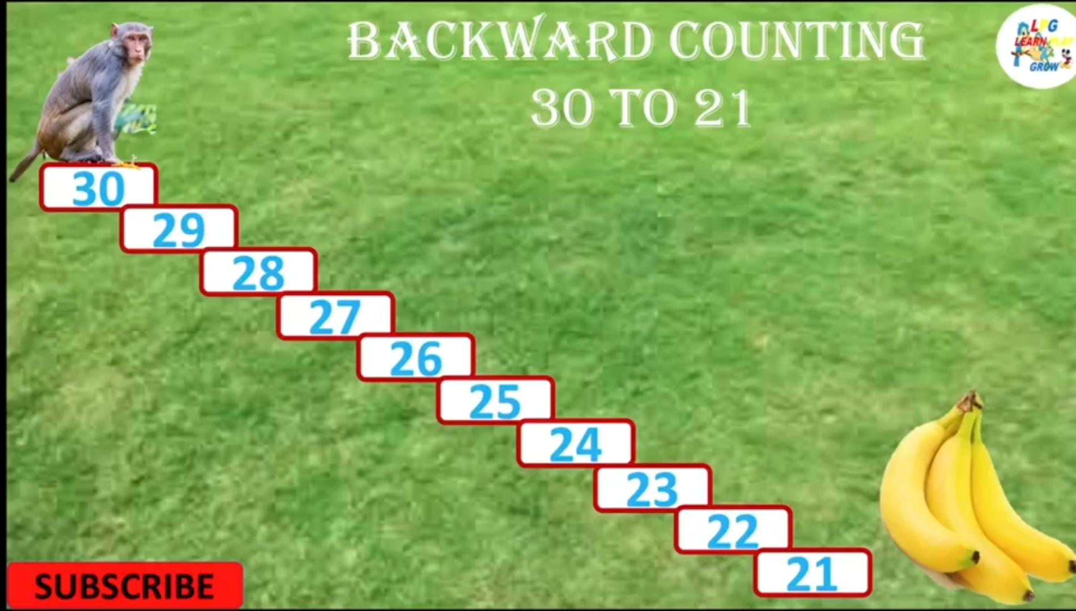
30
29
28
27
26
25
24
23
22
21

Slide 6
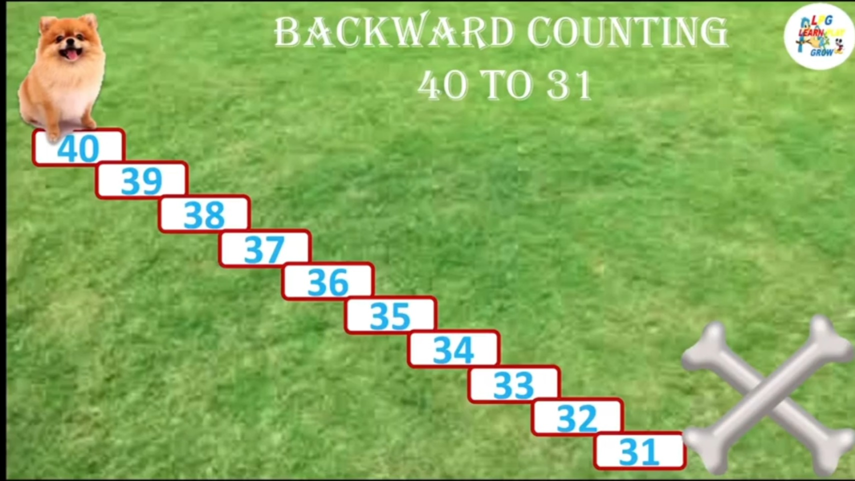
40
39
38
37
36
35
34
33
32
31

Slide 7
CW
7.9.21
WRITE BACKWARD NUMBERS FROM 40 TO 1
T | O |  | T | O |  | T | O |  | T | O |  | T | O
4 | 0 |  | 3 | 1 |  | 2 | 2 |  | 1 | 3 |  |  | 4
3 | 9 |  | 3 | 0 |  | 2 | 1 |  | 1 | 2 |  |  | 3
3 | 8 |  | 2 | 9 |  | 2 | 0 |  | 1 | 1 |  |  | 2
3 | 7 |  | 2 | 8 |  | 1 | 9 |  | 1 | 0 |  |  | 1
3 | 6 |  | 2 | 7 |  | 1 | 8 |  |  | 9
3 | 5 |  | 2 | 6 |  | 1 | 7 |  |  | 8
3 | 4 |  | 2 | 5 |  | 1 | 6 |  |  | 7
3 | 3 |  | 2 | 4 |  | 1 | 5 |  |  | 6
3 | 2 |  | 2 | 3 |  | 1 | 4 |  |  | 5

Slide 8
HW
7.9.21
COUNT BACKWARD AND FILL IN THE BLANKS.
40
39
36
35
17
16

Slide 9

THANKING YOU
ODM EDUCATIONAL GROUP

