Slide 1


Welcome to the Vertual Class
Social Science
SUBJECT : History CHAPTER NUMBER: 01
CHAPTER NAME : THE RISE OF IN
NATIONALISM IN EUROPE
PPT- 05

Slide 2


LEARNING OUTCOMES
Pupil will be able to:
Realize the sufferings of the people and empathized with the people.
Understand the reasons for those sufferings.
Develop courage to voice against injustice.

Slide 3


Slide 4
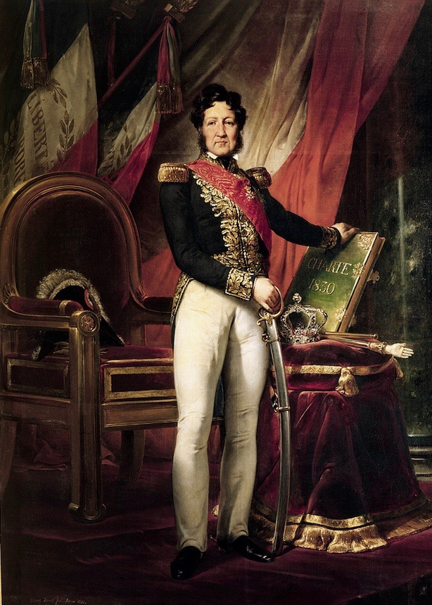

REVOLUTION IN 1830 AND 1848
REVOLUTION IN 1830:
  The first upheaval took place in France in July 1830.
  The Bourbon kings restored to power after 1815, were now overthrown by liberal revolutionaries.
  They installed a constitutional monarchy with Louis Philippe at its head.

Slide 5





Slide 6
HOME ASSIGNMENT
Worksheet Q. No: 12

Slide 7
THANKING YOU
ODM EDUCATIONAL GROUP

