Slide 1


THE ESTABLISHMENT OF COMPANY POWER
The Anglo Sikh War, Reasons for the success of British
SUBJECT : HISTORY
CHAPTER NUMBER:2
CHAPTER NAME :THE ESTABLISHMENT OF COMPANY POWER

Slide 2
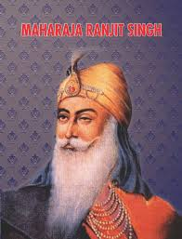
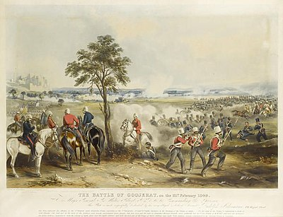
The Anglo Sikh War
British also annexed Punjab through war came to be known as Anglo Sikh War
Taking advantage of the declining power of the Mughal Empire, the Sikhs established a powerful empire in the 18th century under the leadership of Ranjit Singh.
He maintained a friendly relationship with British. After his death, there was anarchy in Punjab and Khalsa became powerful.
The Khalsa distrusted the British and at the same time the British wanted to annex Punjab. Two wars fought between Punjab and the British under the leadership of Lord Dalhousie.
During the second Anglo Sikh war the Sikhs were defeated and Punjab became a vassal state of British.
Video link:
https://www.youtube.com/watch?v=mNt0-ePzUG8&feature=youtu.be

Slide 3
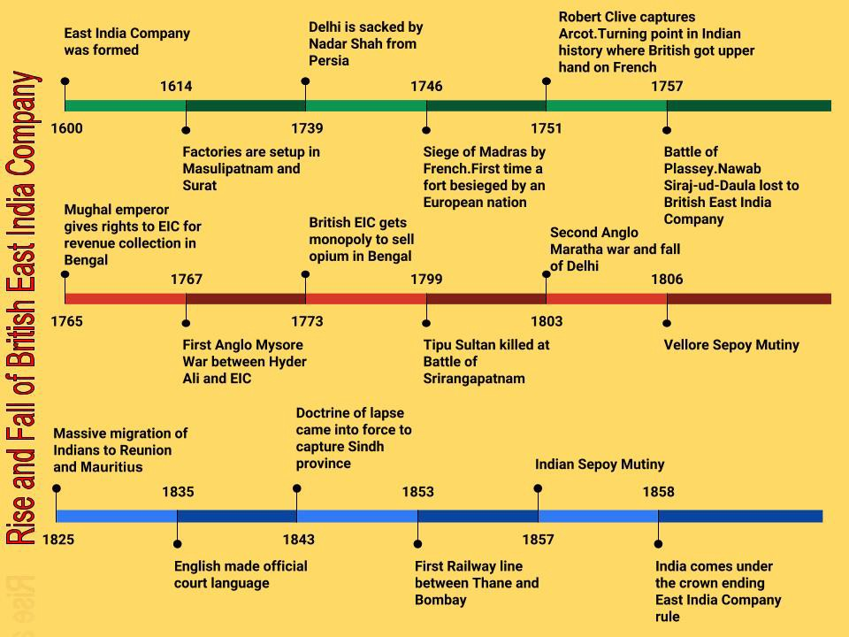
Reasons for the success of British
Absence of Strong Central Leadership- Mughal Empire Decline
Lack of Unity among the Indian States- Most of the Princely states and educated Indians Favoring British
Weakness of the Indian Rulers- Indian Rulers Comfortably lived under British.
Britain superior army and Navy-The British soldiers had better fire arms than Indians

Slide 4
Questions
Name the joint forces which defeated Tipu Sultan?
What do you mean by Doctrine of Lapse?
What do you mean by Subsidiary Alliance system?
What do you mean Annexation?
Name the king who unified Punjab?
Who annexed Awadh in 1856?
Discuss and Explain the different strategies of the British to acquire new territories in the country?
What were the different reasons for the success of British?

Slide 5
Chapter-2
The Establishment of Company Power
Portuguese
The Portuguese had trading settlements at Goa, Diu, Salsette, Bassein and Santhome
Voyages of Discovery
Vasco Da Gama, Portuguese landed at Calicut
And discovered a sea route to East
France
The French who were the last European power to enter India set up factory at Surat and acquired Mahe in Malabar on the west coast.
Dutch
The Dutch East India Company was formed in 1602 and established factories in Masulipatanam, Surat, and Cochin.
Britain
Established Supremacy In India through wars

Slide 6
The Carnatic WarThe wars which fought with French to eliminate them from India came to known as Carnatic Wars. The three states of Carnatic region—Hyderabad, Carnatic, and Mysore were in constant conflict with each other Taking advantage of this conflict both British and French fought three wars between 1746 and 1763. The British defeated French and the British became the main European power in India
The Anglo Maratha War
After the death of Shivaji the governors of different provinces called as Peshwas started to rule Maratha Kingdom. The British wanted to annex Maratha Kingdom so they fought three wars that came to be known as The Anglo Maratha wars.
The British Conquest of India
The Anglo Sikh war:British also annexed Punjab through war came to be known as Anglo Sikh War Taking advantage of the declining power of the Mughal Empire, the Sikhs established a powerful empire in the 18th century under the leadership of Ranjit Singh. He maintained a friendly relationship with British. After his death, there was anarchy in Punjab and Khalsa became powerful
The Battle of Buxar
Mir-Qasim soon grew tired of British control and set about consolidating his power and position. To improve his finances he tried to force the employees of East India Company to pay duty for their private trade. When he was unable to do so, he granted free trade to all Indians.In1763, Mir-Qasim went to Awadh and entered into an alliance with nawab Shujauddaula and the Mughal emperor Shah Alam, who was a refugee after the third battle of Panipat. In 1764, the combined forces of Mir-Qasim, Shujauddaula, and Shah Alam met the British at the Battle of Buxar
The Anglo Mysore War
In order to annex Mysore four battles were fought between the British and the kingdom of Mysore.
In the third Anglo Mysore war (1790-1792) Lord Cornwallis, the Governor General of British entered into an alliance with Marathas and the Nizam of Hyderabad. Their joint forces defeated Tipu Sultan. In 1799 the British defeated Tipu at Seringapatam in the fourth Anglo Mysore war
The Battle of Plassey
The war between British and the nawab of Bengal came to known as Plassey war. The British started fortifying their factory at Fort William in Calcutta.Sirajuddaulah, the Nawab of Bengal, asked British to demolish the fortifications.

Slide 7
Strategies used by the British to annex Indian territories
Reasons for success of British
*Absence of strong central leadership
*Lack of unity among Indian states
*Weakness of Indian Rulers
*Britain’s superior Army and Navy
Annexation means to take control of a neighbouring territory, usually with the use of force. The states annexed through this policy were kingdom of Travancore, Surat and Carnatic. Lord Wellesley introduced this policy
In the Subsidiary Alliance system, an Indian ruler had to maintain British troops in his state, either by giving some of his territory or by paying for the maintenance of the troops.
Doctrine of Lapse means when a ruler of a subsidiary state died without a natural heir, the state could not pass to the adopted child but was annexed to British Territory

Slide 8

THANKING YOU
ODM EDUCATIONAL GROUP

