Slide 1


Welcome to the Vertual Class
Social Science
SUBJECT : History CHAPTER NUMBER: 01
CHAPTER NAME : THE RISE OF IN
NATIONALISM IN EUROPE
PPT- 04

Slide 2


LEARNING OUTCOMES
Pupil will be able to:
Understand the causes of Revolution and about the people who involved in the Revolution.
Analyze the idea of Romanticism.
Identify different symbols used for National feeling.

Slide 3
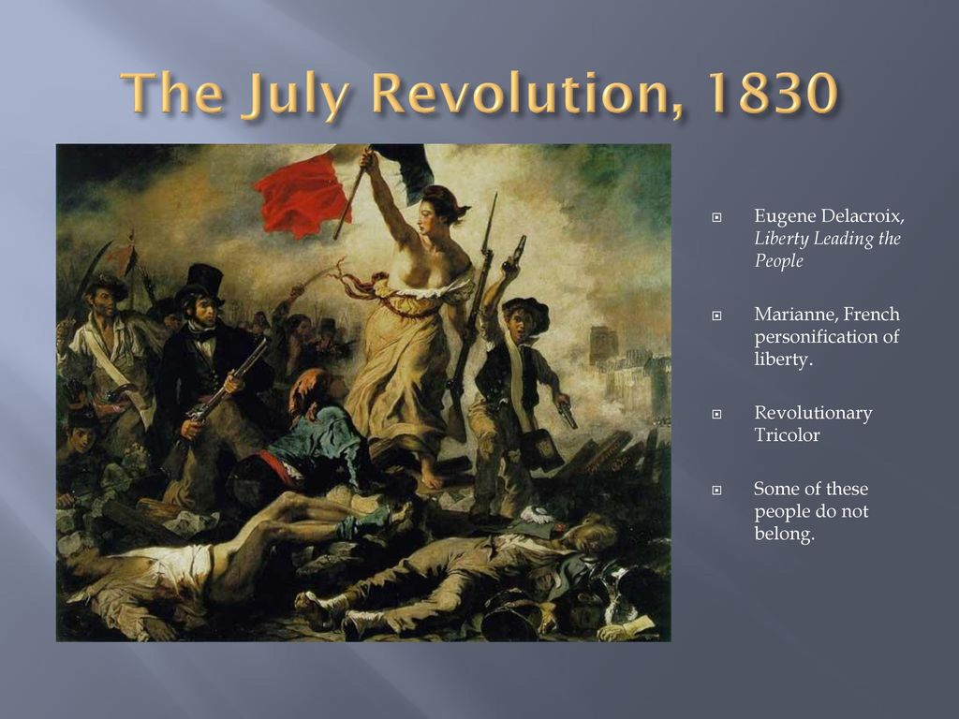
AGE OF REVOLUTIONARIES
As conservative regimes tried to consolidate their power, liberalism and nationalism came up to be increasingly associated with revolution in many regions of Europe.
These revolutions were led by the liberal- nationalists belonging to the educated middle-class elite among whom were professors,
school-teachers, clerks and members of the commercial middle classes.

Slide 4
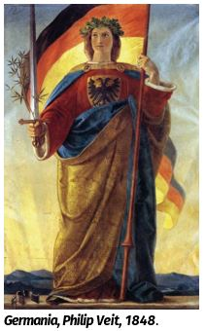
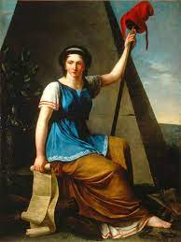
ROMANTIC IMAGINATION AND NATIONAL FEELINGS.
Art and Poetry, Stories and Music helped express and shape nationalist feelings.
Romanticism, a cultural movement
Language also played an important role in developing nationalist sentiments.
Russian language was imposed everywhere.

Slide 5
HOME ASSIGNMENT
Worksheet Q. No: 06

Slide 6

THANKING YOU
ODM EDUCATIONAL GROUP

