Slide 1


The Nationalist Movement (1885-1919)
SUBJECT : HISOTRY CHAPTER NUMBER:13
CHAPTER NAME : The Nationalist Movement (1885- 1919)

Slide 2
RECAPITULATION
1 What was the reason for the split in the Congress in 1907 ?
2. What was meant by Revolutionaries and name any three Revolutionaries?
3 What was Morley – Minto Reforms or India Council Act of 1909 and what was its provisions?
What was the reason for the formation of Muslim League ?
What was the two declarations of the Coronation Durbar of 1911 ?. 6 . Name two Home Rule Leagues?
7 . What was meant by Lucknow Pact of 1916?

Slide 3

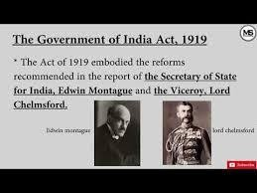
The Government of India Act (1919) session --4
In July 1918 the Montagu-Chelmsford Reforms were announced .It was named after the secretary of state for India, Edwin Montagu and the viceroy, Lord Chelmsford. Its aim was to gradually develop responsible government in India, as a part of the British India. These reforms led to the enactment of the Government of India Act in 1919.

Slide 4
The Nationalist Movement
Home Assignment
What was the aim of Montagu- Chelmsford Reforms?
Name the Reforms which led to the Enactment of the
Government of India ACT of 1919?
When was the First World War ?

Slide 5
THANKING YOU
ODM EDUCATIONAL GROUP

