Slide 1


Period 4
Subtopic: Photosynthesis, Transpiration and their significance
SUBJECT : (Science )
CHAPTER NUMBER: 1
CHAPTER NAME : Getting to know plants

Slide 2
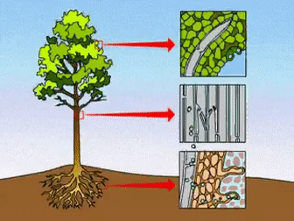
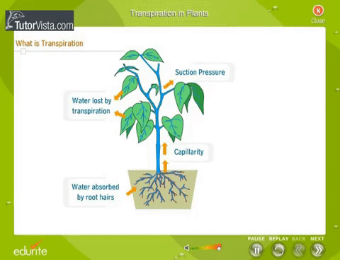
Transpiration is an essential process of eliminating the excess amount of water from the plant's aerial parts

Slide 3
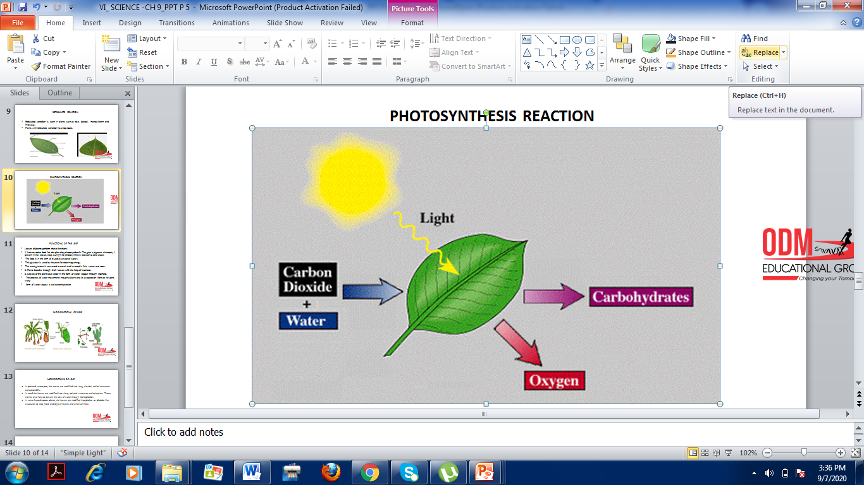
PHOTOSYNTHESIS REACTION

Slide 4
FUNCTIONS OF THE LEAF
Leaves of plants perform these functions.
1. Leaves make food for the plant by photosynthesis. The green pigment chlorophyll present in the leaves traps sunlight for photosynthesis reaction to take place.
The food is in the form of glucose( a type of sugar ).
This glucose is used by the plant for obtaining energy.
The extra glucose is converted to starch and it stored in fruit, stems and roots.
2. Plants breathe through their leaves with the help of stomata.
3. Leaves of the plant lose water in the form of water vapour through stomata.
The process of water movement through a plant and its evaporation from aerial parts in the
form of water vapour is called transpiration.

Slide 5
THANKING YOU
ODM EDUCATIONAL GROUP

