Slide 1


MUGHAL EMPIRE
SHAH JAHAN(1628-1658)
SUBJECT : (HISTORY)
CHAPTER NUMBER:4
CHAPTER NAME :THE MUGHAL EMPIRE

Slide 2
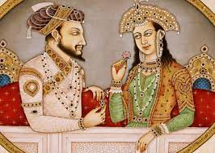
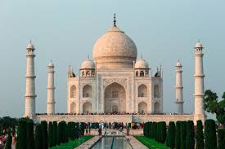
THE MUGHAL EMPIRE
(SHAH JAHAN(1628-1658)
eert

Slide 3
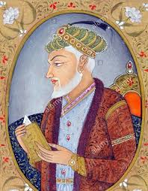
MUGHAL EMPIRE
AURANGZEB(1658-1707)
Aurangazeb was one of the ablest kings of the Mughal.
He assumed the title Alamgir, World Conqueror.
In his first ten years of reign, his military campaigns were a great success.
But in the latter part of his reign, he faced serious difficulties.
The Jats and Satnamis and also the Sikhs revolted against him due to his harsh religious policy.

Slide 4
THANKING YOU
ODM EDUCATIONAL GROUP

