Slide 1


THE ESTABLISHMENT OF COMPANY POWER
The conquest of Mysore, The Anglo –Mysore War, Strategies used by the British
SUBJECT : HISTORY
CHAPTER NUMBER:2
CHAPTER NAME :THE ESTABLISHMENT OF COMPANY POWER

Slide 2
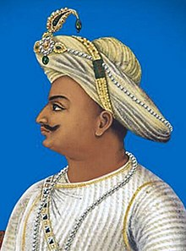
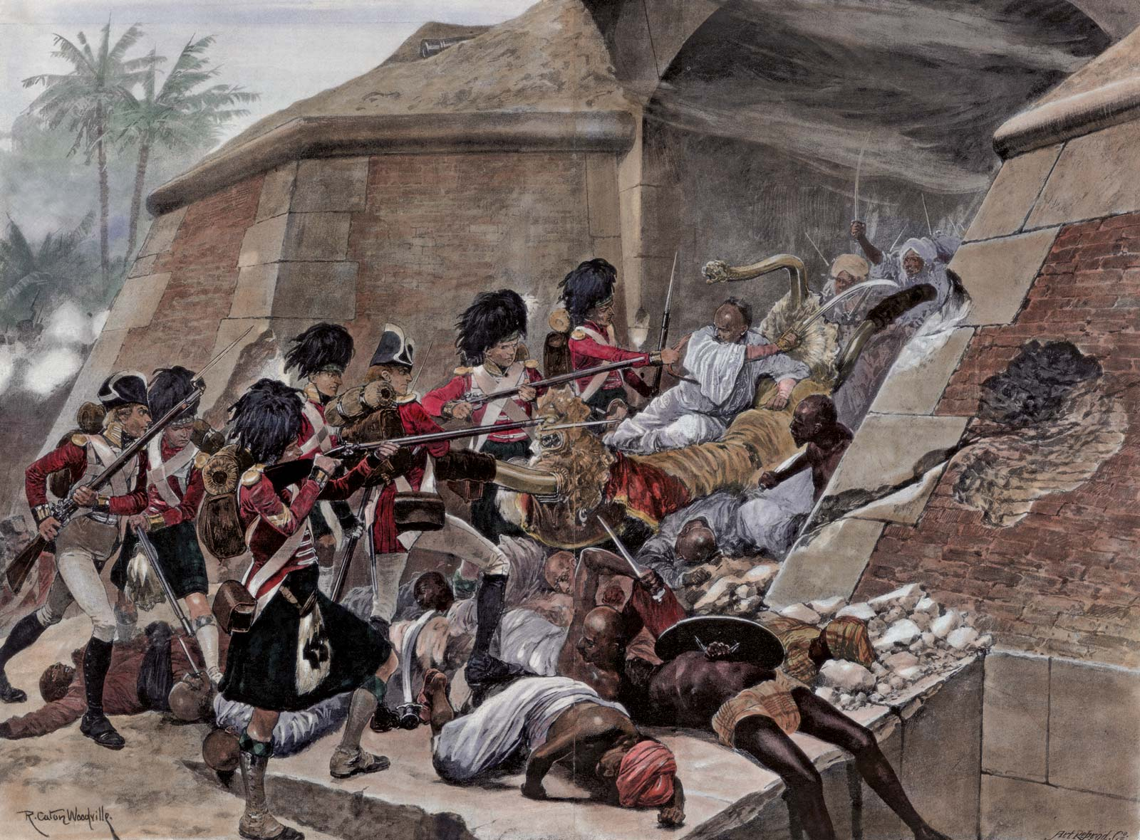
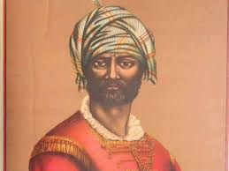
https://youtu.be/_oXAxX9QEpkThe conquest of Mysore
The stiffest opposition to British power in South India came from the state of Mysore. In 1761 Hyder Ali became the ruler of Mysore. After his death his son Tipu Sultan became the ruler. Both of them transformed Mysore in to a powerful kingdom
In order to annex Mysore four battles were fought between the British and the kingdom of Mysore.
The Anglo –Mysore War
In the third Anglo Mysore war (1790-1792) Lord Cornwallis, the Governor General of British entered into an alliance with Marathas and the Nizam of Hyderabad. Their joint forces defeated Tipu Sultan. In 1799 the British defeated Tipu at Seringapatam in the fourth Anglo Mysore war.
Result of the war
The victory over Mysore paved the way for the total control of India by the British.
Videolink:
https://www.youtube.com/watch?v=vT4Vd8jh2NU&feature=youtu.be

Slide 3
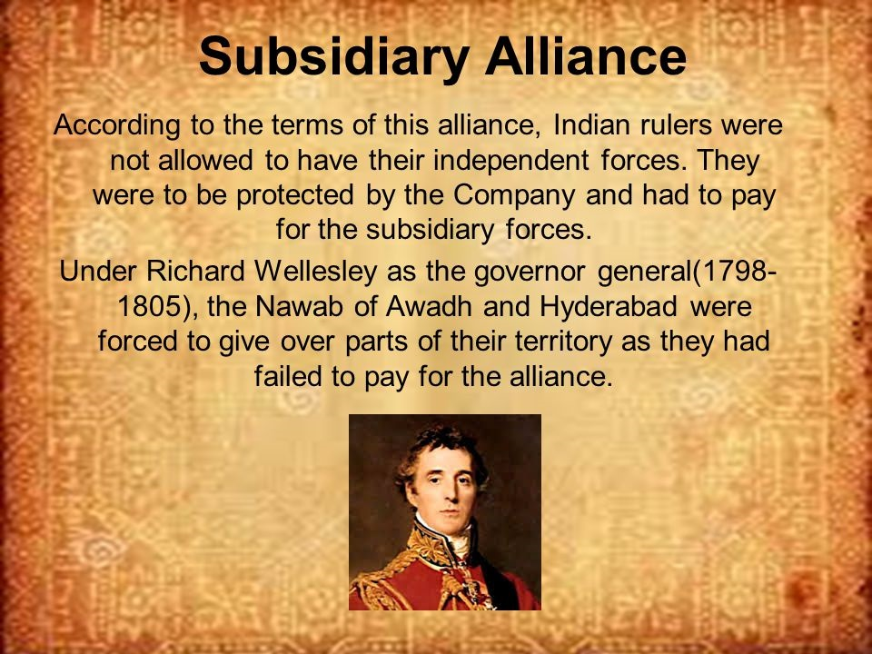
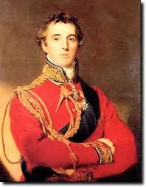
Strategies used by the British
The British used three strategies other than war to annex Indian territories. They are
Subsidiary alliance
Doctrine of Laps
Annexations
Subsidiary alliance
In the Subsidiary Alliance system, an Indian ruler had to maintain British troops in his state, either by giving some of his territory or by paying for the maintenance of the troops.

Slide 4
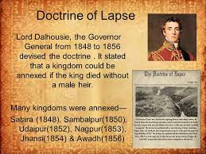
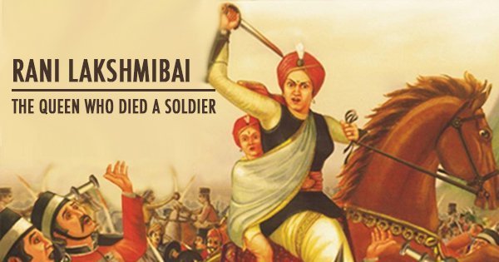
Doctrine of Lapse
Doctrine of Lapse means when a ruler of a subsidiary state died without a natural heir, the state could not pass to the adopted child but was annexed to British Territory.
Video link: https://youtu.be/acb6yl0rUec
https://youtu.be/-5RmM4htZYI
Annexation
Annexation means to take control of a neighbouring territory, usually with the use of force. The states annexed through this policy were kingdom of Travancore, Surat and Carnatic. Lord Wellesley introduced this policy

Slide 5

THANKING YOU
ODM EDUCATIONAL GROUP

