Slide 1


Welcome to the Vertual Class
Social Science
SUBJECT : History CHAPTER NUMBER: 01
CHAPTER NAME : THE RISE OF IN
NATIONALISM IN EUROPE
PPT- 03

Slide 2


LEARNING OUTCOMES
Pupil will be able to:
Understand the idea of Conservatives, Liberals and Radicals.
Identify the principles of Conservatives, Liberals and Radicals.
Differentiate between Conservatives, Liberals and Radicals.

Slide 3
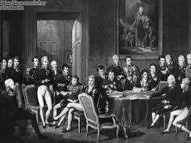
Congress of Vienna in 1815
In 1815,representatives of the European powers – Britain, Russia, Prussia and Austria – who had collectively defeated Napoleon, met at Vienna to draw up a settlement for Europe.
The Congress was hosted by the Austrian Chancellor Duke Metternich.
The delegates drew up the Treaty of Vienna of 1815.

Slide 4
OBJECTIVE
Their objective was to undo most of the changes that had come about in Europe during the Napoleonic Code. The main intention was to restore the monarchies that had been overthrown by Napoleon, and create a new conservative order in Europe.

Slide 5
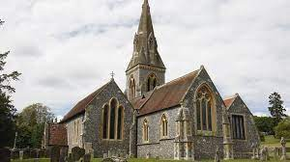
Conservatism Vs Nationalism
Conservatism:
Conservative regimes set up in 1815 were autocratic.
They did not tolerate criticism and dissent, and sought to curb activities that questioned the legitimacy of autocratic governments.
They imposed censorship laws to control what was said in newspapers, books, plays and songs and reflected the ideas of
iii.

Slide 6

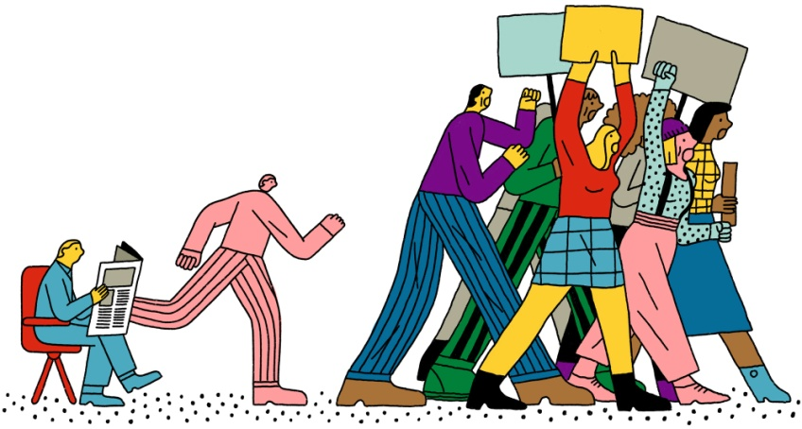
Liberalism:
The memory of the French Revolution nonetheless continued to inspire liberals.
One of the major issues taken up by the liberal-nationalists was freedom of the press.
They criticised the new conservative orders.
.

Slide 7
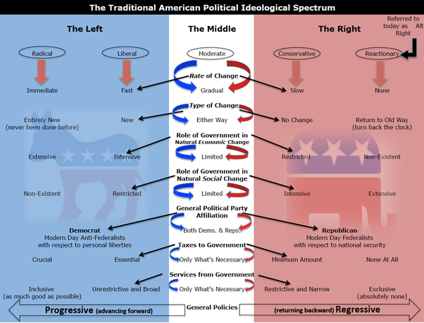
COMPARING THE CONSERVATIVES, LIBERALS, RADICALS

Slide 8
HOME ASSIGNMENT
Worksheet Q. No: 10, 11, 15

Slide 9

THANKING YOU
ODM EDUCATIONAL GROUP

