Slide 1


RURAL LIFE AND SOCIETY
SUBJECT : HISTORY CHAPTER NUMBER:4
CHAPTER NAME :RURAL LIFE AND SOCIETY

Slide 2

1.What was Ryotwari System?
2 . Who introduced Ryotwari System? Where was it introduced?
3. What was Mahalwari System?
4 Who introduced Mahalwari System? Where was it introduced?
5 How was Ryotwari system differ from Permanent settlement System?
RECPITULATION

Slide 3
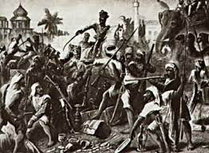
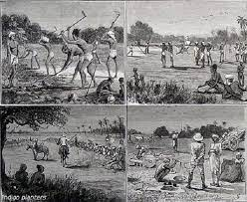
RURAL LIFE AND SOCIETY
IMPOVERISHMENT OF CULTIVATORS
The revenue charged was so high, it led to the impoverishment of the cultivators.
They were driven into debt at the hands of the money lenders or became landless labourers.

Slide 4
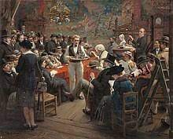
RURAL LIFE AND SOCIETY
FRAGMENTATION OF LAND HOLDINGS
As an increasing number of farmers found themselves unable to pay the revenue, they auctioned or sold off their land part by part. This led to the fragmentation and subdivision of land. Small land holdings are not economical to cultivate.
AUCTION OF LAND HOLDINGS – DRAMATISATION- BY CHILDREN
AUCTION OF LAND HOLDINGS

Slide 5
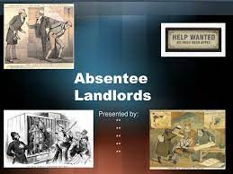
RURAL LIFE AND SOCIETY
RISE OF ABSENTEE LANDLORDS
The landowners who were unable to pay the high tax was auctioned off to the highest bidder. The people who bought these lands were often rich traders from cities and towns. They rarely visited their farm land and had no interest in it. These absentee landlords were much harsher on the local farmers than the traditional zamindars.

Slide 6
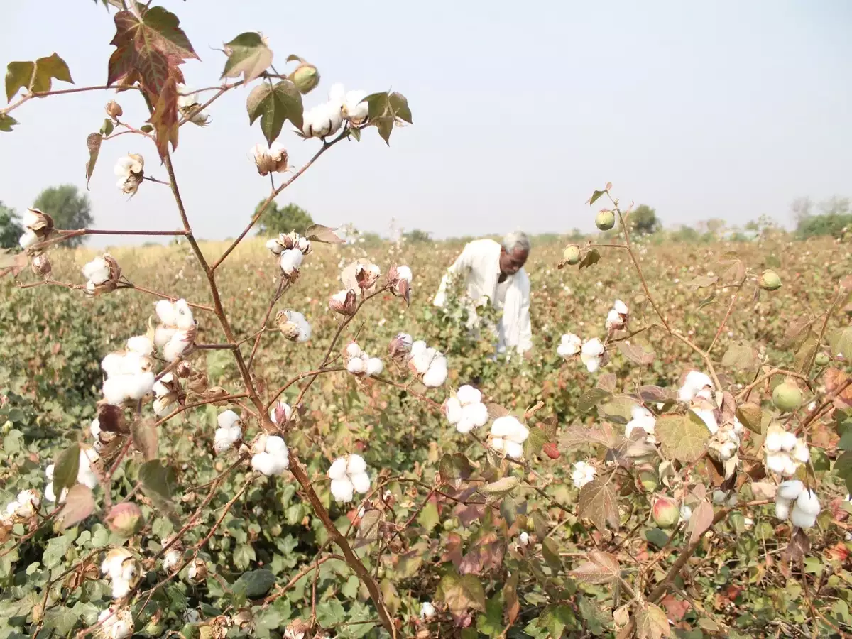
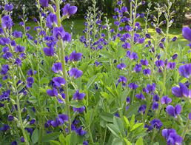

RURAL LIFE AND SOCIETY
COMMERCIALISATION OF AGRICULTURE
Since the cash crops provided raw materials for the Industry the Britishers encouraged the farmers to cultivate cash crops such as cotton, jute, indigo , poppy at the cost of food grains, It resulted in food shortage.

Slide 7
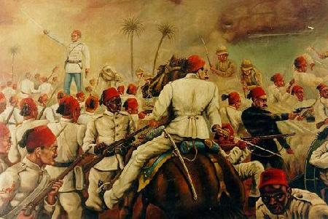
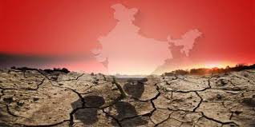
RURAL LIFE AND SOCIETY
NEGLECT OF LAND REFORMS
The British introduced private ownership of land to ensure steady revenue and to motivate the farmers to increase the output. However the landlords were either absentee landlord with no interest to improve the land or were too poor to carry out reforms. This resulted in steady erosion in the quality of land and the life of the farmers.

Slide 8
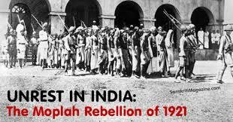
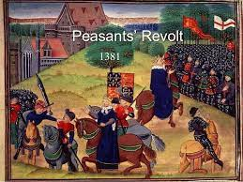
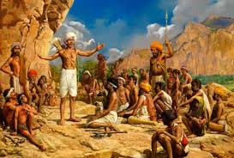
RURAL LIFE AND SOCIETY
PEASANT REVOLTS
The extreme poverty of the peasants drove them to revolt. The famous two revolts were
The Churs revolt of Bihar and Bengal
The Moplah Revolt of Kerala

Slide 9
RURAL LIFE AND SOCIETY
PEASANT REVOLTS
The extreme poverty of the peasants drove them to revolt. The famous two revolts were
The Churs revolt of Bihar and Bengal
The Moplah Revolt of Kerala

Slide 10
RURAL LIFE AND SOCIETY
HOME ASSIGNMENT
1.What do you mean by Commercialization of Agriculture?
2.Name two peasant Revolts?
3.Name the plant used for making a blue dye during British rule?
4.What do you mean by absentee Landlord?
5.Name two places where massive uprising happened against British Indigo Planters?
6.Briefly explain the impact of the revenue systems on the cultivator?

Slide 11
THANKING YOU
ODM EDUCATIONAL GROUP

