Slide 1


THE MUGHAL EMPIRE
RAJPUT POLICY OF AKBAR
SUBJECT : HISTORY
CHAPTER NUMBER:4
CHAPTER NAME :THE MUGHAL EMPIRE

Slide 2
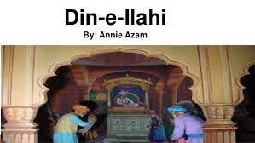
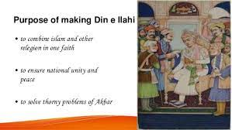
THE MUGHAL EMPIRE
RAJPUT AND RELIGIOUS POLICY OF AKBAR
Akbar realised that administration could not possible without the support of the Rajputs. So he gave important posts to Rajputs and other Hindus in his administration.Akbar gave complete freedom to Rajputs to follow their religion, build temples, celebrate festivals and wear their caste mark on their forehead.
RELIGIOUS POLICY
Akbar was liberal ruler who believed in the equality and unity of all religion. He founded his own religion called Din-i- Iiahi or Divine faith. It was based on the teachings and beliefs of all the major religions. It stressed belief in one God.

Slide 3
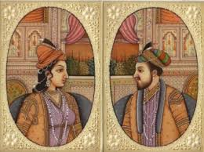
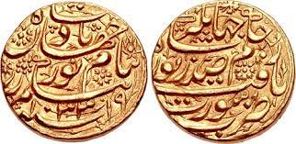
THE MUGHAL EMPIRE
Jahangir(1605-1627)
In 1605, Prince Salim succeeded with the title Jahangir (Conqueror of World) after the death of Akbar.
He also beheaded Guru Arjun, the 5th Sikh Guru and one of the supporters of Khusrau.
One of his supporters, Guru Arjun, the fifth Sikh Guru, was beheaded.
Nur Jahan
In 1611, Jahangir married Mehrunnisa who was known as Nur Jahan (Light of World).
COINS WITH THE IMAGE OF NUR JAHAN

Slide 4
THANKING YOU
ODM EDUCATIONAL GROUP

