Slide 1


Period 3
Subtopic: Venation and Functions of Leaf
SUBJECT : (Science )
CHAPTER NUMBER: 1
CHAPTER NAME : Getting to know plants

Slide 2
VENATION
The arrangement of veins in a leaf is called venation.
There are two types of venation- parallel venation and reticulate
venation.
In parallel venation, all the veins run parallel to each other from the
base to the apex of the leaf.
In reticulate venation, veins are arranged in the form of a net- like
pattern on the leaf .

Slide 3
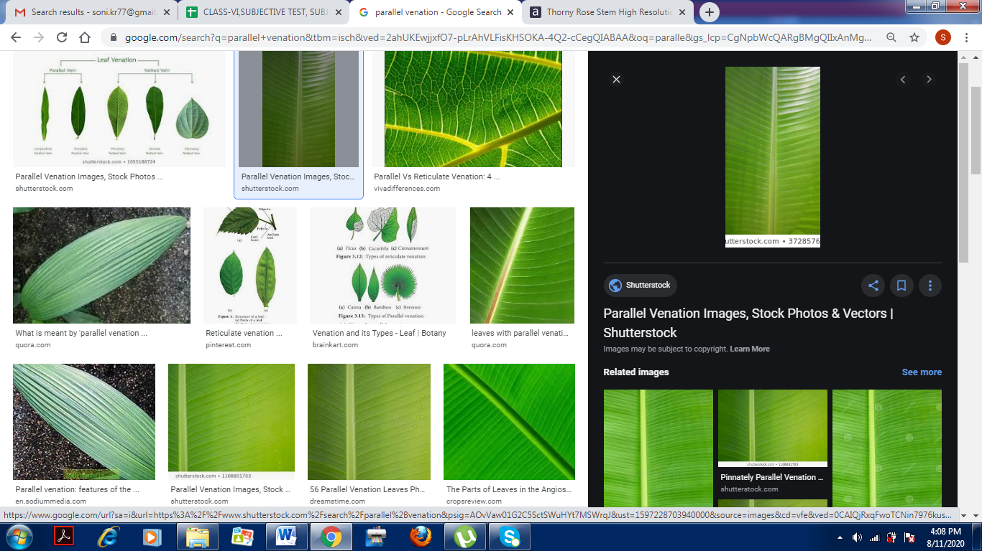
PARALLEL VENATION
Parallel venation is seen in plants such as rice, wheat, bamboo, sugarcane and onion.
In general, plants with parallel venation have fibrous roots.

Slide 4
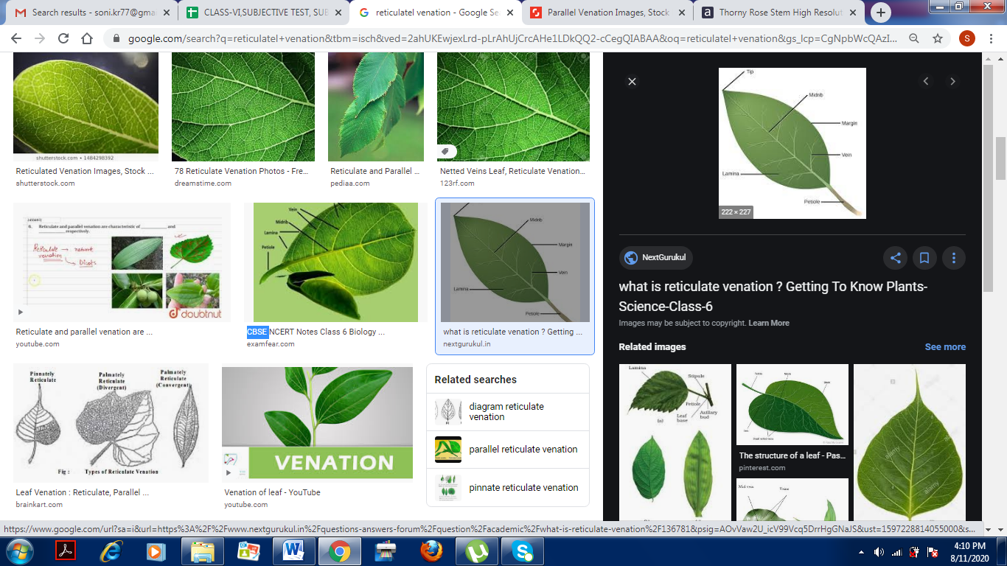
RETICULATE VENATION
Reticulate venation is seen in plants such as rose, peepal, mango neem and Hibiscus.
Plants with reticulate venation have tap roots.

Slide 5
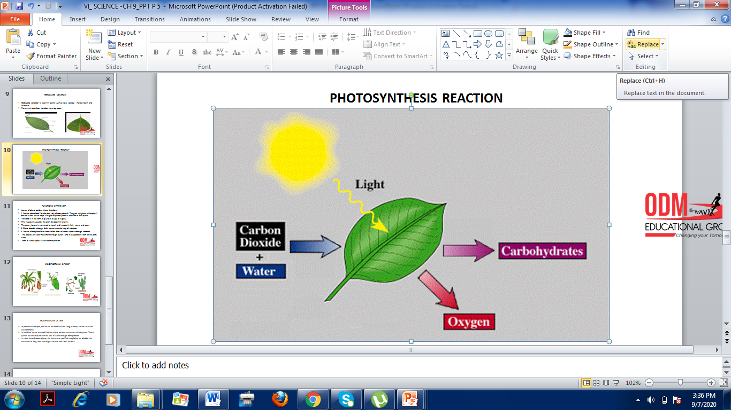
PHOTOSYNTHESIS REACTION

Slide 6
FUNCTIONS OF THE LEAF
Leaves of plants perform these functions.
1. Leaves make food for the plant by photosynthesis. The green pigment chlorophyll present in the leaves traps sunlight for photosynthesis reaction to take place.
The food is in the form of glucose( a type of sugar ).
This glucose is used by the plant for obtaining energy.
The extra glucose is converted to starch and it stored in fruit, stems and roots.
2. Plants breathe through their leaves with the help of stomata.
3. Leaves of the plant lose water in the form of water vapour through stomata.
The process of water movement through a plant and its evaporation from aerial parts in the
form of water vapour is called transpiration.

Slide 7
THANKING YOU
ODM EDUCATIONAL GROUP

