Slide 1


HUMAN EYE AND THE COLOURFUL WORLD
CHAPTER NO.11
SUB: PHYSICS
HUMAN EYE AND THE COLOURFUL WORLD

Slide 2

Refraction through glass prism , dispersion.
Prism is a transparent refracting medium bounded by at least two lateral surfaces , inclined to each other at a certain angle.
It has two triangular bases and three rectangular lateral surfaces.
The angle between two lateral surfaces is called angle of prism.

Slide 3
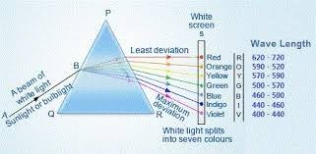
Refraction through a glass prism

Slide 4
Dispersion
The phenomenon of splitting of white light into its constituent colors when passes through a prism is called dispersion
The band of seven colors obtained are
Violet
Indigo
Blue
Green
Yellow
Orange
Red.
This band of seven colors obtained by dispersion of light is called spectrum

Slide 5
Causes of dispersion
Explain the causes of dispersion:
Light rays of different colours , travel with the same speed in vacuum and air but in any other medium they travel with different speeds and bend through different angles which leads to dispersion of light.

Slide 6
Red light has maximum wave length. so, it travels faster and deviates the least.
Wave length α velocity α 1/deviation.
Explain what will happen if two prisms identical in shape are kept close to each other:
Activity:
Keep one prism and near to it keep another prism in inverted position.
The light is dispersed when passes through the first prism.
The second prism receives all seven colours and recombines them into original white light.

Slide 7
Dispersion and rainbow formation The phenomenon of splitting of white light into its constituent seven colours is called as dispersion.

Slide 8
Formation of rainbow
A rainbow is a natural spectrum appearing in the sky after a rain shower.
It is caused by dispersion of sunlight by tiny water droplets present in the atmosphere.
A rainbow is always formed in opposite direction to that of the sun.
The water droplets act like small prisms. They refract, disperse the incident sunlight then reflect it internally and finally refract it again when it comes out of rain drop.
At last different colours reach the human eye and we can see the rainbow

Slide 9
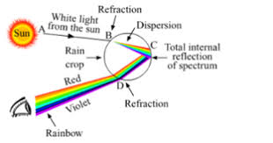
Rainbow formation

Slide 10
Atmospheric refraction
The earth’s atmosphere is not uniform throughout. Its density goes on changing if we go from up to down. So, when the light rays pass through earth’s atmosphere, they undergo refraction

Slide 11
Twinkling of stars:
The stars are very far away from us.
So, they are considered as point sources.
As the light from stars enter earths atmosphere, it undergoes refraction due to varying optical densities.
The continuously changing atmosphere refracts the light by different amounts.
The star light reaching our eye increases or decreases continuously and the star appears to be twinkling at night.

Slide 12
The stars seem higher than they actually are:
As the light from a star enters the earths atmosphere, it undergoes refraction and bends towards the normal each time due to refraction.
Therefore the apparent position of the star is slightly different from its actual position.

Slide 13
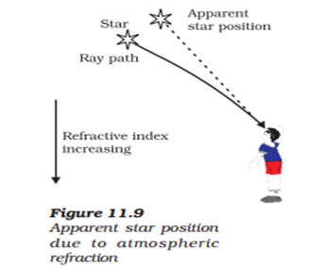
Apparent star position due to atmospheric refraction

Slide 14
Planets do not twinkle:
Planets are larger in size as they are much closer to us , so, they are considered as extended sources.
The total variation in the amount of light entering our eye from all these individual points will average out to zero which nullify the twinkling effect of each other.
Therefore planets do not twinkle.

Slide 15
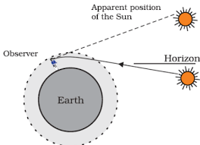
Advance sunrise and delayed sunset:

Slide 16
Advance sunrise and delayed sunset:
The sun is visible to us about two minutes before the actual sun rise and about two minutes after the actual sun set because of atmospheric refraction.
When the sun is slightly below the horizon, the sun light come from less dense to denser air. So it is refracted downwards, due to this sun appears to be raised above the horizon and we can see it before the sun rise.

Slide 17
THANKING YOU
ODM EDUCATIONAL GROUP

