Slide 1

THE JUDICIARY
THE SUPREME COURT
SUBJECT : CIVICS CHAPTER NUMBER: 5
CHAPTER NAME :THE JUDICIARY

Slide 2

RECAPITULATION
1.Name the apex court in the state?
2. Who appointed the chief justice of High Court?
3.Who is the present chief justice of Odisha High Court?
4.Who is Petitioner and who is a respondent?
5.What do you mean by Public Interest Litigation?
6. What do you Subordinate Courts?
7.The highest court for civil justice?
8.The highest court for criminal justice?
9. Differentiate between criminal and civil cases?

Slide 3
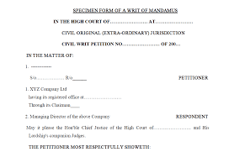
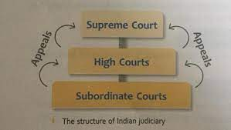
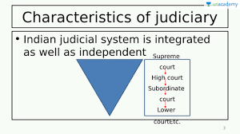
THE JUDICIARY
THE UNIFIED INDIAN JUDICIARY session-3
The Indian Judiciary is a single unified judiciary. In India all courts function under the aegis of the Supreme Court. So if a citizen is dissatisfied with the judgment given in any lower court, he or she can appeal to a higher court. People should not take law into their own hands, and any matter of dispute should be taken to the court for a decision. If a fundamental right is violated, the citizen can either appeal to the High Court or Supreme Court
A Writ is a court order preventing someone from doing or permitting some one to do, something. It could also be a summons issued to some one by the court.

Slide 4
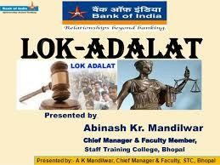
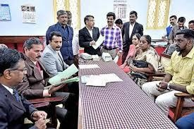
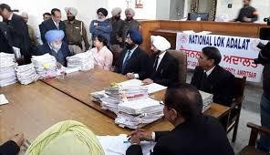
THE JUDICIARY
LOK ADALATS
The word Adalat means court. Lok Adalat means People’s court. The first Lok Adalat was held in
Delhi in 1885.Lok Adalats were established by an Act of Parliament.
The number of courts and judges are highly inadequate to deal with the large number of cases that are being registered each day. As a result there was a heavy backlog of cases in all the courts . In an effort to speed up the process of settling cases Lok Adalat was established.

Slide 5
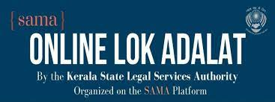
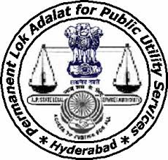
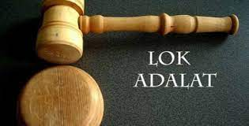
THE JUDICIARY
LOK ADALATS
ADVANTAGES OF LOK ADALAT
Lok Adalats, which offered free legal aid, ensured that justice was not denied to the poor for economic reasons.
Lok Adalats settle disputes through conciliation and compromise.
In Lok Adalat both the parties in dispute should agree for a settlement.
In Lok Adalat both the parties in the dispute can interact with the Lok Adalat judge directly, and explain their stand in the dispute. This is not possible in the regular court.
Disputes can be brought before the Lok Adalat directly instead of having to go to the regular court first.
6. In Lok Adalat is fast and free of cost.

Slide 6
Home Assignments
Which is the highest court in India?
Who appoints the Chief Justice of India?
What are the qualifications needed to become the chief justice of India? 4.What is the retirement age of the judges of the supreme Court?
5. What are the three types of jurisdiction that the supreme court has? 6 .Briefly mention what is meant by Original jurisdiction?
Briefly mention what is meant by Appellate jurisdiction?
Briefly mention what is meant by Advisory jurisdiction? 9 Define the term Judicial Review?
What is meant by Contempt of Court?
What is meant by Public Interest Litigation?
What is meant by Court of Records?

Slide 7
THANKING YOU
ODM EDUCATIONAL GROUP

