Slide 1


The Nationalist Movement (1885-1919)
SUBJECT : HISOTRY CHAPTER NUMBER:13
CHAPTER NAME : The Nationalist Movement (1885- 1919)

Slide 2

RECAPITULATION
1.Who was responsible for the Partition of Bengal?
2.What was the reason for the partition of Bengal?
3.Name two anti-partition movement ?
4.What do you mean by Boycott movement?
5. What do you mean by Swadeshi movement?
6.At which congress session the congress declared attainment of Swaraj was its main objective?
?

Slide 3
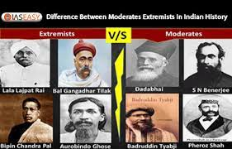
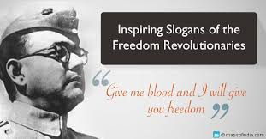
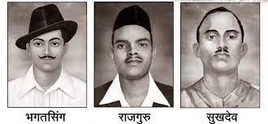
The Nationalist Movement
Reasons for the growth of Nationalism
session --3
The Split in the Congress
The Radicals took Swaraj to mean total freedom from the British domination, while the moderates meant an increased role for Indians in British administration. The Moderates accepted the Swadeshi Movement but refused to accept the Boycott Movement. Radicals wanted to stop in the Congress in 1907.
The Rise of Revolutionaries
In response to the anti- partition movement in Bengal, Lord Curzon’s administration unleashed a policy of repression. Thousands of swadeshi workers, students and ordinary people were prosecuted and imprisoned. The freedom of press was curbed. In 1908 nine prominent nationalist leaders of Bengal were deported. The people of Bengal were angered and frustrated.
Some of them were soon drawn to more violent means of protest. They came to be called the Revolutionaries.

Slide 4
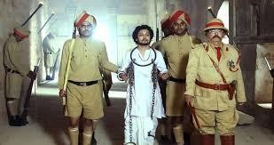
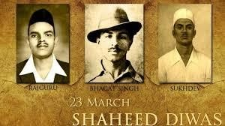
The Nationalist Movement
The Revolutionaries believed in using force to achieve their objective of independence from foreign rule. In the process they killed many British people. Prominent revolutionary leaders were Khudiram Bose, Praffulla Chaki in Bengal, VO Chidambarum Pillai and Vanchi Aiyar in Madras, VD Sarvarkar and Bhikaji Cama in Maharashtra.

Slide 5
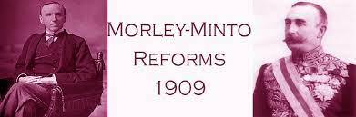
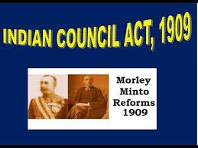
The Nationalist Movement (1885-1919)
The Morley- Minto Reforms
The British responded by recalling Lord Curzon to England. Minto succeeded him as Viceroy of India, Along with John Morely, the secretary of State in England. Minto drew up a plan to win back the goodwill of the Indians. This plan came to known as India Council Act of 1909 or the Morley- Minto Reforms. According to this Act,
The number of elected members in the Imperial Legislative Council was increased.
Indians could now become members of the Provincial Legislative Council.
Separate electorates were introduced for the Muslims.
The Morley- Minto Reforms thus sowed the seeds of division between Hindus and Muslims. As a result of the separate electorates, the Muslims were further isolated from the growing freedom movement.

Slide 6
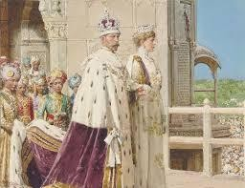
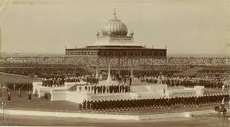
The formation of the Muslim League (1906)
The formation of the Muslim League was instigated by the British as part of their policy of divide and rule. The Muslim leaders feared that if the British did leave India, Muslims would have no share in the Indian government. As a result of this feeling, some Muslim leaders set up a separate political organization in the form of the Muslim League .
The Coronation Durbar (1911)
In 1911, a durbar was held in Delhi to commemorate the accession of King George V to the British throne. This occasion was chosen to make two major announcements. One was to reunite Bengal and the other was to shift the capital from Calcutta to Delhi

Slide 7
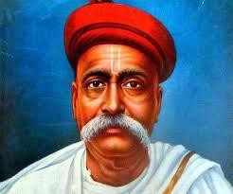
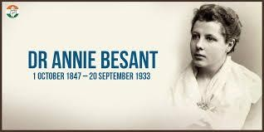
The Home Rule League
Some of the Indian leaders realized that unless popular pressure was brought to bear upon the government, they would never have self rule or home rule. So between 1915 and 1916 two home rule leagues were started- one under the leadership of Lokmanya Tilak in Poona and the other under Annie Besant in Madras. Home Rule Leagues carried out intense propaganda all over the country in favor of the demand for self-rule, or home rule.
The unity between the congress and the league was brought about by the signing of the Congress- League Act popularly called the Luck now Pact in December 1916.

Slide 8
The Nationalist Movement
Home Assignment
1 What was the reason for the split in the Congress in 1907 ?
2. What was meant by Revolutionaries and name any three Revolutionaries?
3 What was Morely – Minto Reforms or India Council Act of 1909 and what was its provisions?
What was the reason for the formation of Muslim League ?
What was the two declarations of the Coronation Durbar of 1911 ?. 6 . Name two Home Rule Leagues?
7 . What was meant by Lucknow Pact of 1916?

Slide 9
THANKING YOU
ODM EDUCATIONAL GROUP

