Slide 1


Welcome to the Vertual Class
Social Science
SUBJECT : History CHAPTER NUMBER: 01
CHAPTER NAME : THE RISE OF IN
NATIONALISM IN EUROPE
PPT- 02

Slide 2


LEARNING OUTCOMES
Pupil will be able to:
Analyze the painting presented by Frederic Sorrieu.
Identify the message behind the painting.
Establish connection between Nationalism and the idea of Frederic Sorrieu.

Slide 3

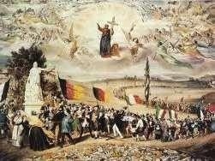
THE DREAM OF WORLDWIDE DEMOCRATICAND SOCIALREPUBLICS

Slide 4
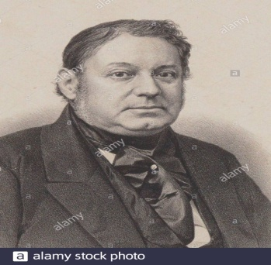
EMERGENCE OF NATIONALISM IN EUROPE
During the nineteenth century, nationalism brought about sweeping changes in the political and mental world of Europe.
Nation statesemerged in place of the multi-national dynastic empires of Europe.
The concept of a modern state had been developing over a long period.

Slide 5
EMERGENCE OF NATIONALISM IN EUROPE
Nation state is one in which the majority of its citizens, and not only its rulers come to develop a sense of common identity and shared history or descent which were forged through struggles, actions of leaders and the common people.

Slide 6
Home Assignment
Worksheet Q. No: 5, 8, 9, 16

Slide 7

THANKING YOU
ODM EDUCATIONAL GROUP

