Slide 1


THE JUDICIARY
THE SUPREME COURT
SUBJECT : CIVICS CHAPTER NUMBER: 5
CHAPTER NAME :THE JUDICIARY

Slide 2
RECAPITULATION
1.The Indian Judiciary is single , integrated and unified! What does it mean?
Name the states which has a common High Court?
3. Name the highest court in India?
4. Who appointed the chief justice of India?
5.What is required qualification to become the chief justice of India?
6.What is the term of office of the chief justice of India?
7.Name the three types of Jurisdictions that the supreme court has?
8.What is meant by Original Jurisdiction ?
9. What is meant by Appellate Jurisdiction?
10. What is meant by Judicial Review?

Slide 3
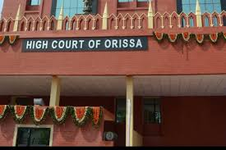
THE JUDICIARY
HIGH COURT
session-2
The High Court is the apex court in the state. The chief justice of the high court is appointed by the president on the recommendation of and in consultation with the chief justice of India and the Governor of the state concerned.
QUALIFICATION
Must be a citizen of India.
A high court advocate with at least ten year’s experience or a judicial officer with at least ten year’s experience.
RETIREMENT.
A high court judge retires at the age of 62. He or she can also face impeachment on charges of misconduct.

Slide 4
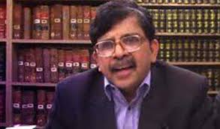
THE JUDICIARY
HIGH COURT
POWERS AND FUNCTIONS OF THE HIGH COURT
Original Jurisdiction of High Court
Case involving the enforcement of fundamental rights,
High Court can issue writ.
Appellate Jurisdiction of High Court
High Court hears appeals of both civil and criminal cases
against the decision taken by the lower courts.
Supervisory Jurisdiction of High Court
Supervisory Jurisdiction involves supervising the activities
of the lower court
JUSTICE S. MURALIDHAR
CHIEF JUSTICE OF ODISHA HIGH COURT SINCE 4TH JANUARY 2021.

Slide 5
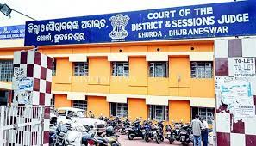
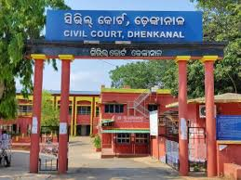
THE JUDICIARY
SUBORDINATE COURTS
Each of the district has a district court. The District court and the courts below it are called Subordinate Courts.
There are separate courts for civil and criminal cases.
The Court of the district judge is the highest court for Civil Justice in the district level
Court of the civil judge and the court of the Munsif are the Subordinate Courts under it
The court of sessions judge is the highest court in the district dealing with criminal cases.
The courts of the chief judicial magistrate, the first class judicial magistrate and second class judicial magistrate are the Subordinate Courts under it .

Slide 6
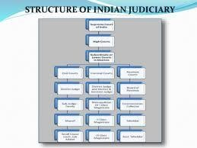
THE JUDICIARY
SUBORDINATE COURTS
The Structure of Judiciary

Slide 7
The Judiciary
High Court ( Home Assignments )
Which is the apex court in the state?
Who appoints the chief justice of high court?
What are the qualifications needed to become the chief justice of high court?
What is the age at which the high court judge retires? 5.Briefly mention the powers and functions of the High Court? 6.What do you mean by the term a petitioner or the appellate?
Who is a respondent?
What do you mean by Subordinate Courts?
9 .Which is the highest court in the district dealing with civil cases? 10.Which is the highest court in the district dealing with criminal cases?
Draw and explain the hierarchical structure of the various courts of the Indian Judiciary?
Differentiate between civil and criminal cases?

Slide 8
THANKING YOU
ODM EDUCATIONAL GROUP

