Slide 1


The Nationalist Movement (1885-1919)
SUBJECT : HISOTRY CHAPTER NUMBER:13
CHAPTER NAME : The Nationalist Movement (1885- 1919)

Slide 2

RECAPITULATION
Who translated Vedas and Upanishads of Indian Literature in to English?
Define the term Nationalism?
3 . Briefly explain any five reasons for the growth of Nationalism in India during the period 1885 to1919?
How did the growth of regional press and regional literature help the growth of Nationalism in India?
How did better means of transport and communication help the growth of Nationalism in India?

Slide 3


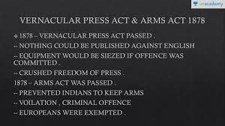
The Nationalist Movement (1885-1919)
Reasons for the growth of Nationalism
session –2
Discrimination against Indians
In 1878 British Government had reduced the age limit from 21 to 19 for the civil service examinations.
In the same year The Indian Arms Act was passed, which forbade Indians from possessing weapons.
The Vernacular press Act of 1878 forbade any provocative writings in regional languages against the government
The bill called Ilbert Bill passed in 1883 which aimed at establishing equality between Indian and English judges in Indian courts. The English
Community and other Europeans in India reacted harshly, declaring that even the most the most highly educated Indians were unfit to try Europeans. So the British Government amended the Bill. The Indians were shocked and also realized that they too needed to organize themselves at a national level to get equal rights and to have their demands met by the government.
●

Slide 4
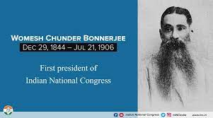
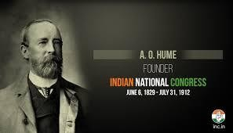
The Nationalist Movement (1885-1919)
The founding of the Indian National Congress.
In 1885, Allen Octavian Hume, a retired British Civil Servant, founded the Indian National Congress (INC).
Some of the prominent leaders of the congress were Dadabhai Naoroji, Pherozeshsh Mehta, S.Subramania Iyer, Rahimatullah, W.C. Bannerjee and Dinshaw Wadia. The main aim of Congress was
To seek the cooperation of all Indians.
To eradicate prejudices of race, religion, caste etc.
To discuss the major problems of India and come out with suggestions to solve them.

Slide 5
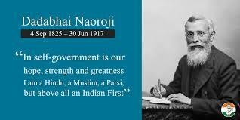
The second session of congress was presided
over by Dadabhai Naoroji, met at Calcutta. Dadabhai Naoroji was thrice elected president of the Congress- in 1886, 1893, and 1906.Because of his long association with
India’s freedom struggle he is called the Grand Old Man of India.

Slide 6
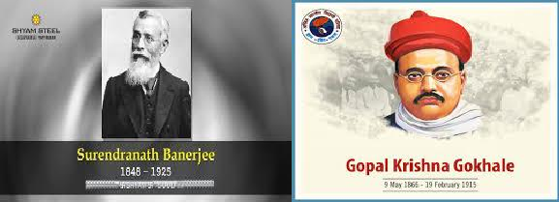
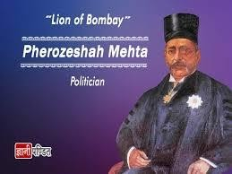
The Demand for Swaraj
The Nationalist Movement(1885-1919)
Most of the Congress members were Indians and had faith in British. They only wanted gradual reforms. They aimed at better and friendly association with the British. They came to be called the Moderates.
The Moderates wanted the British to train Indians in the art of self government. The Moderates included leaders like Surendranath Banerjee, Pherozeshsh Mehta, and Gopal Krishna Gokhale.

Slide 7
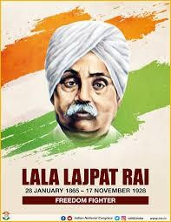
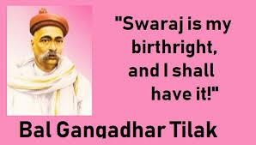
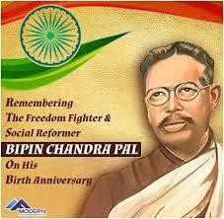
However, some Indian leaders like Bal Gangadhar Tilak in Maharashtra and Lala
Lajpat Rai in Punjab demanded Swaraj or self rule. Tilak made a forceful
claim,’’Swaraj is my birth right and I shall have it ‘.’These leaders came to be called the extremists or the radicals, because they believed in adopting stronger measures to achieve freedom.Bipin Chandra Pal and Aurobindo Ghosh were the other prominent radical leaders.

Slide 8
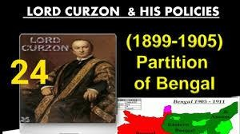
The Partition of Bengal ( 1905)
The Nationalist Movement ( 1885-1919)
Lord Curzon became the governor general of India in 1898. He did his best to suppress the movement of extremist nationalism. In 1905 he partitioned Bengal. Bengal was the stronghold of the Congress. Curzon’s real reason was to separate East Bengal with its majority Muslim population, from the rest of Bengal and to weaken the Congress. It also served to divide the Hindus and the Muslims. This created a fur ore among the Indians. The leaders of Congress and the Nationalists leaders of Bengal firmly opposed the partition.
●

Slide 9
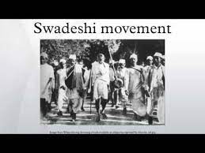
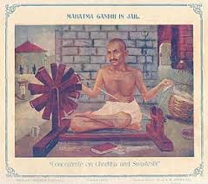
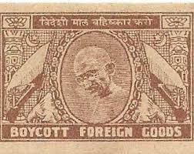
The Boycott Movement and the Swadeshi Movement
The Congress leaders decided to introduce two anti- partition movement, The Boycott movement and The Swadeshi Movement. People decided to use only Indian goods and to boycott British goods. People gathered at crosswords, and burnt the imported clothes that they had. This movement was called Boycott Movement.
People resolved to use only things made in India. This was called Swadeshi
Swadeshi means ‘of one’s own country ‘. People began wearing cotton clothes made in India. The Boycott Movement affected British trade and industry. While the Swadeshi Movement helped local Indian Industries to prosper

Slide 10
The Nationalist Movement
Home Assignment
1.What do you meant by Vernacular Press Act? 2.What do you meant by Arms Act?
3.Who founded Indian National Congress? and when?
4 What was the aim of the Indian National Congress at the beginning?
Who was known as the Grant Old Man of India and why?
Who were Moderates and name three Moderates?
Who were Radicals? And name three Radicals?
8 Who said ‘’Swaraj is my birth right and I shall have it ‘’? 9 . Who partitioned Bengal and what was its reason?
10 . Name two Anti- Partition Movement and explain it ?

Slide 11
THANKING YOU
ODM EDUCATIONAL GROUP

