Slide 1


Period 2
Subtopic: The leaf - Structure of a leaf , Types of leaves- simple and compound , Arrangement of leaves
SUBJECT : (Science )
CHAPTER NUMBER: 1
CHAPTER NAME : Getting to know plants

Slide 2
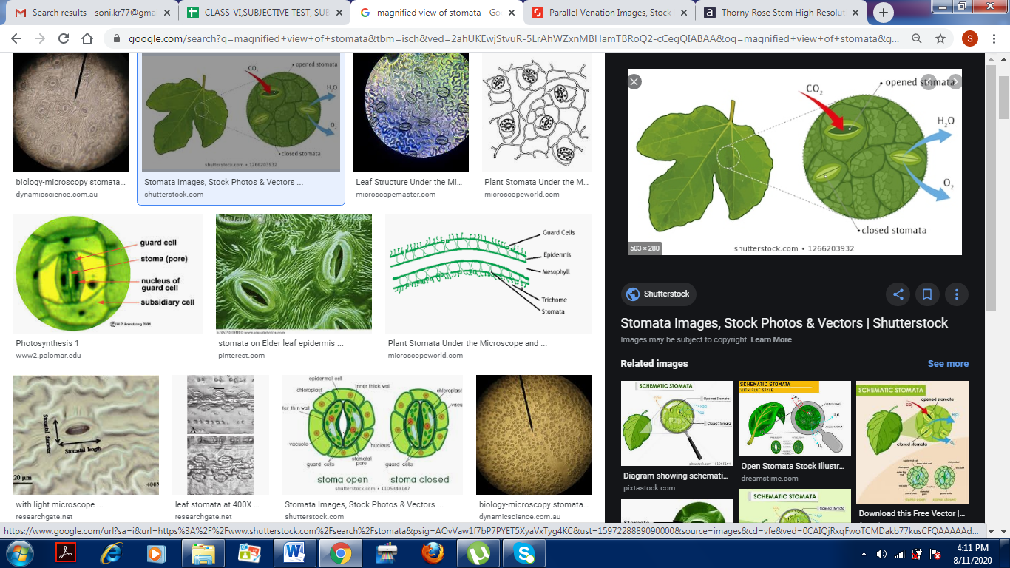
THE LEAF
The leaf is a thin, flattened, green part of a plant that is a attached to the stem or branch at a node.
Leaves contain tiny openings called stomata, through which exchange of gases, such as carbon dioxide, oxygen and water vapour takes place.

Slide 3
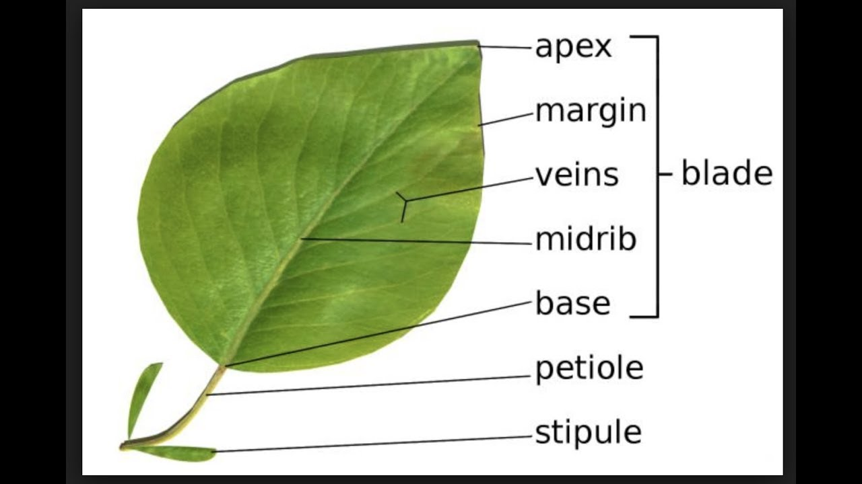
PARTS OF A LEAF

Slide 4
PARTS OF A LEAF
The leaf has different parts - lamina, petiole, apex, margin, midrib and veins.
The flat, broad and green portion of the leaf is called leaf blade or lamina.
The tip of the leaf is called apex.
The edge or boundary of the leaf is called leaf margin.
The fine lines which spread across the lamina are the veins.
The midrib is the main vein which continues from the petiole and runs from the base of the leaf to the apex.
Stipule is the leafy outgrowth at the base of some leaves or its stalk , usually occurring in pairs and soon shed.

Slide 5
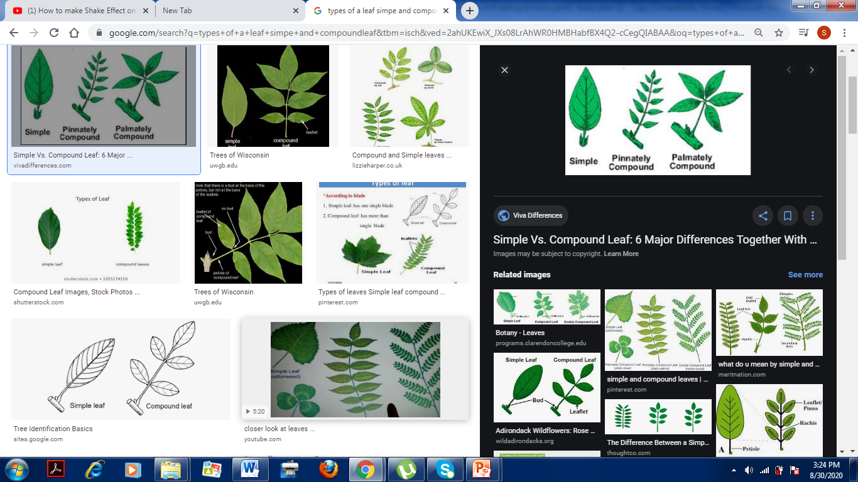
Types of leaf
A simple leaf consists of a single lamina, which is not divided into segments . E.g mango, guava etc.
A compound leaf is one in which lamina is divided into several small leaflets , each attached to the same petiole.
A

Slide 6
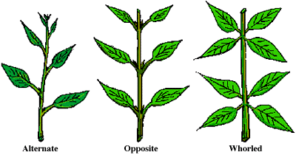
Arrangement of leaves

Slide 7
VENATION
The arrangement of veins in a leaf is called venation.
There are two types of venation- parallel venation and reticulate
venation.
In parallel venation, all the veins run parallel to each other from the
base to the apex of the leaf.
In reticulate venation, veins are arranged in the form of a net- like
pattern on the leaf .

Slide 8
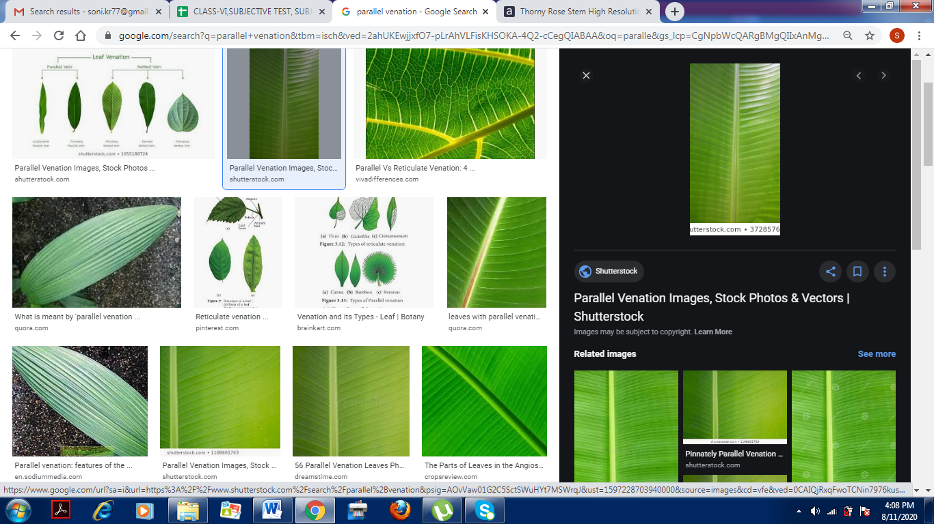
PARALLEL VENATION
Parallel venation is seen in plants such as rice, wheat, bamboo, sugarcane and onion.
In general, plants with parallel venation have fibrous roots.

Slide 9
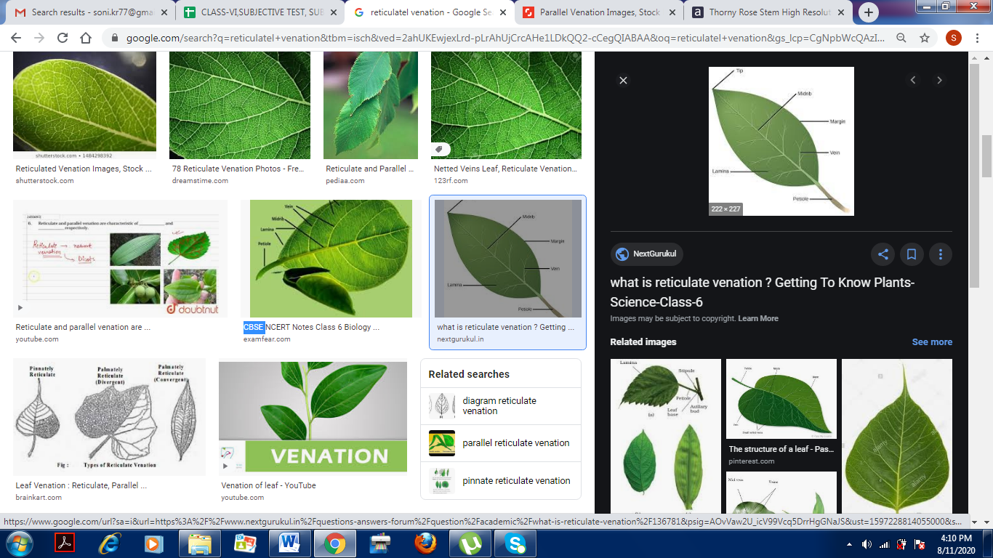
RETICULATE VENATION
Reticulate venation is seen in plants such as rose, peepal, mango neem and Hibiscus.
Plants with reticulate venation have tap roots.

Slide 10
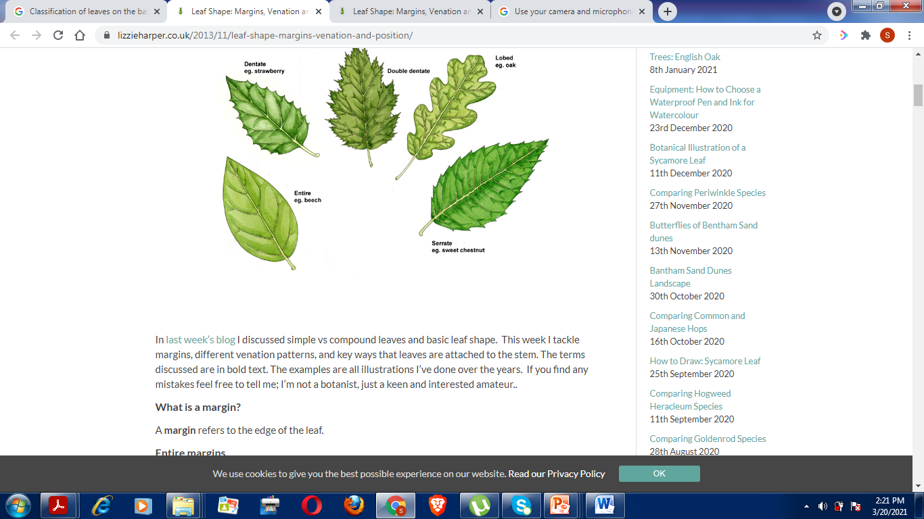
Classification of leaves on the basis of margin

Slide 11
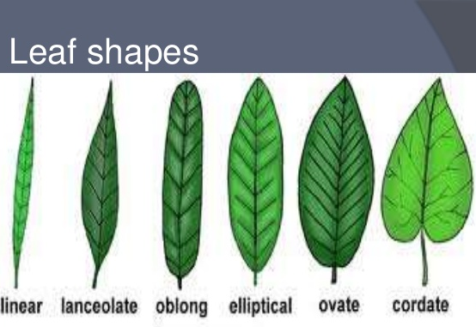
Classification of leaves on the basis of shapes

Slide 12
THANKING YOU
ODM EDUCATIONAL GROUP

