Slide 1


HUMAN EYE AND THE COLOURFUL WORLD
CHAPTER NO.11
SUB: PHYSICS
HUMAN EYE AND THE COLOURFUL WORLD

Slide 2

Accommodation:
It is the ability of the eye lens to focus both near and distant objects by adjusting its focal length
Near point: The minimum distance at which an object can be seen most distinctly without any strain is called the least distance of distinct vision.
It is 25 cm for normal eye of an adult.
It is also called near point of the eye.

Slide 3
Far point:
it is the farthest point up to which the eye can see clearly. It is infinity for normal eye
Persistence of vision: The time for which sensation of an object continues in the eye is called persistence of vision.
It is about 1/16th of a second.
Range of vision: The distance between the near point and far point of of the eye is called range of vision.
It is 25cm to infinity.
Q. When we try to read a printed page by holding it very close to our eyes , we may see blurred image and feel strain in our eyes. Why?
Because our eye can focus object till a particular distance that is 25 cm .

Slide 4
Define power of accommodation:
It is the maximum variation in power of eye lens for focusing nearby or far objects.
For young adults, with normal vision, the power of accommodation is about 4D.
d = 25 cm
P= 100/f = 100/d = 100/25 =4 D(dioptre)
Q.2. When we enter from bright light to a room with dim light, we cannot see objects clearly. For some times . Why?
Because the iris takes some time to allow more light to enter the eye.

Slide 5
Defects of vision
The defects due to which a person cannot see the objects distinctly and comfortably are called defects of vision.
The three main defects are:
1) Myopia or short sightedness 2)Hypermetropia or long sightedness 3)Presbyopia

Slide 6
Myopia:
1. The defect in which a person can see nearby objects distinctly but cannot see distant objects clearly is called myopia.
2.In this case, the image is formed before retina.
3. causes: i. Excessive curvature of eye lens.
ii. Elongation of eye ball
correction: This defect can be corrected by using concave lens of appropriate power.

Slide 7
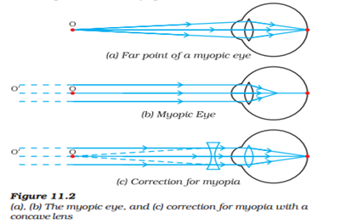
Myopic Eye and its correction

Slide 8
Hypermetropia: :
1. The defect in which a person can see distant objects distinctly but cannot see nearby objects clearly is called hypermetropia.
2.In this case, the image is formed after retina.
3. causes: i. Focal length of eye lens become large.
ii. Eye ball becomes too short.
Remedy: This defect can be corrected by using convex lens of appropriate power.

Slide 9
Presbyopia:
It is found in old people.
For most people the near point recedes away with age.
Sometimes people may suffer from both myopia and hypermetropia.
Causes: Weakness of ciliary muscles.
Hardening or loss of elasticity of eye lens.
Remedy: The defect can be corrected by using bifocal lenses which contains both concave lens and convex lens.

Slide 10
THANKING YOU
ODM EDUCATIONAL GROUP

