Slide 1


MUGHAL EMPIRE
SHER SHAH SURI( 1540 – 1545 CE)
SUBJECT : HISTORY
CHAPTER NUMBER : 4
CHAPTER NAME :MUGHAL EMPIRE

Slide 2
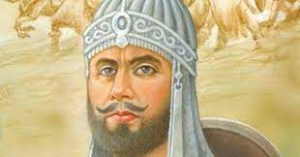
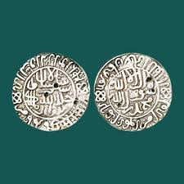
MUGHAL EMPIRE
SHER SHAH SURI( 1540 – 1545 CE)
Sher Khan, whose real name was Farid Khan, assumed the title of Sher Shaha Suri. He established his capital at Delhi.
Sher Shaha Suri was an excellent administrator.He introduced the silver rupee, called rupiya, as a standarad mode of exchange. Gold coins called mohur and copper coins called dam were also minted by his govt.With the death of Sher Shah ended one of the best rulers on the throne of Delhi.
.c

Slide 3
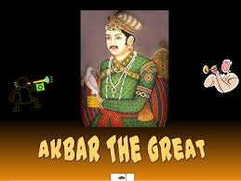
MUGHAL EMPIRE
Akbar the Great – (1556-1605 CE)
Akbar’s position was in dangerous when he succeeded his father Humayun as Delhi was seized by the Afghans.
In 1556, in the second battle of Panipat, Akabar defeated Hemu and the army of Hemu fled which made the victory of Mughal decisive.
During the first 5 years of Akbar’s reign, Bairam Khan acted as his regent.
Later, Akbar removed Bairam Khan and sent him to Mecca but Bairam Khan was killed by an Afghan on his way.

Slide 4
THANKING YOU
ODM EDUCATIONAL GROUP

