Slide 1

WELCOME TO ONLINE CLASS
CLASS- UKG
SUBJECT- ENGLISH
CHAPTER- 4
TOPIC - MY SCHOOL( INTRODUCTION)

Slide 2
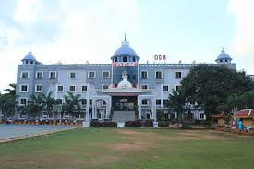

This is my school.

Slide 3
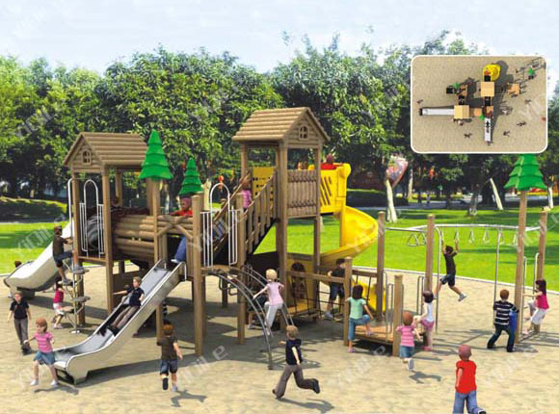
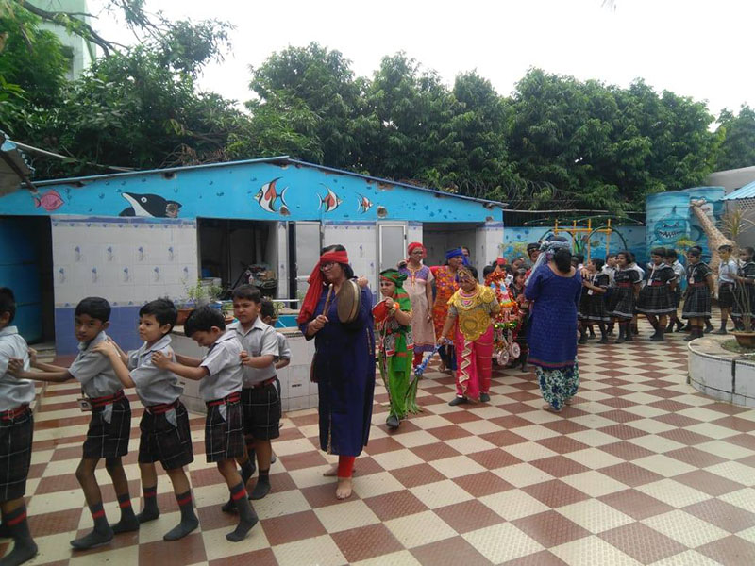
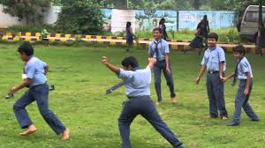
Play ground.

Slide 4
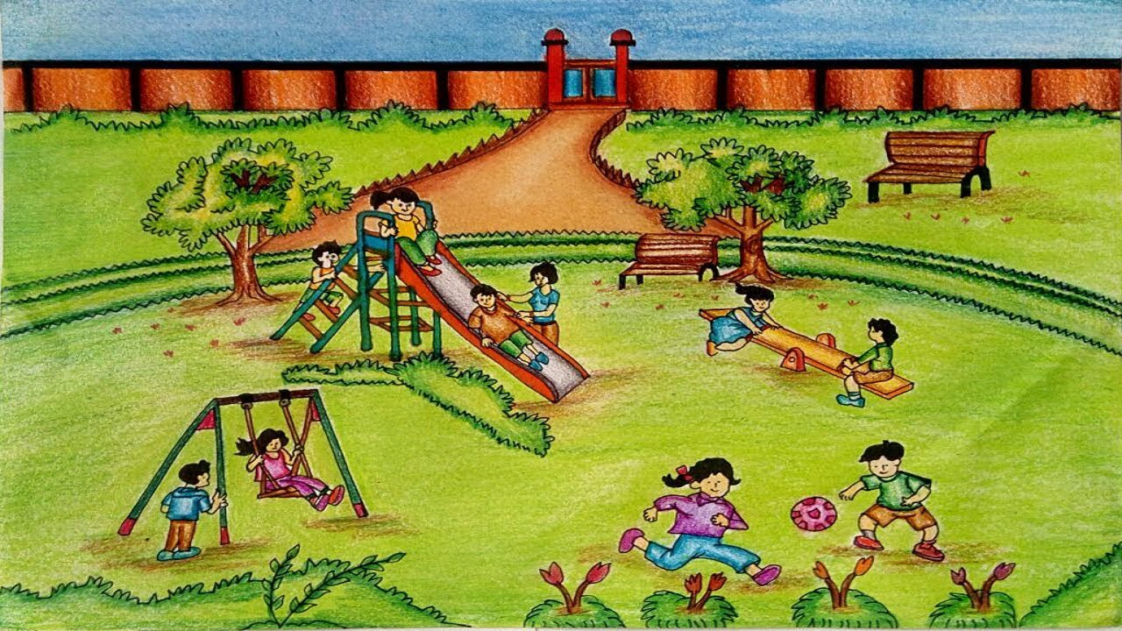
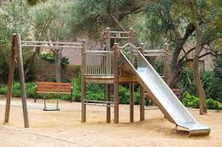
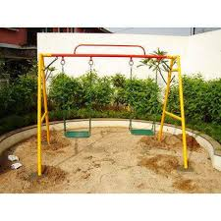
Children’s
park

Slide 5
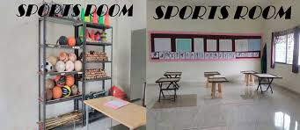
Sports room.

Slide 6

School library.

Slide 7

Principal’s office

Slide 8
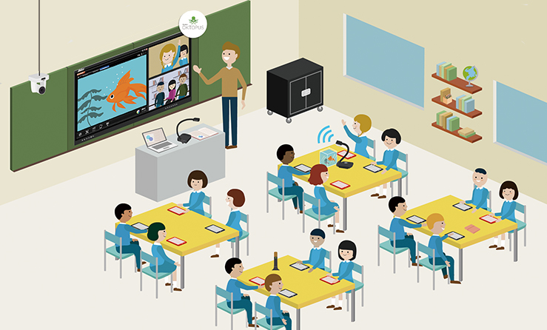
Class room.

Slide 9
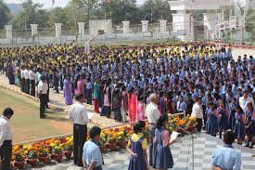
School assembly

Slide 10
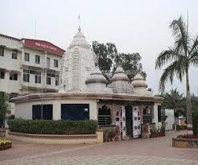
School temple

Slide 11
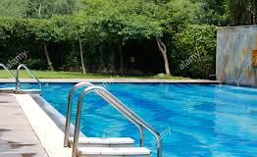
Swimming pool

Slide 12

THANKING YOU
ODM EDUCATIONAL GROUP

