Slide 1


THE ESTABLISHMENT OF COMPANY POWER
The Conquest of Bengal, The Battle of Buxar, The Anglo Maratha war
SUBJECT : HISTORY
CHAPTER NUMBER:2
CHAPTER NAME :THE ESTABLISHMENT OF COMPANY POWER

Slide 2
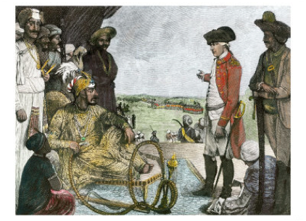
The Conquest of Bengal
The province of Bengal included present day Bihar, Jharkhand and Odisha. It was one of the richest provinces of the Sub- Continent known for its textiles and silk.
The Battle of Plassey
The reason for the Plassey war
The British started fortifying their factory at Fort William in Calcutta.
Sirajuddaulah, the Nawab of Bengal, asked British to demolish the fortifications.
The British refused. So Sirajuddaulah, marched to Calcutta and occupied Fort William.
So Robert Clive, the commander of the British troops declared war on Sirajuddaulah.
Process of the War
Finding that Mir –Jafar had turned traitor, Sirajuddaulah fled the battlefield. The British won the war.
According to the promise Mir-Jafar was made Nawab of Bengal by the British.
However , when Mir –Jafar tried to control the corrupt trading practices of the British he was replaced by his son – in law Mir- Qasim by British in 1760 now the British were not just traders but became the rulers.
Result of the War
The battle of Plassey paved the way for British rule in India.
Video Link
https://www.youtube.com/watch?v=8HEl9E70SxU&feature=youtu.be

Slide 3
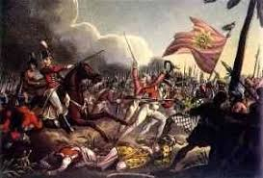
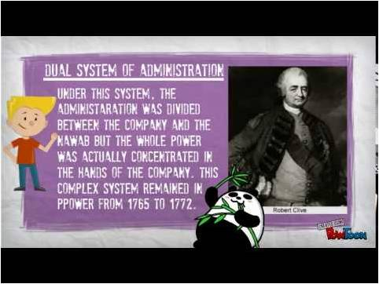
The Battle of Buxar
Reasons of the War
In1763, Mir-Qasim went to Awadh and entered into an alliance with nawab Shujauddaula and the Mughal emperor Shah Alam, who was a refugee after the third battle of Panipat. In 1764, the combined forces of Mir-Qasim, Shujauddaula, and Shah Alam met the British at the Battle of Buxar.
Result of the War
Clive defeated them. Mir –Qasim fled. While others signed a Treaty known as Treaty of Allahabad with the British. As a result all territories were returned to the Nawab of Awadh. The first Nawab Mir –Jafar was brought back as a nawab of Bengal.
Though the nawab continued to be responsible for the administration of the province, the revenue from the land went to British, which was called The System of Dual Government

Slide 4
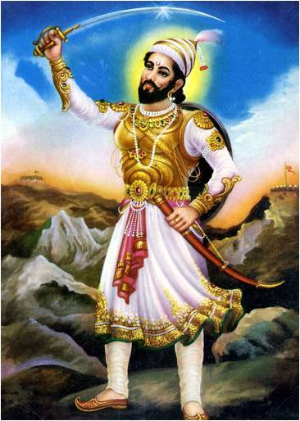
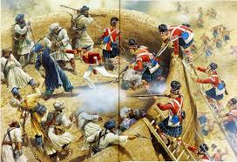
The Anglo Maratha war
After the death of Shivaji the governors of different provinces called as Peshwas started to rule Maratha Kingdom. The British wanted to annex Maratha Kingdom so they fought three wars that came to be known as The Anglo Maratha wars.
Result of the war
In the third Anglo Maratha war the British defeated Marathas.
The post of the Peshwa was abolished.
Large part of the Maratha kingdom was annexed by the British.
Video Link
https://www.youtube.com/watch?v=wc2ErbLu2kA&feature=youtu.be

Slide 5

THANKING YOU
ODM EDUCATIONAL GROUP

