Slide 1


RURAL LIFE AND SOCIETY
SUBJECT : HISTORY CHAPTER NUMBER:4
CHAPTER NAME :RURAL LIFE AND SOCIETY

Slide 2
1.Who introduced Patta system in India?
2.Name three land revenue policies which was introduced by British?
3.Who introduced Permanent Settlement System of Bengal?
4. Mention the advantages of British from the Permanent Settlement of Bengal?
5. Mention the disadvantages of permanent settlement for the Farmers?
6 Name the provinces where the Permanent Settlement policy was introduced?
7. Name the revenue policy which introduced by Lord Cornwallis and Explain it ?
RECAPITULATION

Slide 3
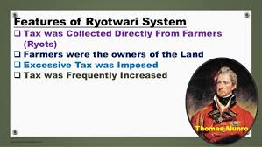
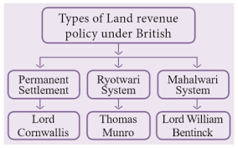
RURAL LIFE AND SOCIETY
RYOTWARI SYSTEM
It was introduced in the Madras and Bombay Presidencies between 1792 and 1827.
According to this system the middlemen or the zamindars were removed and settlement was made directly between the company and the cultivator (Ryot). They had to pay the government about half the value of the crop. The revenue amount was revised after 20-30 years depending on the fertility of the soil.

Slide 4
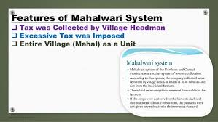
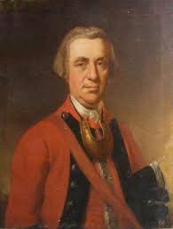
RURAL LIFE AND SOCIETY
The Mahalwari System
It was introduced in parts of Uttar Pradesh, parts of central India, the north west province and parts of Punjab.
According to this system the settlement was made between landlords, village headman and the government. The landlords and the village headman were jointly responsible for the payment of the revenue to the company. The revenue was fixed for a period of 20-30 years after which it was revised.

Slide 5
RURAL LIFE AND SOCIETY
HOME ASSIGNMENT
1.What was Ryotwari System?
2 . Who introduced Ryotwari System? Where was it introduced?
3. What was Mahalwari System?
4 Who introduced Mahalwari System? Where was it introduced?
5 How was Ryotwari system differ from Permanent settlement System?

Slide 6
THANKING YOU
ODM EDUCATIONAL GROUP

