Slide 1


THE ESTABLISHMENT OF COMPANY POWER
VOYAGES OF DISCOVERY, THE BRITISH EAST INDIA
SUBJECT : HISTORY
CHAPTER NUMBER:2
CHAPTER NAME :THE ESTABLISHMENT OF COMPANY POWER

Slide 2
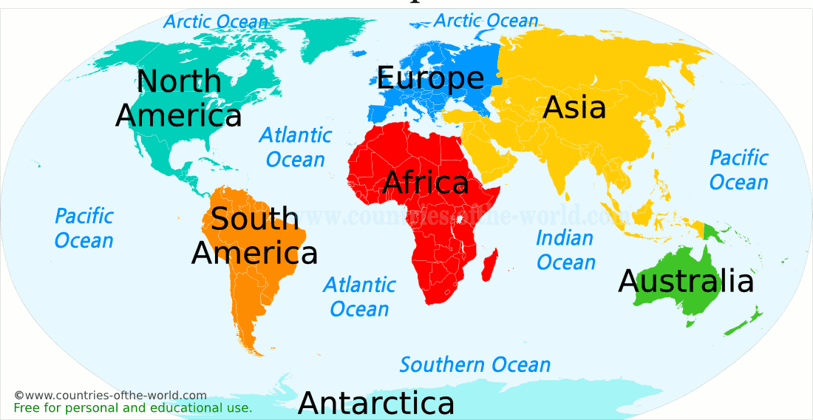
THE ESTABLISHMENT OF COMPANY POWER
INTRODUCTION
Introduction
The British came to India only for trade.
Their Trade Company was known as British East India Company

Slide 3
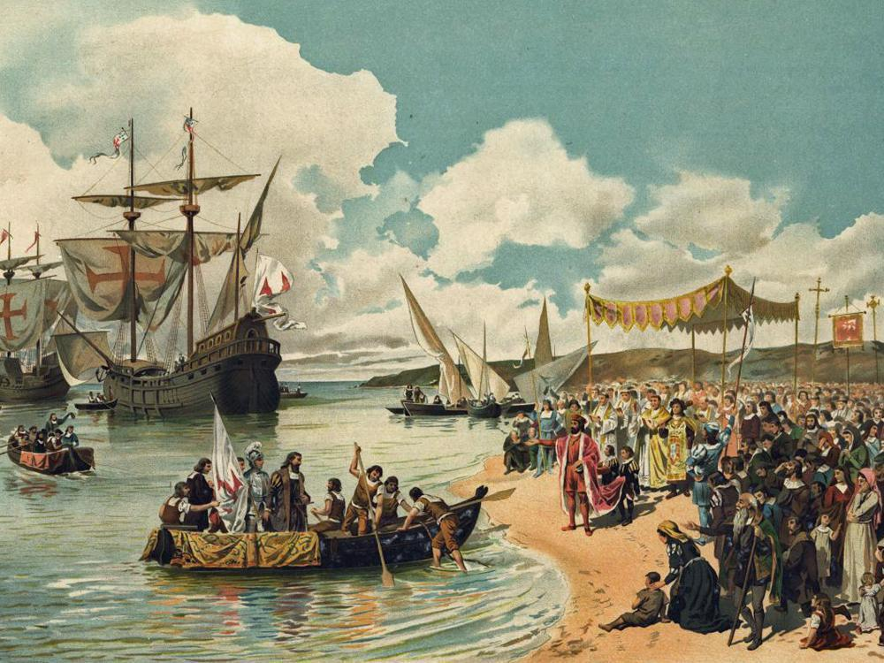
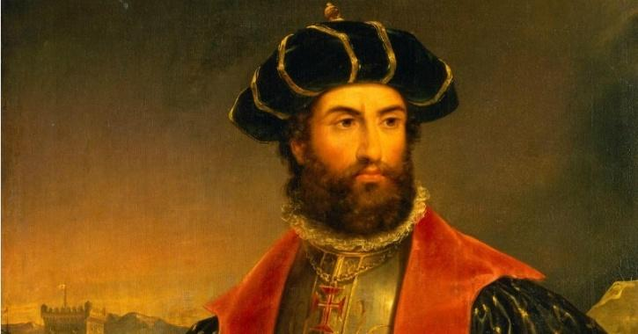
Voyages of discovery
Between 7th and 14th centuries Arab traders dominated the trade between the East and the West.
It became essential to find a direct sea route to the East. For this purpose a series of voyages were undertaken by European Explorers.
The Arab domination of the Indian Ocean was replaced by the Portuguese who were the first Europeans to establish a trade base in India. Followed by them, the Dutch, the British, and the French reached India for trade.

Slide 4
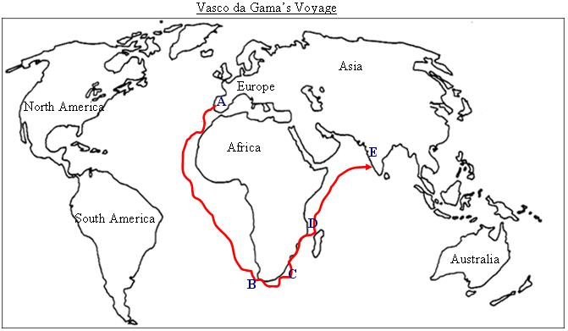
Vasco da Gama’s Voyage
Sea Route to India

Slide 5
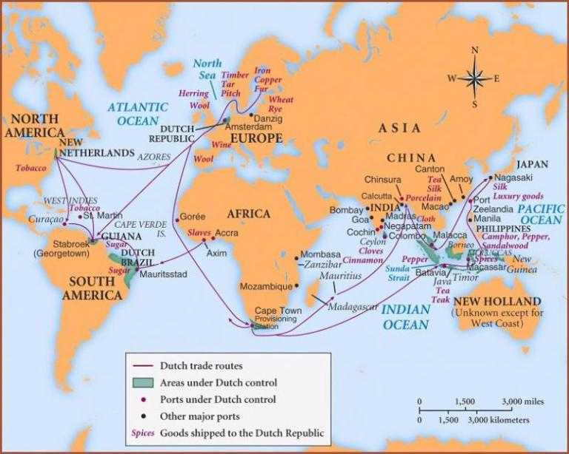
Formation of European Trading Companies in India
The Portuguese had trade settlements at Goa, Daman and Diu. Salsette, Bassein and Santhome near Chennai. (Salsette is an island in the state of Maharashtra on India’s west coast. Bassein is situated at about 70 kms North of Bombay in the Arabian Sea.)
The Dutch East India Company was formed in 1602 and established factories in Masulipatnam (Andhra Pradesh), Surat and Cochin.
The French were the last European power to enter India. The first French factory came up at Surat in 1668. They also acquired Mahe in Malabar on the west coast in 1724.
Video Link: https://www.youtube.com/watch?v=7-3A9f3vfE0&feature=youtu.be

Slide 6
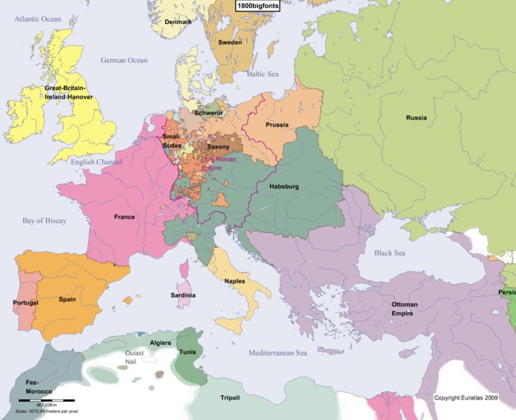
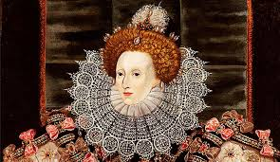
The British East India Company
The British East India Company was found in 1600 by a group of enterprising businessmen. On 31 December 1600, Queen Elizabeth 1 gave permission to the company to trade with India, in return for a share of its profits.
From Trading post to Presidency
The European trading companies used to come by ships, and the captains of the ships asked permission to the local rulers for trade. If trade proved profitable the captains set up trading posts which came to known as Factories.
Groups of factories developed came to known as Settlements. And the developed settlements came to known as Presidencies.

Slide 7
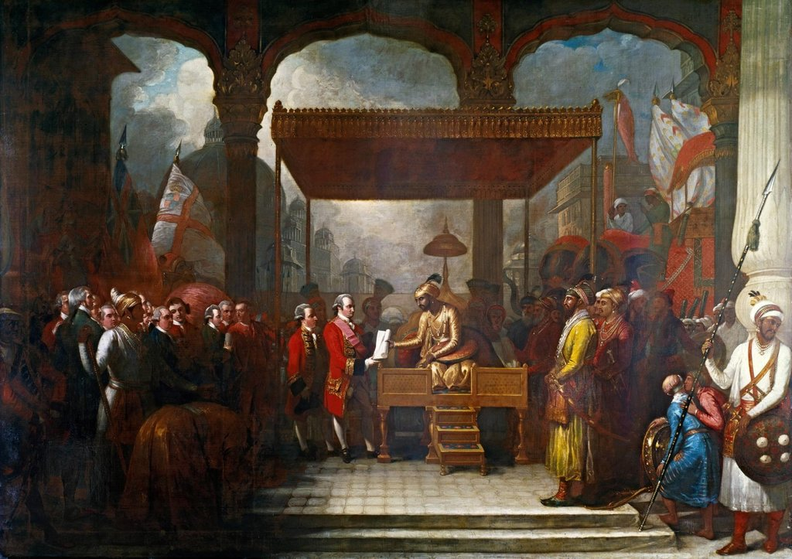
A British official Captain William Hawkins landed in Surat in 1612 and obtained permission from Mughal Emperor Jahangir to set up factories in Surat.
In 1615 King James 1 of England sent Sir Thomas Roe and he received permission from Jahangir to set up factories in any part of Mughal Empire.
From Traders to Rulers—The British Conquest of India
Starting from small trading settlements, the Europeans soon established powerful colonies in India.
Colony is a country or region that is politically controlled by another distant country and Colonialism is a rule of a country for a long period by another one.
Now India became Colony of British

Slide 8
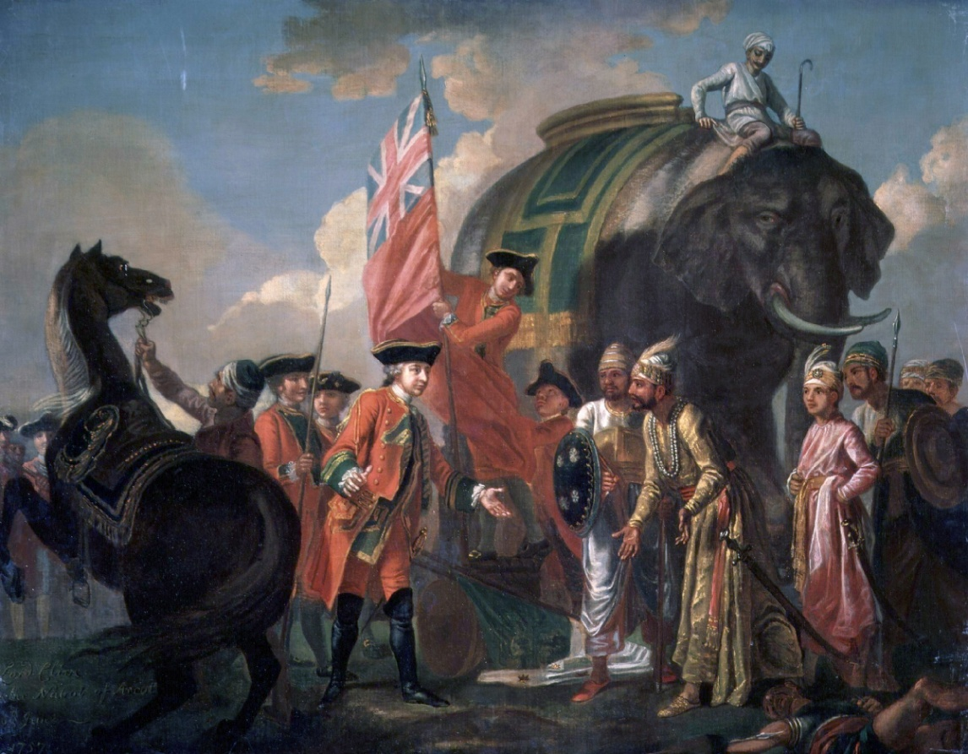
The Carnatic Wars
In order to eliminate France from India Britain fought a War came to known as Carnatic Wars
The conflict between the French and the British was focused around the Carnatic region.
The south eastern part of the Indian Peninsula was known as Carnatic Region. There Hyderabad, Carnatic and Mysore were in constant conflict with each other.
Taking advantage of this conflict among the local rulers Britain and France fought three wars between 1746 and 1763 came to be called the Carnatic Wars.
By the end of third Carnatic war the British defeated French and French
detained in Pondicherry and Chandernagore.
The result of the Carnatic War was The British became the main European Power in India.

Slide 9

THANKING YOU
ODM EDUCATIONAL GROUP

