Slide 1


Welcome to the Vertual Class
Social Science
SUBJECT : History CHAPTER NUMBER: 01
CHAPTER NAME : THE RISE OF IN
NATIONALISM IN EUROPE
SESSSION: 01

Slide 2


LEARNING OUTCOMES
Pupil will be able to:
Recall the previous knowledge.
Relate French Revolution with the idea of Nation.
Analyze the role of Napoleon Bonaparte in the History of France

Slide 3
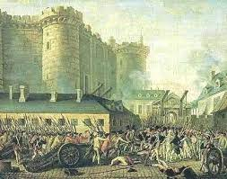


THE FRENCH REVOLUTION AND THE IDEA OF NATION
The first clear expression of nationalism came with the French Revolution in 1789.

Slide 4
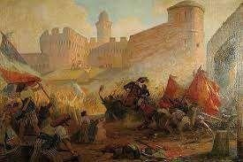

Slide 5
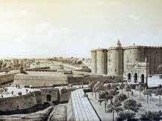
THE BASTILLE FORT
FRANCE

Slide 6
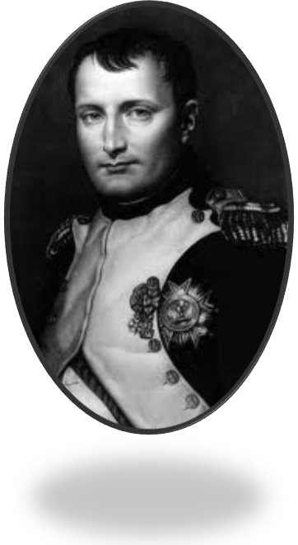
The Napoleonic Code
The Civil code of 1804 – usually known as the Napoloenic Code – did awaywith all the privileges basedon birth, established equality before the law and securedthe right to property
This code was exported to the regions under French cotrol.
NAPOLEON BONAPARTE

Slide 7
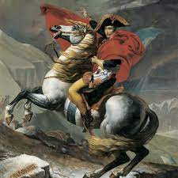
In the Dutch Republic, in Switzerland, in Italy and Germany, Napoleon simplified administrative divisions, abolished the feudal system and freed peasantsfrom serfdom and manorial dues.
Transport and communication systems were improved.
In the towns too, guild restrictionswere removed.
Peasants, artisans, workers and new businessmen enjoyed a new found freedom.

Slide 8
HOME ASSIGNMENT
Worksheet Q. No: 1, 2, 3, 4, 13

Slide 9

THANKING YOU
ODM EDUCATIONAL GROUP

