Slide 1


Period 4
SUBJECT : (Science )
CHAPTER NUMBER: 6
CHAPTER NAME :RESPIRATOERY SYSTEM.

Slide 2
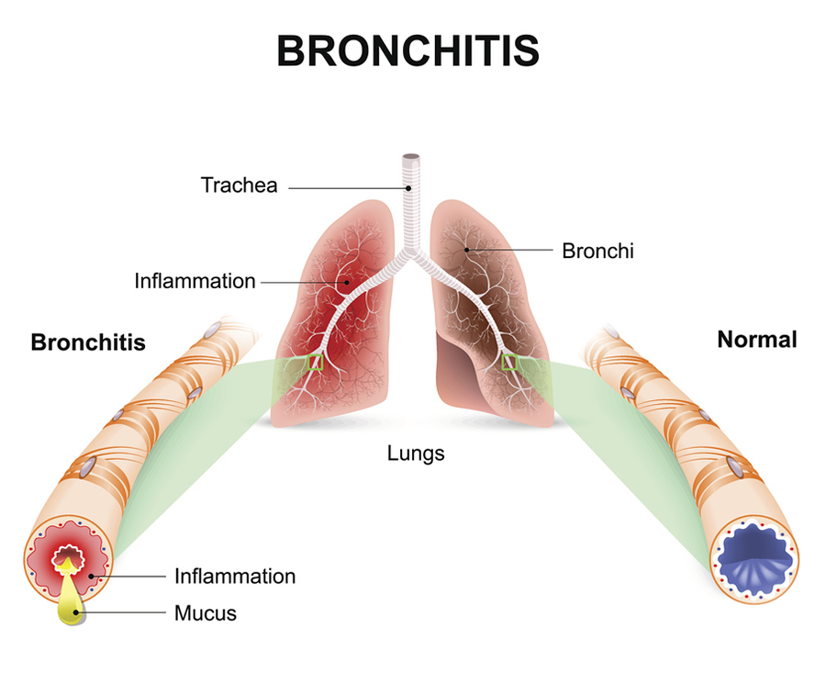
Common Respiratory Diseases
BRONNCHITIS
Bronchitis is an inflammation of the lining of your bronchial tubes, which carry air to and from your lungs. People who have bronchitis often cough up thickened mucus, which can be discolored. Bronchitis may be either acute or chronic.

Slide 3
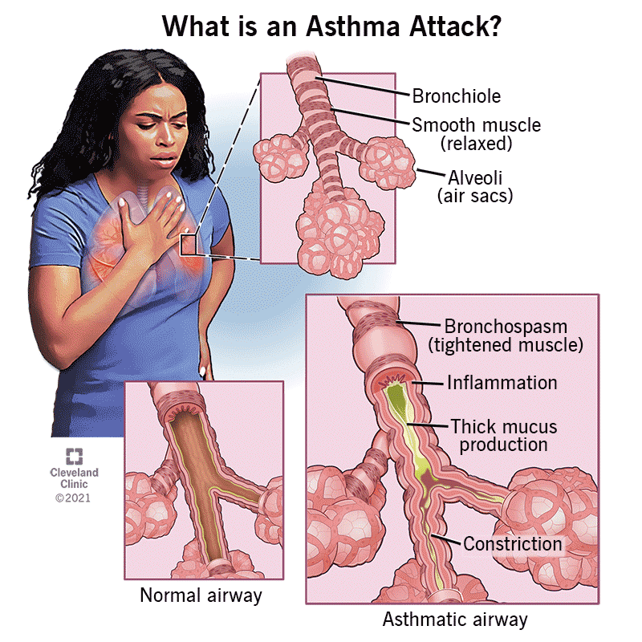
ASTHMA
Asthma is a major noncommunicable disease (NCD), affecting both children and adults, and is the most common chronic disease among children. Inflammation and narrowing of the small airways in the lungs cause asthma symptoms, which can be any combination of cough, wheeze, shortness of breath and chest tightness.

Slide 4
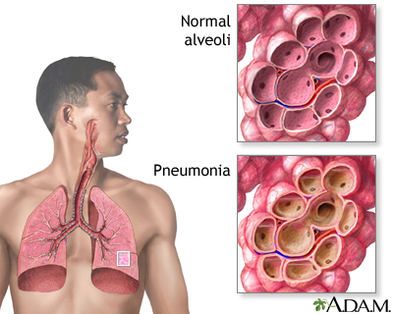
PNEUMONIA
Pneumonia is an infection that inflames the air sacs in one or both lungs. The air sacs may fill with fluid or pus (purulent material), causing cough with phlegm or pus, fever, chills, and difficulty breathing. A variety of organisms, including bacteria, viruses and fungi, can cause pneumonia.

Slide 5
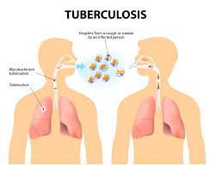
TUBERCULOSIS
Tuberculosis (TB) is a potentially serious infectious disease that mainly affects the lungs. The bacteria that cause tuberculosis are spread from person to person through tiny droplets released into the air via coughs and sneezes.

Slide 6
THANKING YOU
ODM EDUCATIONAL GROUP

