Slide 1


Period 3
SUBJECT : (Science )
CHAPTER NUMBER: 6
CHAPTER NAME :RESPIRATOERY SYSTEM.

Slide 2

Phases of respiration
1- Breathing – it involves inhalation and exahalation.
2- Gaseous transport- oxygen combines with haemoglobin present in the blood and move to different parts of the body cell where it is utilised and carbon dioxide is released .
Cellular respiration- It is the process of breakdown of glucose in cells with the release of carbon dioxide, water, and energy( ATP-Adenosine Triphosphate.)

Slide 3
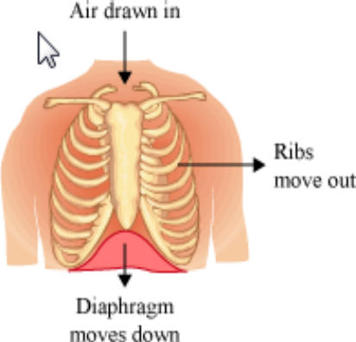
Mechanism of breathing
During inhalation, the diaphragm moves down and the ribs move upwards and outwards, thereby increasing the space in the chest cavity. This leads to the movement of air inside the lungs.

Slide 4
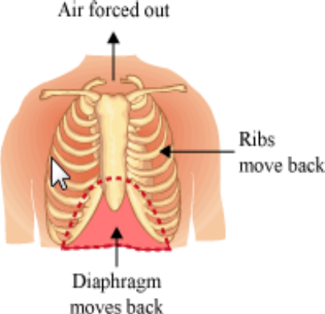
During exhalation, the diaphragm moves to its former position and the ribs move downwards and inwards, thereby reducing the size of the chest cavity. This leads to the movement of air out of the lungs.

Slide 5
THANKING YOU
ODM EDUCATIONAL GROUP

