Slide 1


Digestive system
Period 1
SUBJECT : (Science )
CHAPTER NUMBER: 1
CHAPTER NAME :Digestive system

Slide 2
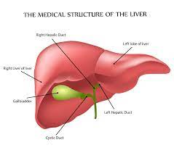
liver
Largest organ of the human body
Produce bile
Bile is Stored in gall bladder
Bile breaks fats into tiny droplets called emulsified fat and the processes is called emulsification.

Slide 3
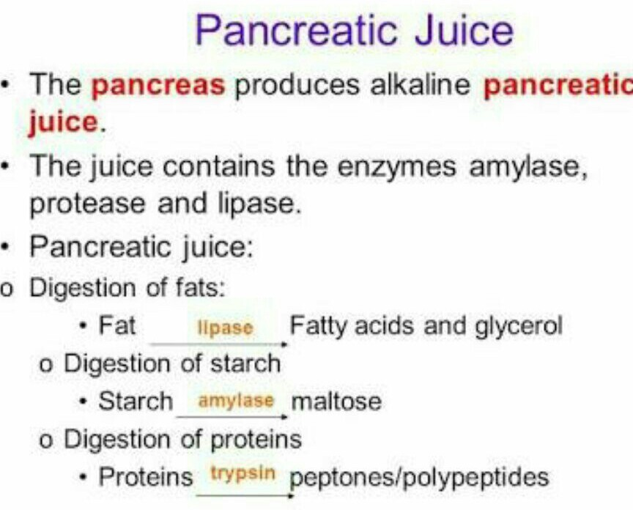
pancreas

Slide 4
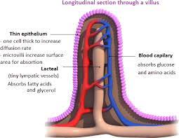
Absorption of food
The inner lining of the small intestine contains finger-like projections known as villi.
The villi increase the surface area of the small intestine for greater absorption of the digested food.
Each villus has a network of thin and small blood vessels.
The blood carries the absorbed food material to different parts of the body.

Slide 5
THANKING YOU
ODM EDUCATIONAL GROUP

