Slide 1


Digestive system
Period 1
SUBJECT : (Science )
CHAPTER NUMBER: 1
CHAPTER NAME :Digestive system

Slide 2
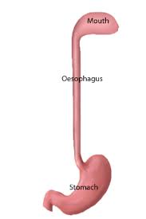
Oesophagus
The esophagus is a muscular tube.
It connects your mouth to your stomach.
When you swallow food, the walls of the oesophagus contracts and relax of its muscles, called peristalsis.
This moves the food down the oesophagus to the stomach.

Slide 3
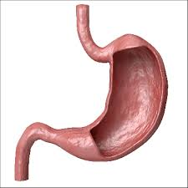
stomach
It is an elastic bag like structure.
The inner wall of the stomach contain gastric glands .
The gastric gland secretes – water , HCL, pepsin ,renin
HCL- kills germs , activates the enzymes pepsin.
Pepsin converts proteins into peptones.
Renin converts casein into curd.

Slide 4
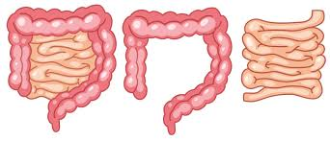
Small intestine
It is a long tube about 7 meters.
The principal function of the small intestine is to break down food, absorb nutrients needed for the body, and get rid of the unnecessary components.

Slide 5
THANKING YOU
ODM EDUCATIONAL GROUP

