Slide 1


Digestive system
Period 1
SUBJECT : (Science )
CHAPTER NUMBER: 1
CHAPTER NAME :Digestive system

Slide 2
NUTRIENT-
A constituent of food that helps one way or the other in the body’s functions.

Slide 3
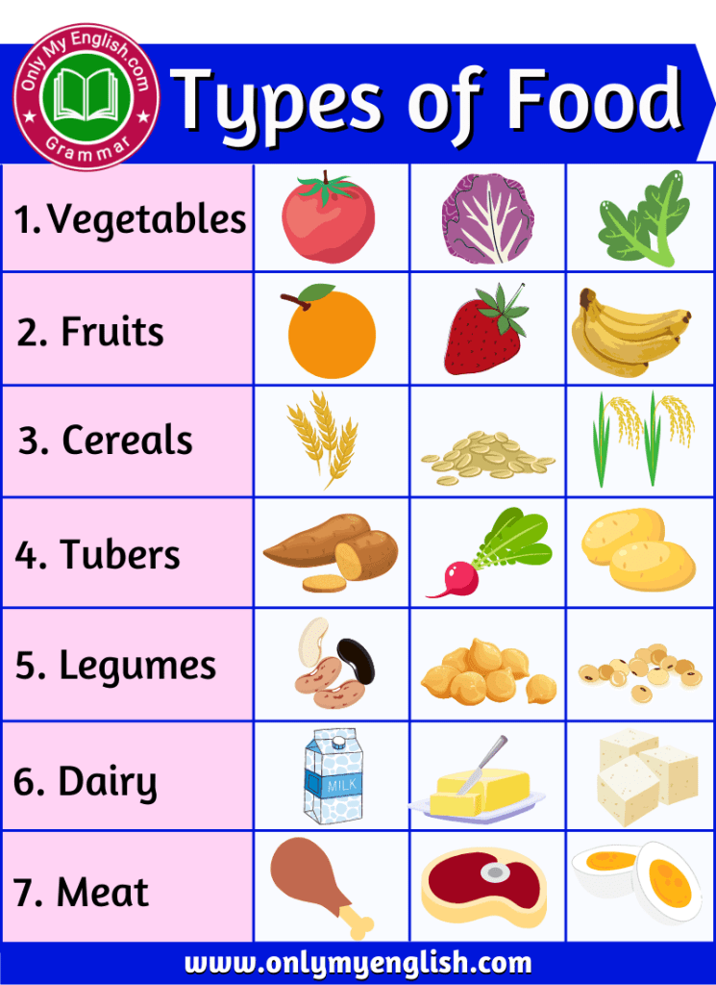
Food

Slide 4
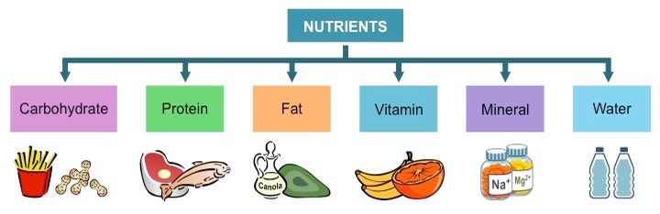
Types of Nutrients
It is the process of obtaining nutrients from the environment.
It is an important source of energy for growth and development of body.

Slide 5
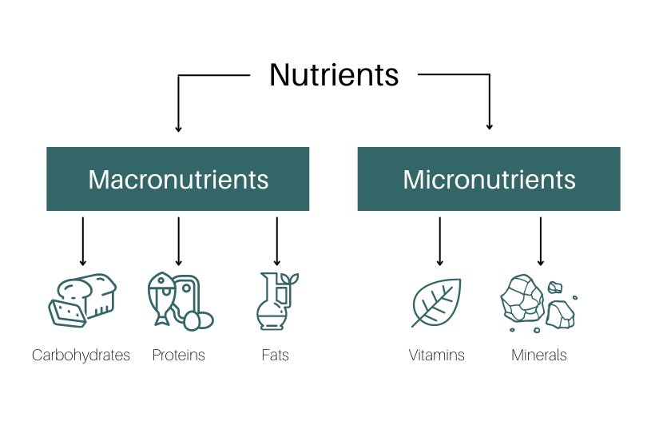
Micronutrients and macronutrients

Slide 6
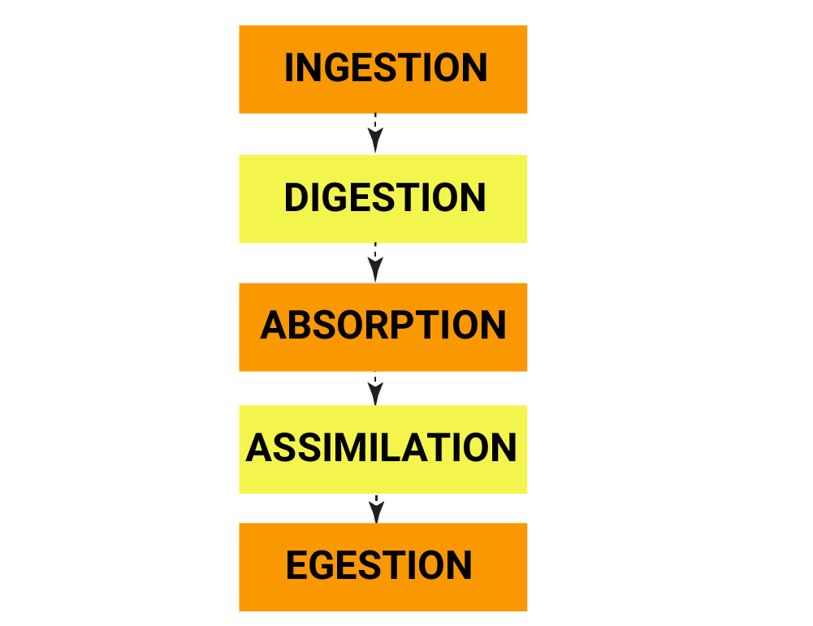
Process of nutrition.

Slide 7
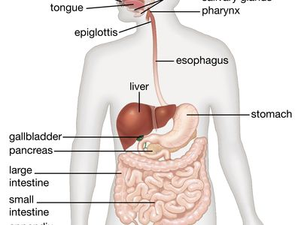
Digestive system

Slide 8
Alimentary canal and digestive glands
Alimentary canal consists of
Mouth
Oesophagus
Stomach
Small intestine
Large intestine
Rectum
Digestive glands consists of
Salivary glands
Liver
Pancreas

Slide 9
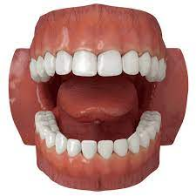
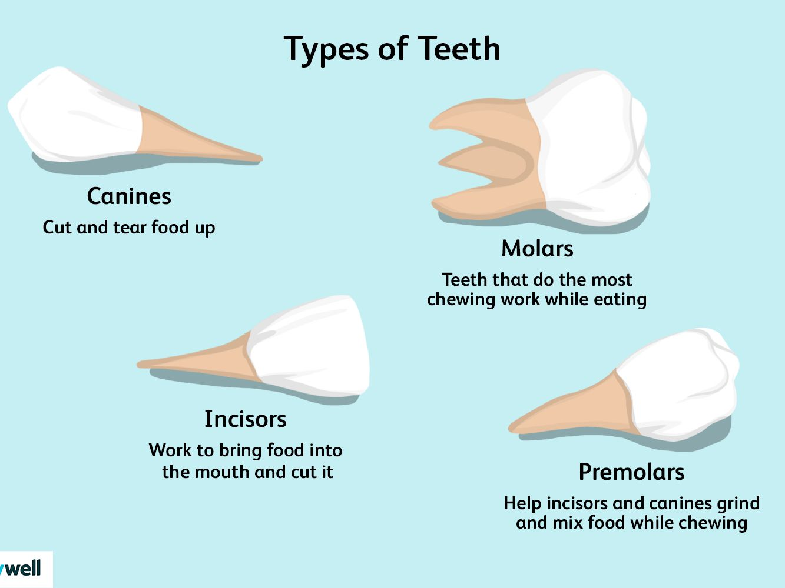
Types of Teeth

Slide 10
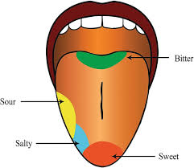
Tongue

Slide 11
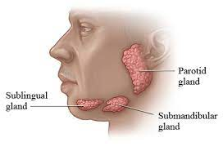
Salivary Glands

Slide 12
THANKING YOU
ODM EDUCATIONAL GROUP

