Slide 1


Parts of a plant , The root system and shoot system , types of roots , functions of roots and stem
Period 1
SUBJECT : (Science )
CHAPTER NUMBER: 1
CHAPTER NAME : The Leaf

Slide 2
ROOT SYSTEM AND SHOOT SYSTEM
A plant can be broadly divided into two systems- the root system and the shoot system.
The part of the plant that remains in the soil is called the root system .
The part of the plant that grows above the soil forms the shoot system.
It consists of the stem, branches, leaves, buds ,flowers and fruits.

Slide 3
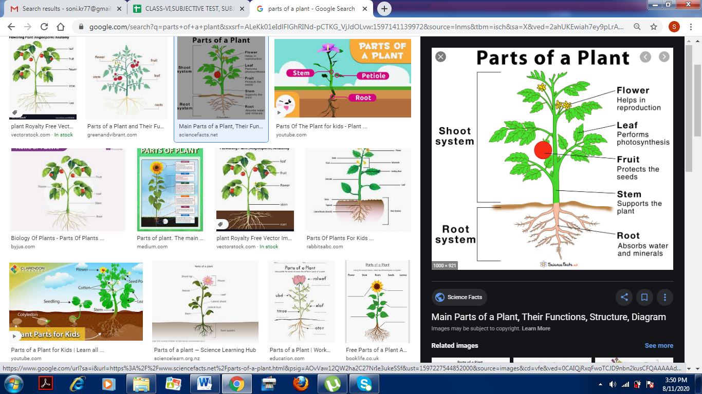
ROOT SYSTEM AND SHOOT SYSTEM

Slide 4
Roots , stems and leaves are the vegetative parts of the plant.
Flowers , fruits and seeds are the reproductive parts of the plant.

Slide 5
Characteristics of roots
It is the part that usually grows below the ground.
It always grow towards moisture and gravity , and grow away from light.
They do not have seeds , flowers or fruits .

Slide 6
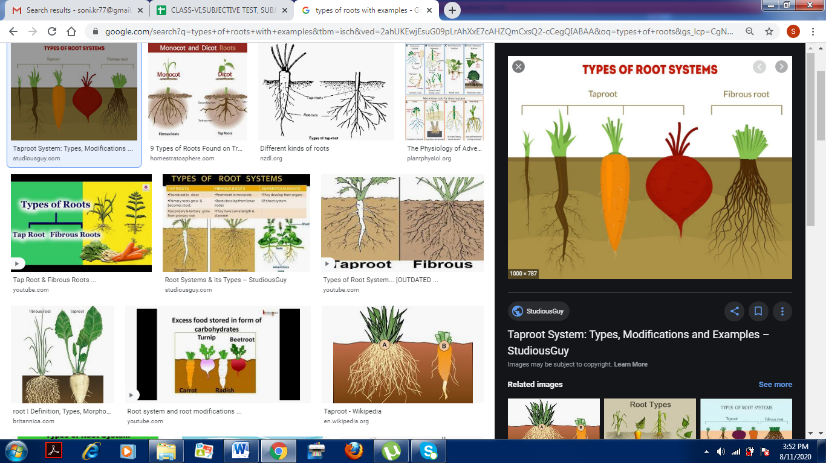
THE ROOT SYSTEM
The root is a part of a plant that attaches it to the soil for support.
Mostly it grows under the soil .
Roots are of two types - taproot and fibrous root.

Slide 7
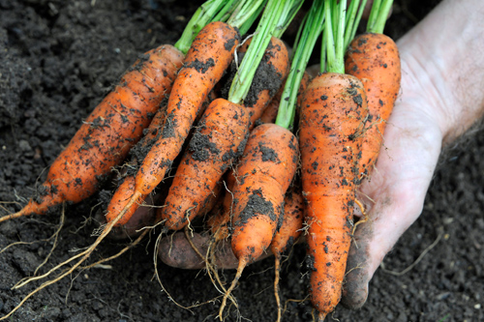
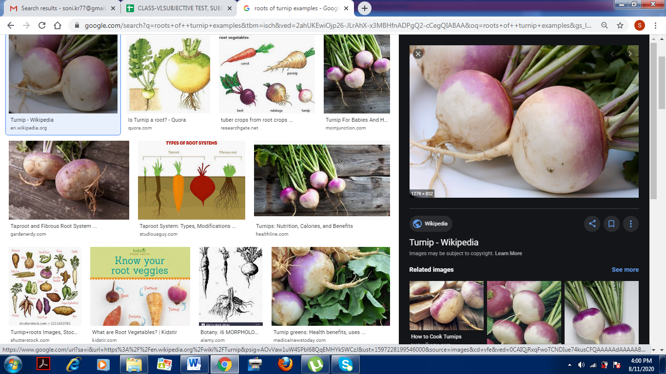
TAP ROOT

Slide 8
TAP ROOT
In a tap root, a single, thick main road grows from the base of the stem.
This root is generally broad at the top and tapers gradually to become narrow at the bottom .
Smaller branch roots, called lateral roots, grow from the main root.
Plants with tap roots include carrot, beetroot turnip, mango, neem, mustard sunflower, rose and tulsi.

Slide 9
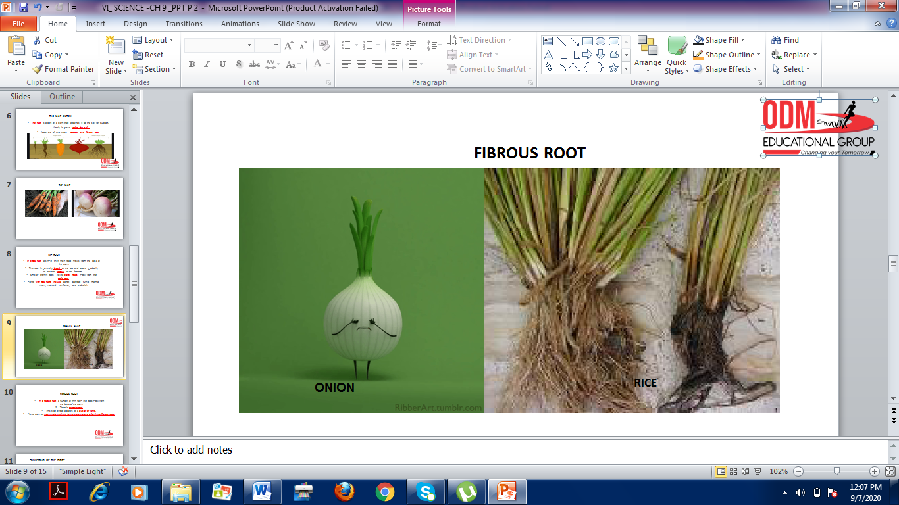
FIBROUS ROOT

Slide 10
FIBROUS ROOT
In a fibrous root, a number of thin, hair- like roots grow from
the base of the stem.
There is no main root.
This type of root appears as a cluster of fibres.
Plants such as grass, maize, wheat, rice, sugarcane and onion have fibrous roots

Slide 11
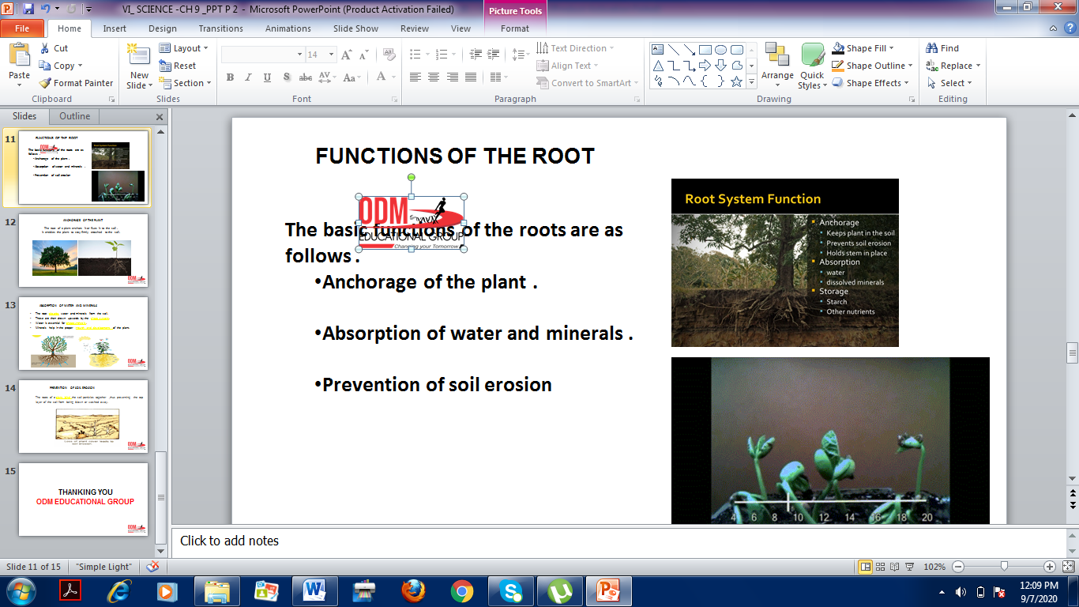
FUNCTIONS OF THE ROOT
The basic functions of the roots are as follows .
Anchorage of the plant .
Absorption of water and minerals .
Prevention of soil erosion

Slide 12

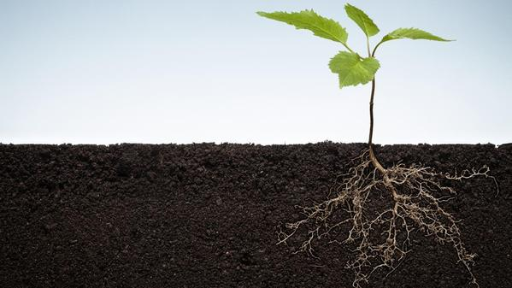
ANCHORAGE OF THE PLANT
The root of a plant anchors it or fixes it to the soil .
It enables the plant to stay firmly attached to the soil.

Slide 13
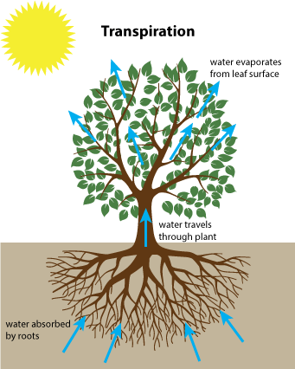
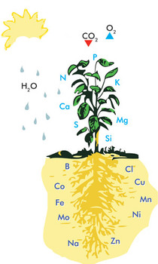
ABSORPTION OF WATER AND MINERALS
The root absorbs water and minerals from the soil.
These are then drawn upwards by the shoot system.
Water is essential for photosynthesis.
Minerals help in the proper growth and development of the plant.

Slide 14
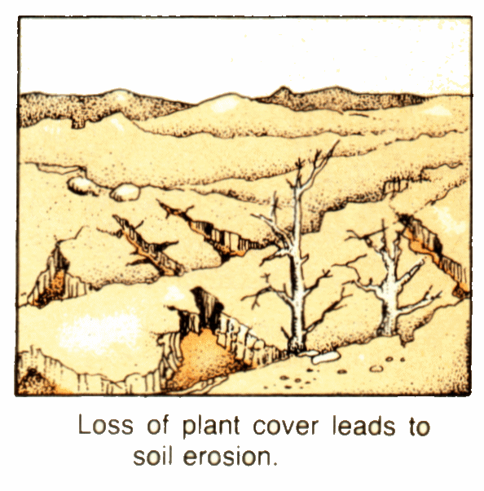
PREVENTION OF SOIL EROSION
The roots of a plant bind the soil particles together ,thus preventing the top layer of the soil from being blown or washed away.

Slide 15
THANKING YOU
ODM EDUCATIONAL GROUP

