Slide 1


Flower : Germination: Necessary Conditions for germination (Activity 7 and Activity 8)
Period 6
SUBJECT : (Science )
CHAPTER NUMBER: 2
CHAPTER NAME : The Flower

Slide 2

What is Seed Germination? Parts Of A Seed rts Of A Seed
Seed germination may be defined as the fundamental process by which different plant species grow from a single seed into a plant. This process influences both crop yield and quality.
A common example of seed germination is the sprouting of a seedling from a seed of an angiosperm or gymnosperm.

Slide 3
The Process of Seed Germination Parts Of A Seed rts Of A Seed
During the beginning stage of germination, the seeds take up water rapidly and this results in swelling and softening of the seed coat at an optimum temperature. This stage is referred to as Imbibition. It starts the growth process by activation of enzymes. The seed activates its internal physiology and starts to respire and produce proteins and metabolizes the stored food. This is a lag phase of seed germination.
By rupturing of the seed coat, radicle emerges to form a primary root. The seed starts absorbing underground water. After the emerging of the radicle and the plumule, shoot starts growing upwards.
In the final stage of seed germination, the cell of the seeds become metabolically active, elongates and divides to give rise to the seedling.

Slide 4
Conditions Necessary for Seed Germination Parts Of A Seed rts Of A Seed
Here are some important requirements which are essential for a seed to germinate into a seedling and to a plant.
Water: It is extremely necessary for the germination of seeds. Some seeds are extremely dry and need to take a considerable amount of water, relative to the dry weight of the seed. Water plays an important role in seed germination. It helps by providing necessary hydration for the vital activities of protoplasm, provides dissolved oxygen for the growing embryo, softens the seed coats and increases the seed permeability. It also helps in the rupturing of seed and also converts the insoluble food into soluble form for its translocation to the embryo.

Slide 5
Parts Of A Seed rts Of A Seed
Oxygen: It is an important and essential source of energy required for seed growth. It is required by the germinating seed for metabolism and is used as a part of aerobic respiration until it manages to grow green leaves of its own. Oxygen can be found in the pores of soil particles, but if the seed is buried too deep it will be deprived of this oxygen.
Temperature: For a seed to germinate, it requires a moderate temperature of around 25-30°C. Quite obviously different seeds require different optimum temperatures. There are some seeds which require special requirements either lower or higher temperature between 5 to 40°C.
Light or darkness: This can act as an environmental trigger. Many seeds do not germinate until sunlight falls on them.

Slide 6
Types Of Germination- Parts Of A Seed rts Of A Seed
Germination is the fundamental process in which the sown plant seeds are grown into young plants or seedlings. Based on their growing conditions and the fate of the cotyledons, the process of germination is classified into two main types:
Epigeal Germination
Hypogeal Germination

Slide 7
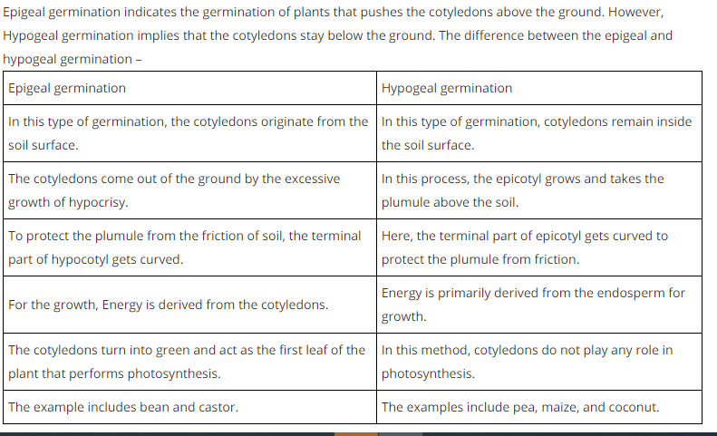
Parts Of A Seed rts Of A Seed

Slide 8
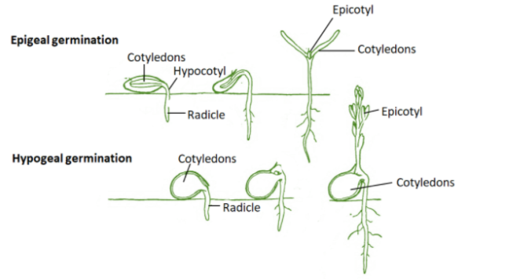


Slide 9
https://www.youtube.com/watch?v=TE6xptjgNR0
https://www.youtube.com/watch?v=_2tgcvvHOHI
https://www.youtube.com/watch?v=ZdOmVDRNXys

Slide 10
THANKING YOU
ODM EDUCATIONAL GROUP

