Slide 1


Flower :Seed: types of seeds, structure of a seed-bean, coconut
Period 5
SUBJECT : (Science )
CHAPTER NUMBER: 2
CHAPTER NAME : The Flower

Slide 2

Pa Parts Of A Seed Parts Of A Seed rts Of A Seed
A seed is an important part of a flowering plant. They give rise to a new plant. They may be of different shapes, colours and sizes. They may be round, wrinkled, winged or hairy. They are in a dormant condition until they receive adequate sunlight, water, and soil. The growth of the plant from a seed is known as germination. A seed has three parts:
Seed Coat
Endosperm
Embryo

Slide 3
Seed Coat
A seed coat protects the internal parts of a seed. The seed coat has two layers. The outer layer is thick and known as the testa. The inner layer is thin and known as tegmen.
A thick seed coat protects the seed from sunlight and water. It prevents the loss of water and entry of parasites within the seeds. The hard seed coats prevent germination during unfavourable environmental conditions.
An opening in the integument of the ovule is known as the micropyle and is visible on some seed coats. The hilum is also visible which is equivalent to the naval in humans where the umbilical cord is attached.

Slide 4
Endosperm
The endosperm contains the nutrients stored in it. It provides nutrients to the seed in the form of starch, carbohydrates and proteins to support the embryo during germination. It is located below the seed coat. The seeds remain viable with the intake of nutrients until germination.
In corns and other cereals, endosperm constitutes a major portion of the seed. In seeds like beans, the endosperm is utilized in the embryo development and is absent in the seed. Coconut is the liquid endosperm.

Slide 5
Embryo
The embryo is the most important part of a seed. It is diploid, developed from the fertilized egg. All the cells that need to develop into a mature embryo are present within the embryo. An embryo comprises the following parts:
Epicotyl
Hypocotyl
Radicle
Cotyledons
Epicotyl is a small shoot which gives rise to the entire plant shoot system.
The primary root emerges first during germination. It is also known as hypocotyl. It anchors the plant firmly in the soil.
Radicle is a small embryonic root.
The cotyledons provide nourishment to different parts of the embryo. It emerges as a tiny or fleshy leaf from the soil with the seedling during growth. It stores food in the form of starch and protein.
The embryonic leaves are the first to appear above the ground. An embryo develops from a fertilized egg.

Slide 6
Types of Seeds
There are two types of seeds:
Monocotyledonous seeds
Dicotyledonous seeds
Monocotyledonous Seeds
These comprise a single cotyledon emerging from the seeds on germination. For eg., rice
2. Dicotyledonous Seeds
These comprise two cotyledons emerging from the seeds on germination. For eg., tomato

Slide 7
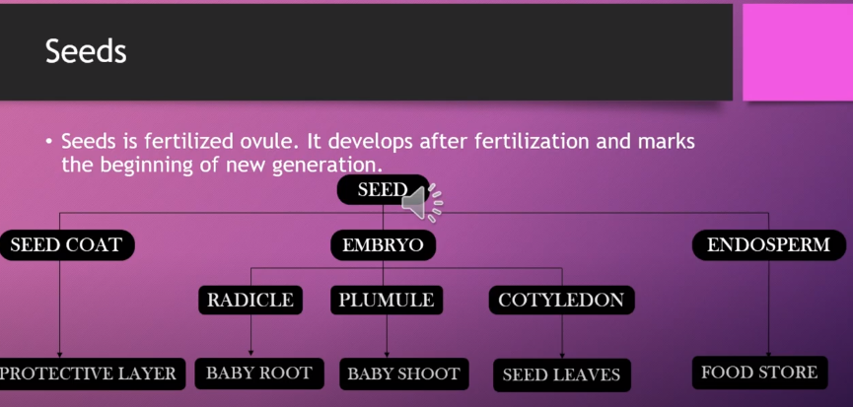


Slide 8
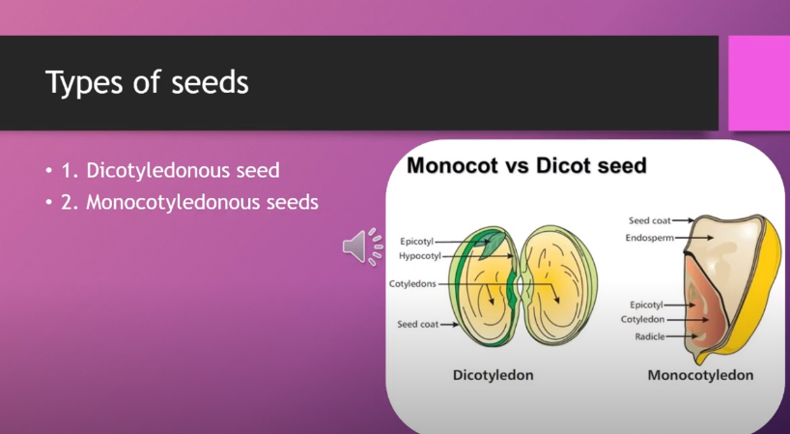

Slide 9
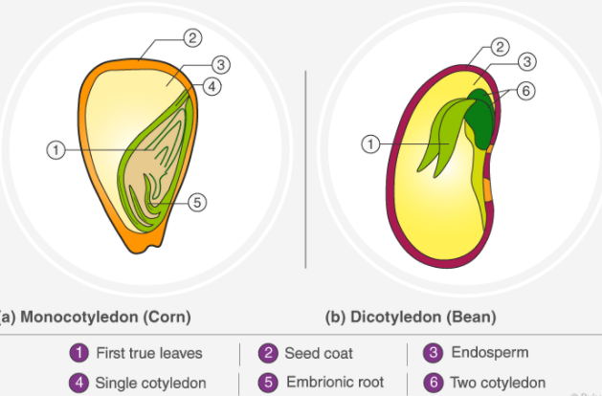
MONOCOTYLEDON & DICOTYLEDON-

Slide 10
Monocotyledon vs Dicotyledon
Monocotyledon | Dicotyledon
The monocot embryos have a single cotyledon | The dicot embryos have a pair of cotyledons
They have a fibrous root system | They have a tap root system
Leaves in monocots have parallel venation | Leaves in dicots have reticulate or net venation
In monocot flowers, the count of parts of the flower is a multiple of three or equal to three | The count of parts in a dicot flower is a multiple of four or five or equal to four or five
The roots and stems of Monocotyledons do not possess a cambium and cannot increase in diameter | The roots and stems of Dicotyledons possess a cambium and have the ability to increase in diameter
A few examples of monocotyledons are garlic, onions, wheat, corn and grass | A few examples of dicots are beans, cauliflower, apples and pear

Slide 11
VIDEO LINK- https://www.youtube.com/watch?v=xDeei76ii5E
VIDEO LINK- https://www.youtube.com/watch?v=Ilz9nkxUvhQ

Slide 12
THANKING YOU
ODM EDUCATIONAL GROUP

