Slide 1


Fruit : Parts of a fruit , types and functions of fruit
Period 4
SUBJECT : (Science )
CHAPTER NUMBER: 2
CHAPTER NAME : The Flower

Slide 2
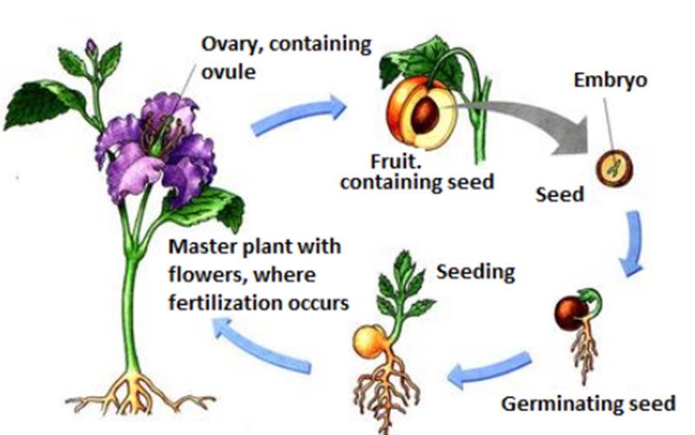

FORMATION OF FRUIT
Video link- https://www.youtube.com/watch?v=3OVd2_bPoBY
After fertilization a number of events take place in the flower.
1.The ovary remains attached to the stalk of the flower and grows in to fruit.
2.The ovules develop in to seeds.
3.The wall of ovary develops in to fruit wall.
4.The other parts of flower sepal, petals falls off.
5.Style,stigma and stamen also fall off.

Slide 3
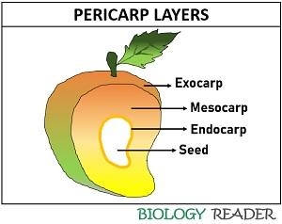
PARTS OF FRUIT
A fruit is ripened ovary. It consists of pericarp(fruit wall) and seeds.
Pericarp develops from ovary wall. It may be thick (in fleshy fruits) or thin 9 in dry fruits. It has three parts :
Epicarp : It is outer thin covering of the fruit.
Mesocarp : In fleshy fruits, It is the sweet, fleshy middle layer of the pericarp.
Endocarp: It is the inner layer hard part of the pericarp.

Slide 4
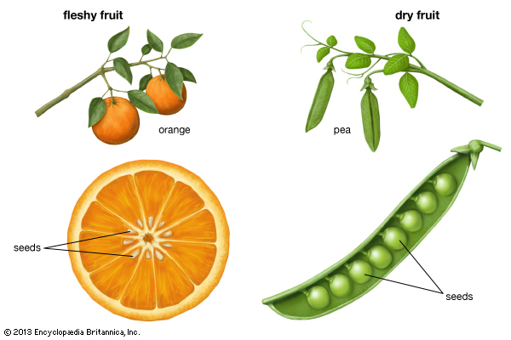
DRY AND FLESHY FRUITS
In dry fruits, the pericarp is dry and non edible. The edible part of the fruit is seeds. Ex maize, gram , pea
In fleshy fruits, the pericarp or some of its part are soft and pulpy.Grapes, apple etc.

Slide 5

FUNCTIONS OF FRUIT
It protects seeds from the unfavorable environment conditions.
Fruits store food inside them
Fruits help in dispersing the seeds present inside them and facilitate their germination.

Slide 6
Multiple Choice questions:
1. Tick () the appropriate answer.
(i) In a germinating seed the roots develop from.
(a) Radicle (b) Plumule
(c) Tegmen (d) Hilum
(ii) In a germinating seed the shoot develops from
(a) Radicle (b) Plumule
(c) Tegmen (d) Hilum
(iii) Which one of the following is a monocotyledonous seed?
(a) Bean (b) Pea
(c) Maize (d) Gram
(iv) If the cotyledons are pushed above the soil, then such type of
germination is called
(a) Epigeal (b) Hypogeal
(c) Perigeal (d) Progeal
(v) If the cotyledons remain under the soil, then such type of
germination is called
(a) Epigeal (b) Hypogeal
(c) Perigeal (d) Progeal
(vi) Pollen is produced in the
(a) Filament (b) Style
(c) Pistil (d) Anther

Slide 7
(vii) Reproductive whorl of a flower are
(a) Stamen and carpels (b) Sepals and petals
(c) Sepal and stamens (d) Petals and carpels
(viii) Which one of the following is a false fruit?
(a) Tomato (b) Apple
(c) Potato (d) Pea
(ix) In a seed food is generally stored in
(a) Radicle (b) Plumule
(c) Fruit (d) Cotyledons or endosperms

Slide 8
Short Answer questions
1. Giving below is a longitudinal section of a bean seed. Level the parts
Marked 1 to 5 and right their functions.
1. Testa: It is the outer exposed part of of the seed.
2. Plumule: It is located between the two cotyledons and
develops in to a shoot.
3. Radicle: It is located between the two cotyledons and
develops in to a root.
4. Micropyle: It absorbs and allows the entry of as much as water as is
required for germination.
5. Cotyledon: It stores the food material which is used by the seedling for
growth.

Slide 9
2. Name the following:
a) A seed which shows hypogeal germination. ------ Pea
b) A monocot seed. -------- Maize grain
c) A dicot seed. ---------- Bean seed
d) A seed which shows epigeal germination ------- Bean seed

Slide 10
3. Differentiate between the following pairs of terms:
a) Radicle and plumule
The radicle develops in to a root, while the plumule develops in to a
shoot.
b) Hilum and micropyle.
Hilum is the inner concave side of the seed, where the seed was
attached to the fruit wall. Micropyle is a small pore which absorbs
and allows water required for germination.
c) Testa and tegmen.
Testa is the outer exposed part of the seed coat, whereas tegmen
is a thin membrane and lies under the testa. It is the inner part of
the seed coat

Slide 11

4. Give two functions of fruit.
The two functions of fruit are
i) It protects the seed from the unfavorable environmental
conditions.
ii) Fruits store food inside them.

Slide 12
5. Match the columns: Ans. a- iii, b- i, c- ii, d- v, e- iv
Ans. a- iii, b- i, c- ii, d- v, e- iv

Slide 13
Long answer questions:
1. What is meant by pollination? Name two types of pollination.
Pollination is the transfer of pollen grains from the anthers to the stigma
of a flower.
The two types of pollination are
a) Self pollination: It occurs within a single flower or between the flowers
of same plant.
b) Cross Pollination: It occurs in flowers of different plants of same kind.

Slide 14
3. What is a flower? Draw a typical flower and level its different parts
A flower is the most
beautiful and colourful
part of a plant which
serves as a reproductive
organ.

Slide 15
8. State the location of the following in a flower.
(a) Sepals: Sepals are the green outermost part of a flower.
(b) Petals: This forms the second inner whorl. Petals are the large,
fragrant and brightly coloured parts of the flower.
(c) Anthers: It is located in the third whorl of the flower. The filament
of the stamen bears the anther at its tip.
(d) Stigma: It is located in the fourth and the innermost whorl of the
flower. The style bears the stigma at its tip.

Slide 16
9. Given below the diagram of a typical flower. Label the parts marked by Guidelines.

Slide 17
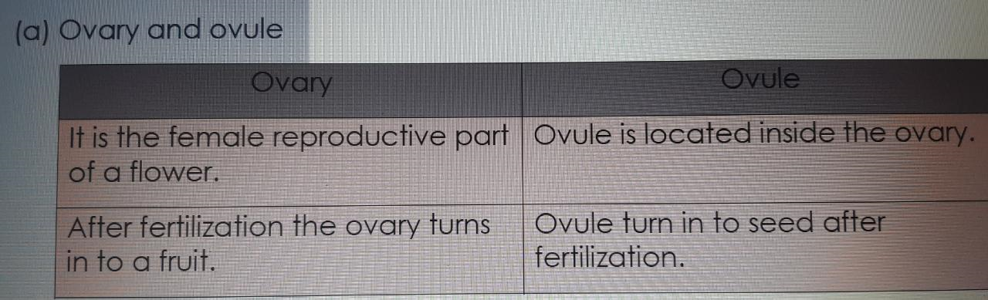
10. Give the difference in the function between the following parts. (a) Ovary and ovule (b) Petal and sepal (c) Filament and style (d) Pollen grains and ovule

Slide 18
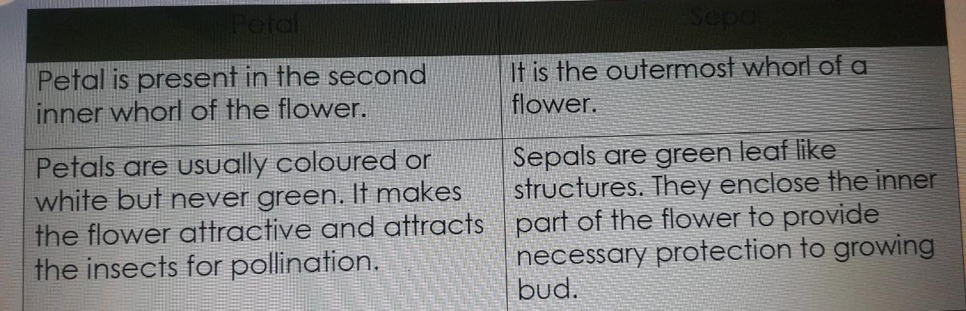
PETAL AND SEPAL

Slide 19
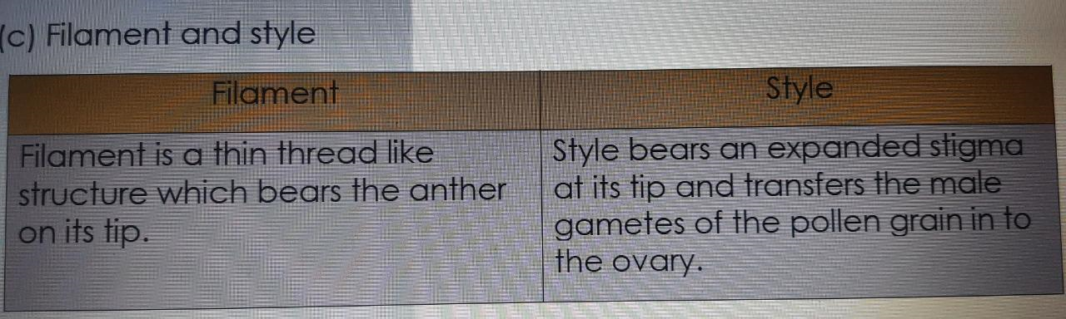

Slide 20
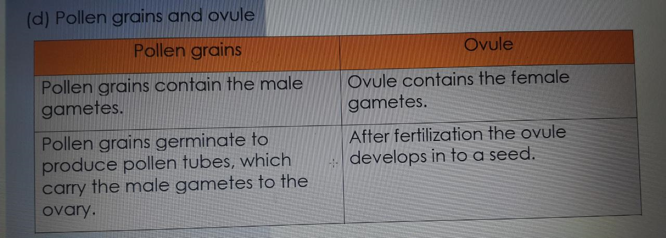

Slide 21
THANKING YOU
ODM EDUCATIONAL GROUP

