Slide 1


Flower :Fertilisation and after fertilisation changes in a flower, Parts of a fruit , types and functions of fruit
Period 3
SUBJECT : (Science )
CHAPTER NUMBER: 2
CHAPTER NAME : The Flower

Slide 2

What is Fertilization?
In plants, fertilization is a process of sexual reproduction, which occurs after pollination and germination.
Fertilization can be defined as the fusion of the male gametes (pollen) with the female gametes (ovum) to form a diploid zygote. It is a physicochemical process which occurs after the pollination of the carpel. The complete series of this process takes place in the zygote to develop into a seed.
In the fertilization process, flowers play a significant role as they are the reproductive structures of angiosperms (flowering plants). The method of fertilization in plants occurs when gametes in haploid conditions fuse to produce a diploid zygote.
In the course of fertilization, male gametes get transferred into the female reproductive organs through pollinators (honey bees, birds, bats, butterflies, flower beetles) and the final product will be the formation of the embryo in a seed.
Video link- https://www.youtube.com/watch?v=vMyKhxCEy1Q

Slide 3
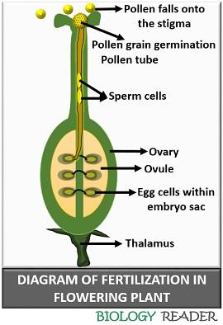

Slide 4
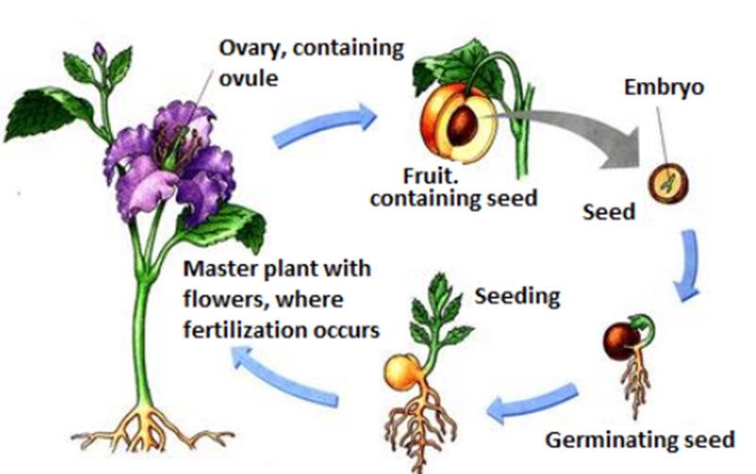
FORMATION OF FRUIT
Video link- https://www.youtube.com/watch?v=3OVd2_bPoBY
After fertilization a number of events take place in the flower.
1.The ovary remains attached to the stalk of the flower and grows in to fruit.
2.The ovules develop in to seeds.
3.The wall of ovary develops in to fruit wall.
4.The other parts of flower sepal, petals falls off.
5.Style,stigma and stamen also fall off.

Slide 5
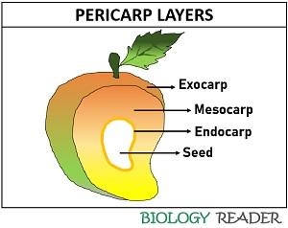
PARTS OF FRUIT
A fruit is ripened ovary. It consists of pericarp(fruit wall) and seeds.
Pericarp develops from ovary wall. It may be thick (in fleshy fruits) or thin 9 in dry fruits. It has three parts :
Epicarp : It is outer thin covering of the fruit.
Mesocarp : In fleshy fruits, It is the sweet, fleshy middle layer of the pericarp.
Endocarp: It is the inner layer hard part of the pericarp.

Slide 6
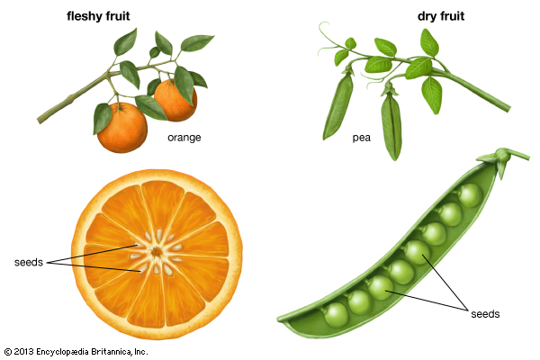
DRY AND FLESHY FRUITS
In dry fruits, the pericarp is dry and non edible. The edible part of the fruit is seeds. Ex maize, gram , pea
In fleshy fruits, the pericarp or some of its part are soft and pulpy.Grapes, apple etc.

Slide 7
THANKING YOU
ODM EDUCATIONAL GROUP

