Slide 1


Flower : Types of flower, pollination and its types, agents of pollination
Period 2
SUBJECT : (Science )
CHAPTER NUMBER: 2
CHAPTER NAME : The Flower

Slide 2
FLOWER
ACCESSORY WHORLS
CALYX
COROLLA
ESSENTIAL WHORLS
ANDROCIUM
GYNOECIUM

Slide 3
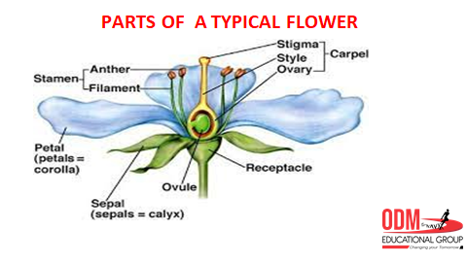
Parts of a Flower

Slide 4
TYPES OF FLOWER
Unisexual flowers
The flowers which contain only the male or female reproductive organs are called unisexual flowers. They are called incomplete flowers. To reproduce they undergo cross-pollination.
They do not have both stamen and carpels.
Examples: Papaya, White mulberry and Watermelon.
Bisexual flowers
The flowers which contain both male and female reproductive organs are known as full or bisexual flowers.
They will self-pollinate themselves.
Examples: Tulip, Sunflower and Lily.

Slide 5
Complete flowers have sepals, petals, pistils and stamens on each flower, as in the drawing above:
Both male and female reproductive parts
Sepals protect the flower buds during development
Petals lure pollinators to the flower to promote pollination
Incomplete flowers are missing one or more of those features
Perfect/imperfect flowers refer only to the sexual flower parts:
Perfect flowers have both male (staminate) and female (pistillate) parts on the same flower.
Imperfect flowers are missing one set of reproductive parts

Slide 6
FUNCTIONS OF FLOWER
Gametophytes develop in the flowers.
The flowers can produce diaspores without fertilization.
After fertilization, the ovary of the flower develops into a fruit containing a seed.
The most important function of flowers is reproduction. They help in the union of male and female gametes.
Flowers provide nectar to certain birds and insects, which in turn help in the transfer of pollen from one flower to the other.
Flowers may promote selfing, i.e., the union of sperms and eggs from the same flower, or cross-fertilization, i.e., the union of sperms and eggs from different flowers.

Slide 7

Pollination in Plants
Reproduction is the life process which helps an organism to procreate its own offspring. There are a lot of events involved in this. In plants, pollination is one among them. Pollination can be defined as the pre-fertilization event or process where pollen grains from anther are transferred to the stigma of a flower.
Plants are immobile. Unlike animals, both male gamete and female gamete are immobile. They can’t copulate with each other by themselves. They need a vector for this. Pollination is the process that helps to unite the male and female gametes and thus helps in fertilization. It can be broadly classified into two, cross-pollination and self-pollination and this is achieved with the help of a variety of vectors/agents. For successful pollinations, it must occur between the same species.

Slide 8
Pollination
What Is Pollination?
Pollination is a biological process in which the pollen grains are transferred from an anther (male part of a flower) to the stigma (female part of a flower). There are two types of pollination:
Self-Pollination
Cross-Pollination
What Is Self-Pollination?
Self-pollination is referred to as the primary type of pollination, which occurs by transferring the pollen grains directly from anther into the stigma of the same flower.
What is Cross-Pollination?
Cross Pollination is referred to as the complex type of pollination during which the pollen grains are transferred from the anther of one flower into the stigma of another flower.

Slide 9
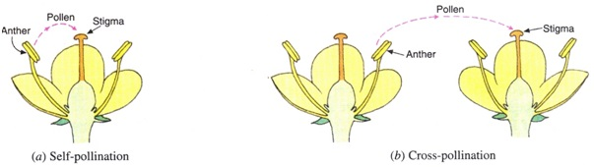

Slide 10
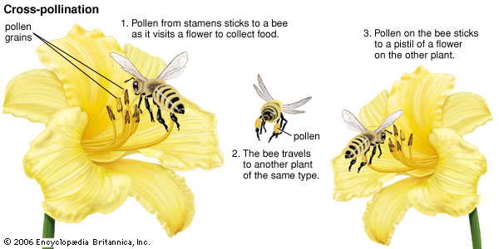

Slide 11
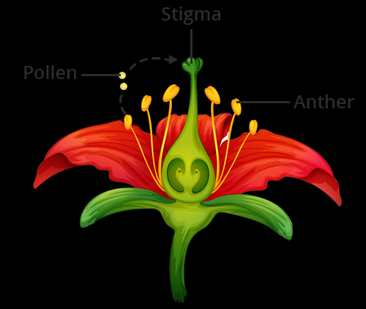


Slide 12
What are the Pollinating Agents?
The agents which are involved in transferring the pollen grains from one flower to another flower are called as the Pollinating Agents. Animals, birds, insects, wind and other biotic and abiotic agents are all examples of Pollinating Agents.
How does Pollination occur in Plants?
There are two different types of pollinations in which the pollen grains are transferred from one flower to another. In both the process, pollen grains are transferred from a stamen to the stigma of the same plant or to a flower of different plants.

Slide 13
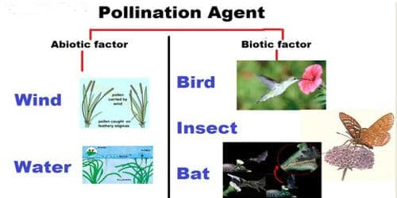
AGENTS OF POLLINATION
1.WIND 2.WATER 3.INSECTS 4.ANIMALS
POLLINATION BY WIND
EX WHEAT,MAIZE
POLLINATION BYWATER
EX VALLISNERIA,HYDRILLA
POLLINATIONBY INSECTS
EX ROSE,MARIGOLD
POLLINATION BY ANIMALS
EX BIGONIA,RED SILK COTTON, KADAM ETC.

Slide 14
THANKING YOU
ODM EDUCATIONAL GROUP

