Slide 1


Flower : Parts(whorls) and their respective functions
Period 1
SUBJECT : (Science )
CHAPTER NUMBER: 1
CHAPTER NAME : The Flower

Slide 2
THE FLOWER
Flowers are the reproductive part of a plant. They are not only involved in reproduction, but are also a source of food for other living organisms. They are a rich source of nectar.
Flowers can either be
Complete
Incomplete.
A complete flower is the one that consists of sepals, petals, stamens and pistil. On the contrary, an incomplete flower is the one that lacks one or more of these structures.
A complete flower consists of two different parts:
Vegetative Part
Reproductive Part

Slide 3
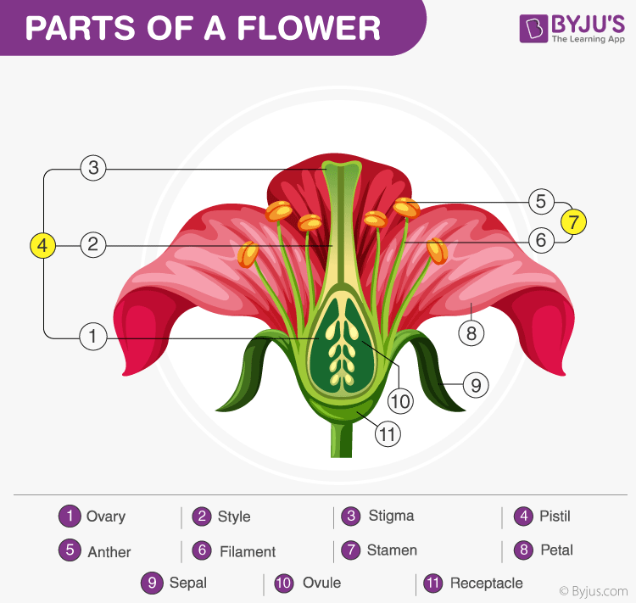
ROOT SYSTEM AND SHOOT SYSTEM

Slide 4
Parts of a Flower
Vegetative Parts of a Flower
The vegetative part of a flower consists of the following:
Petals: This is a bright-coloured part that attracts bees, insects, and birds. Colour of petals varies from plant to plant; some are bright while some are pale coloured. Thus, petals help us to differentiate one flower from another.
Sepals: Sepal is the green-coloured part beneath the petals to protect rising buds. Some flowers have fused petals-sepals while a few have separated petals-sepals.
LINK-

Slide 5
Reproductive Parts of a Flower
Flowers contain the plant’s reproductive structures
In different plants, the number of petals, sepals, stamens and pistils can vary. The presence of these parts differentiates the flower into complete or incomplete. Apart from these parts, a flower includes reproductive parts – stamen and pistil. A flower may have only female parts, only male parts, or both.

Slide 6
The reproductive parts of a flower consist of the following:
Stamen: This is the male reproductive organ and is also known as Androecium. It consists of two parts namely: anther and filaments.
The anther is a yellowish, sac-like structure, involved in producing and storing the pollens.
The filament is a slender, threadlike object, which functions by supporting the anther.
Pistil: This is the innermost part and the female reproductive organ of a flower which comprises three parts -stigma, style and ovary. This is collectively known as the pistil.
Stigma: It is the topmost part or receptive tip of carpels in the gynoecium of a flower.
Style: It is the long tube-like slender stalk that connects stigma and the ovary.
Ovary: It is the ductless reproductive gland that holds a lot of ovules. It is the part of the plant where the seed formation takes place.

Slide 7
Whorls
Along with the vegetative and reproductive parts, a flower is also composed of four whorls, which are largely responsible for the radial arrangement of a flower. A typical flower has a circular section with a common centre, which can be clearly observed and distinguished from the top of the flower. There are four whorls:
Calyx
The calyx is the outermost whorl of a flower. It comprises sepals, tiny leaves present at the base of a flower. These protect the flower whorls against mechanical injuries and desiccation. Some plants have coloured sepals the calyx and are called petaloid.
If the sepals are free the calyx is called polysepalous, and if they are united it is called gamosepalous.
In many flowers, the sepals fall off before the flower even opens fully. Such sepals are known as caducous.
In some, the sepals fall off after fertilization. Such sepals are known as deciduous.
The persistent sepals remain up to the fruiting stage.

Slide 8
Corolla
This is the second whorl of a flower. It contains petals which serve two main functions:
To attract pollinators.
To protect the reproductive parts of a flower
Petals are brightly coloured and scented to attract animals and insects for pollination. The calyx and corolla are collectively called the perianth.

Slide 9
ANDROCIUM
Stamens
Stamen is also known as the third whorl of the flower and is the male reproductive part. It consists of a filament which is a thread-like structure with a circular structure anther on the top. Pollen is produced by the anther which contributes to the male reproductive process of the plant. All the stamens do not bear fertile anthers.

Slide 10

GYNOECIUM
Carpels The carpel is the fourth whorl of the flower present in the centre. The carpels contain the pistil, the female reproductive part of the flower. It comprises the ovary, style, and stigma. The egg or the ovule is present in the ovary. After fertilization, sometimes the ovary turns into the fruit to keep the seed. At the top of the ovary is a vertical structure called style that supports the stigma. The dispersed pollens stick to the stigma and travel down to the ovary through the style.

Slide 11
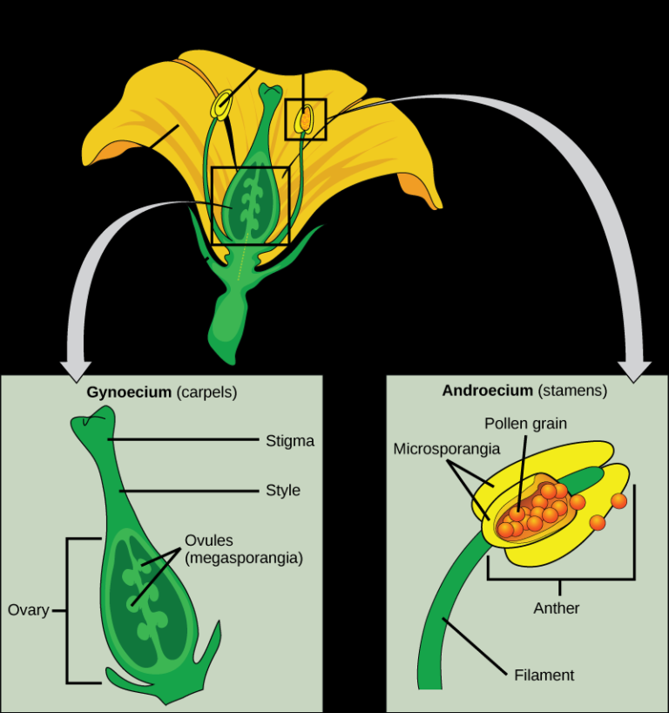

Slide 12
THANKING YOU
ODM EDUCATIONAL GROUP

