Slide 1


MUGHAL EMPIRE
BABUR ( 1526-1530 CE)
SUBJECT : HISTORY
CHAPTER NUMBER:4
CHAPTER NAME :MUGHAL EMPIRE

Slide 2
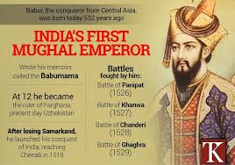
MUGHAL EMPIRE
Babur ( 1526- 1530 CE
Babur (1526-1530)
Babur is the founder of the Mughal Empire in India.

Slide 3
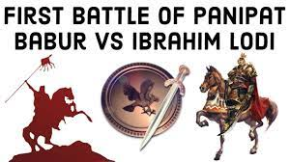
MUGHAL EMPIRE
Babur (1526-1530 CE)
He was a descendant of Timur (on his father’s side) and Genghis Khan (on his Mother’s side).
His original name was Zahiruddin Muhammad.
In 1494 at the age of 11, Babur became the ruler of Farghana (at present in Chinese Turkistan) succeeding Umar Shaikh Mirza, his father.
Daulat Khan, the most powerful noble of Punjab, who was discontented with Ibrahim Lodhi, invited Babur to invade India.

Slide 4
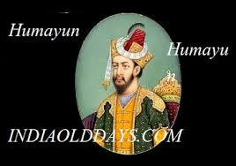
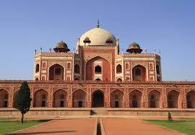
MUGHAL EMPIRE
Humayun(1530-1540 CE)
Humayun was the eldest son of Babur.
In 1540, in the Battle of Bilgram or Ganges also known as Battle of Kanauj, Humayun was forced to fight with Sher Khan alone and after losing his kingdom, Humayun became an exile for the next fifteen years.

Slide 5
THANKING YOU
ODM EDUCATIONAL GROUP

