Slide 1

WELCOME TO ONLINE CLASS
CLASS-UKG
SUBJECT-MATHS
TOPIC- BIGGEST NUMBER
& BIG TO SMALL
( NOTEBOOK WORK)

Slide 2
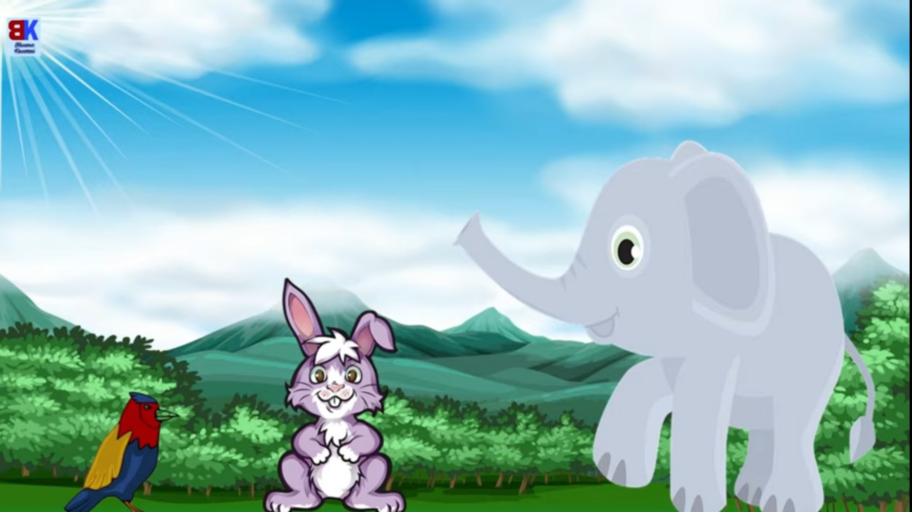

B
I
G
G
E
S
T
IDENTIFY THE BIGGEST ANIMAL

Slide 3
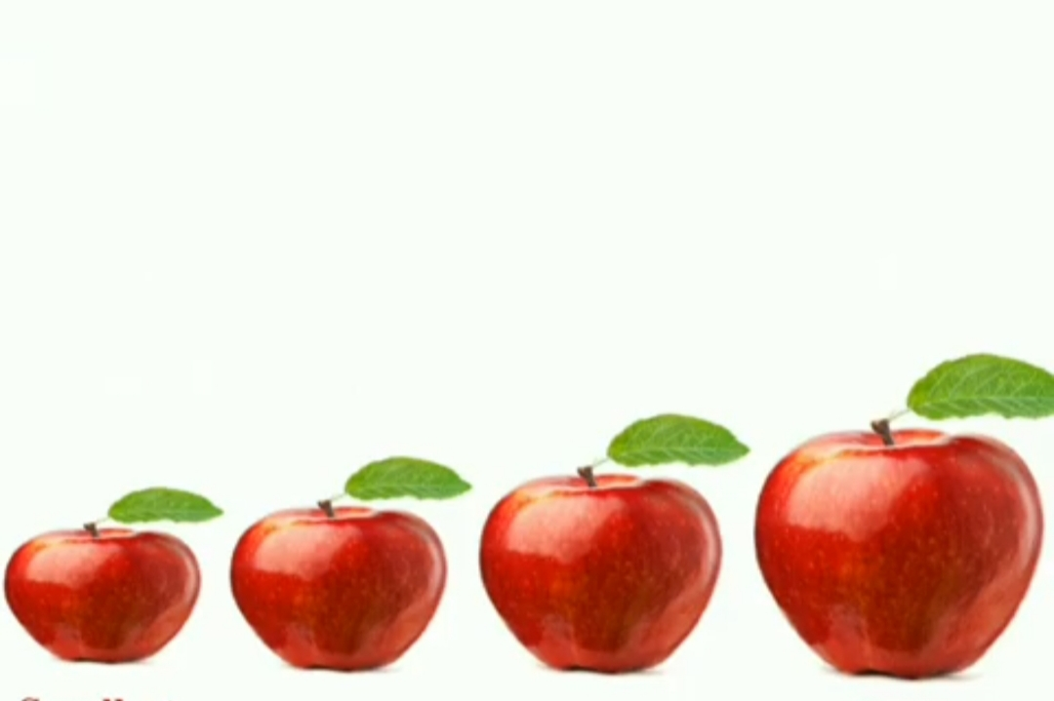
ARRANGE THE APPLES FROM BIG TO SMALL
D
D
C
C
A
B
B
A

Slide 4
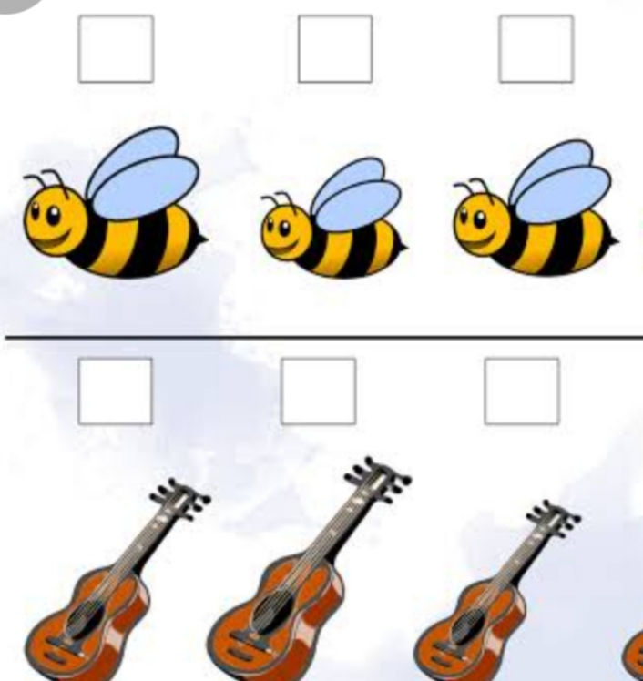
NUMBER THEM FROM BIG TO SMALL
1
3
2
2
1
3

Slide 5

TODAY’S TOPIC
BIGGEST NUMBER &
ARRANGING NUMBERS FROM BIG TO SMALL

Slide 6
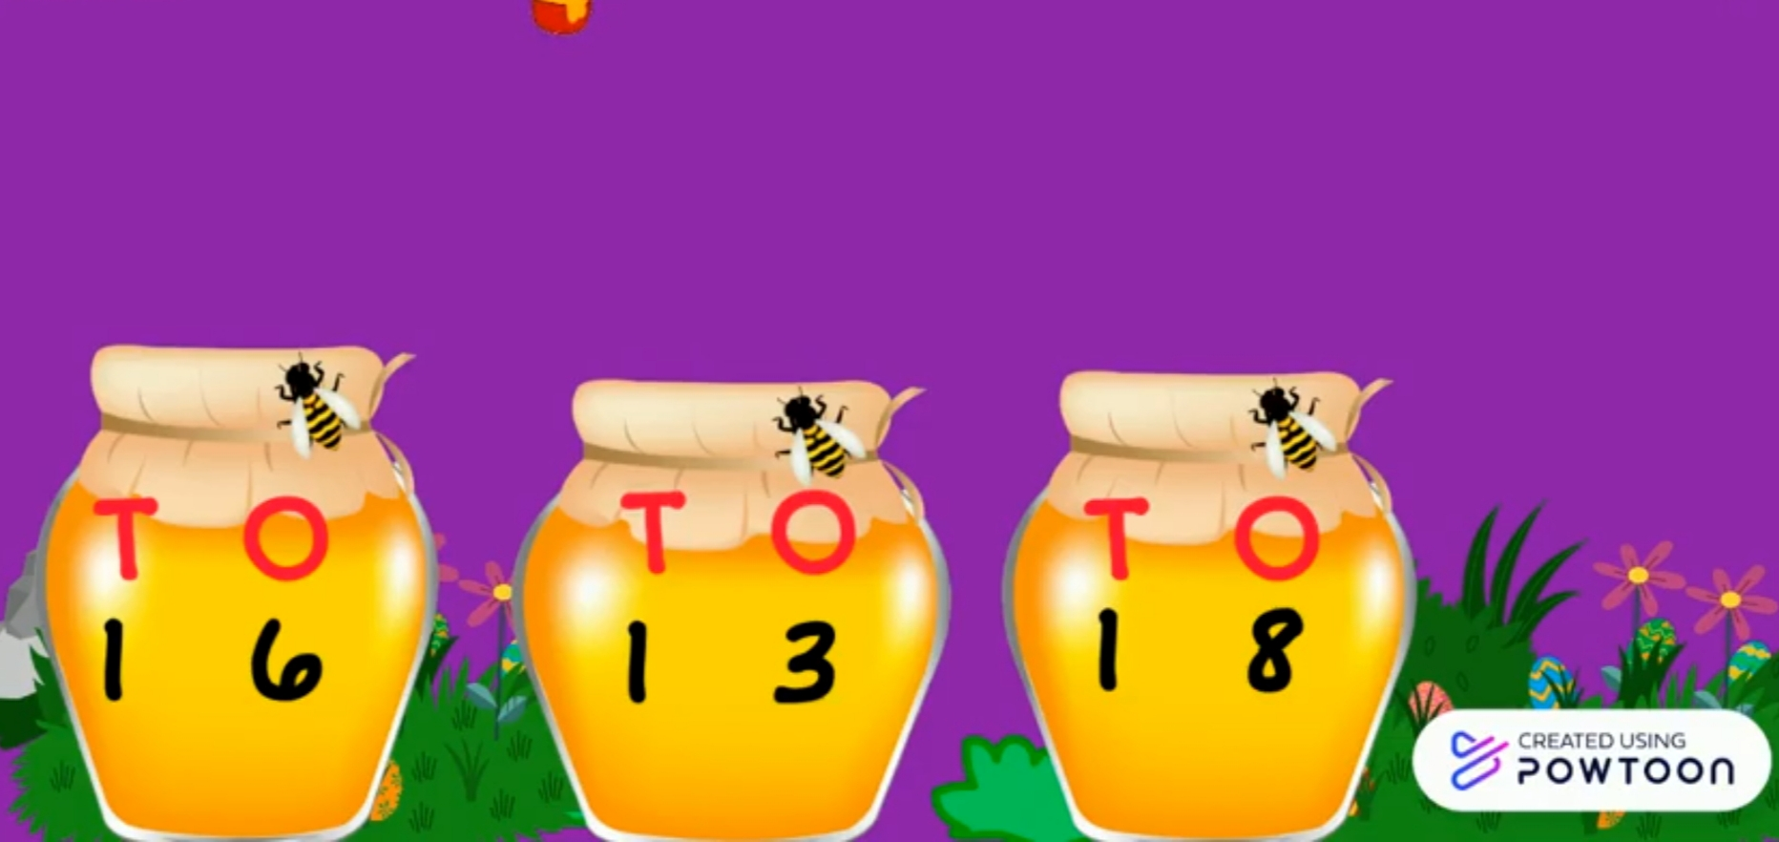
CIRCLE THE TOFFEE JAR HAVING MORE TOFFEES
BIGGEST NUMBER

Slide 7
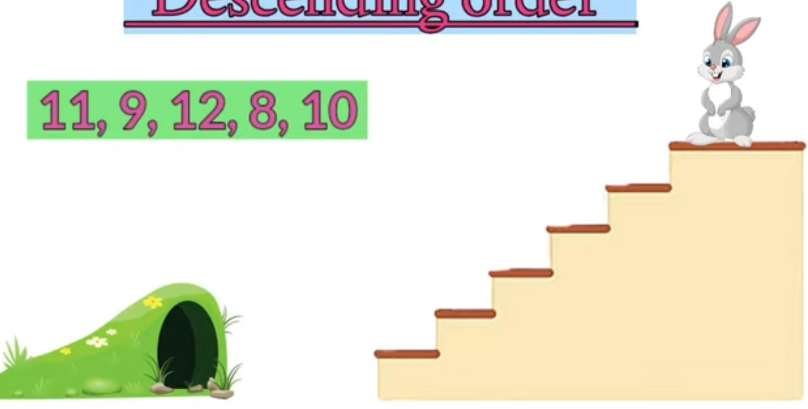
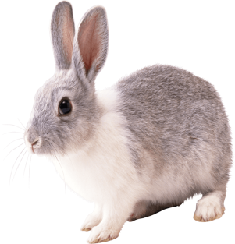
Arrange the numbers from big to small and help the bunny to reach in his house.
12
11
10
9
8

Slide 8
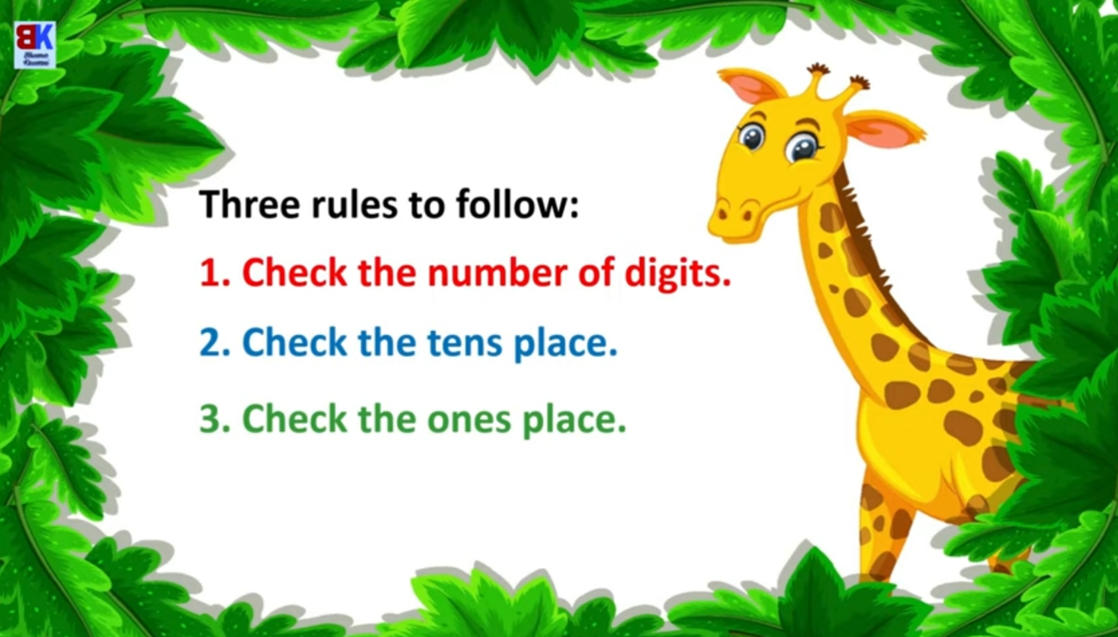
Let’s know rules for arranging numbers from big to small.

Slide 9
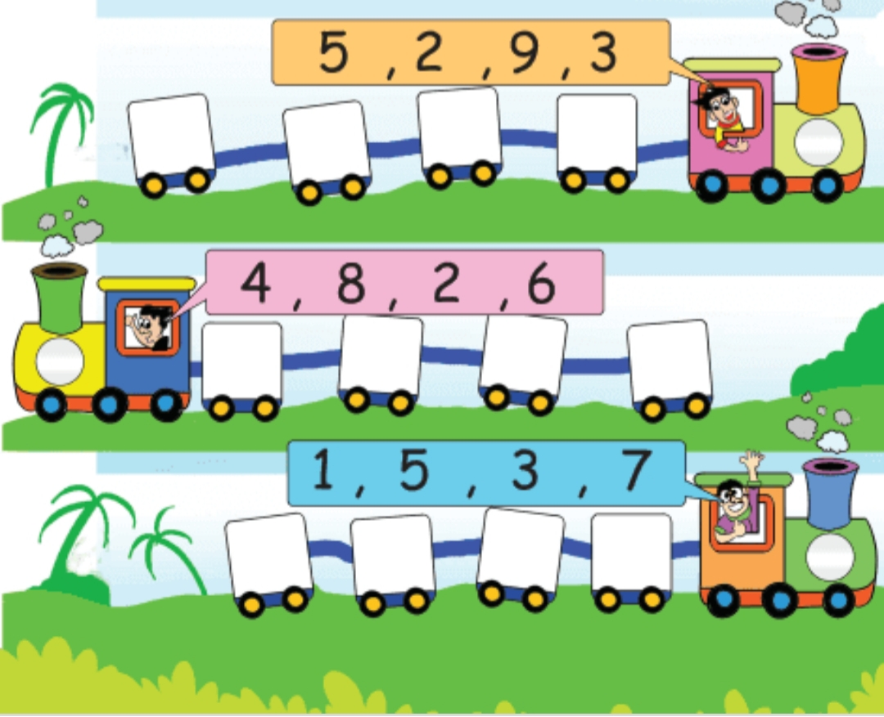
LET’S ARRANGE FROM BIG TO SMALL
53,
55,
52,
54
55
54
53
52
18,
16,
19,
17
19
18
17
16
68,
71,
69,
70
71
70
69
68

Slide 10
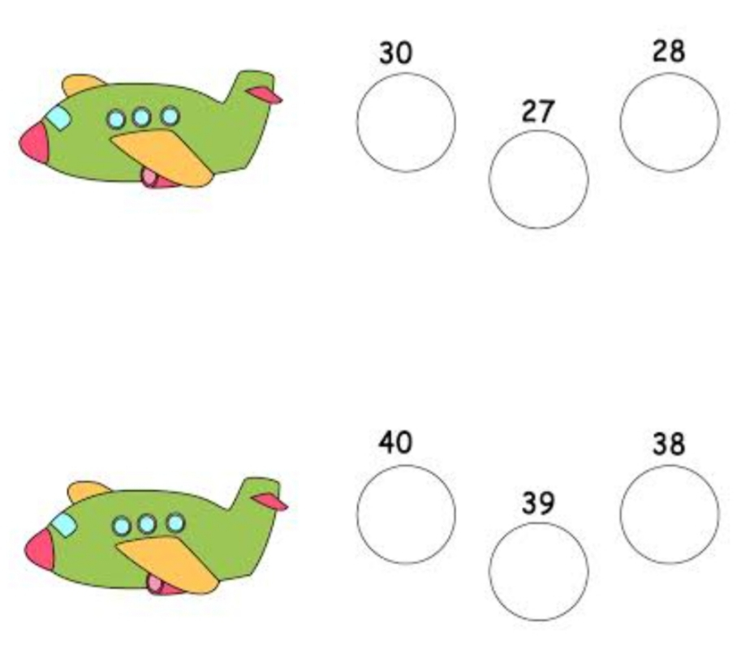
30
27
28
40
38
39

Slide 11
cw
16.9.21
FIND AND WRITE THE BIGGEST NUMBER
25, 36, 18
74, 86, 51
97, 66, 78
34, 72, 43
85, 50, 90

Slide 12
WRITE NUMBERS FROM BIG TO SMALL
HW
16.9.21
34
65
28
77
83
20
18
46
90
52
37
89

Slide 13

THANKING YOU
ODM EDUCATIONAL GROUP

