Slide 1


CLASS : UKG
SUBJECT :MATHS
CHAPTER :21
TOPIC :MONEY
SUB TOPIC :BOOK PAGE(151 TO 152)

Slide 2



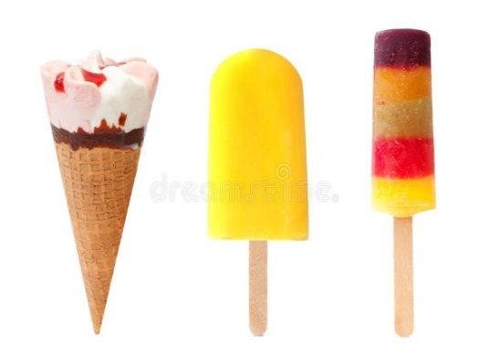
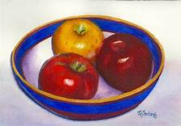

RECAP-
A paise or rupee are unit of measurement of money in India.
The symbol of rupee is -
We use money in term of coins and notes to purchase different things-

Slide 3
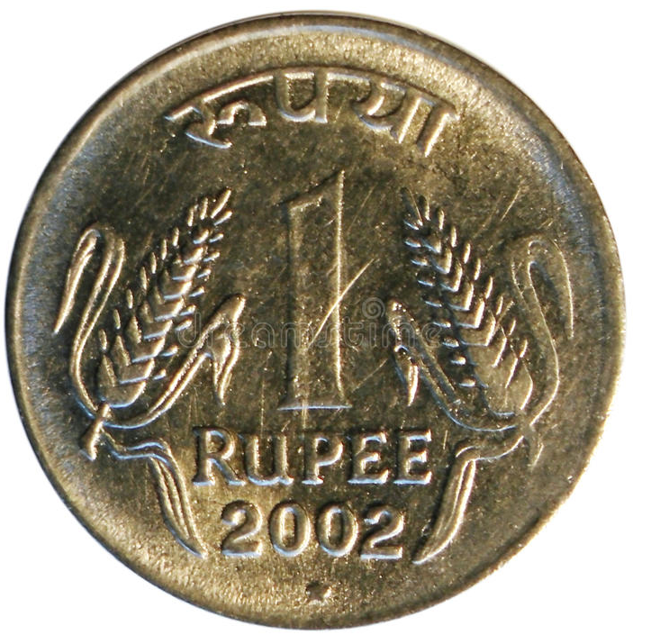
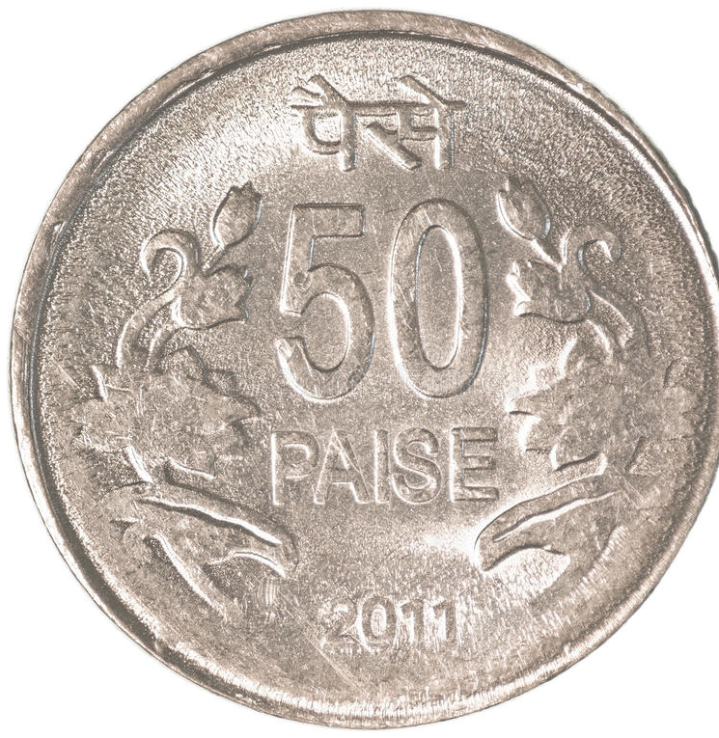
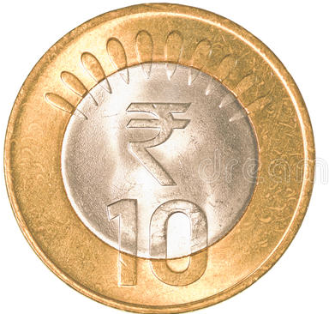
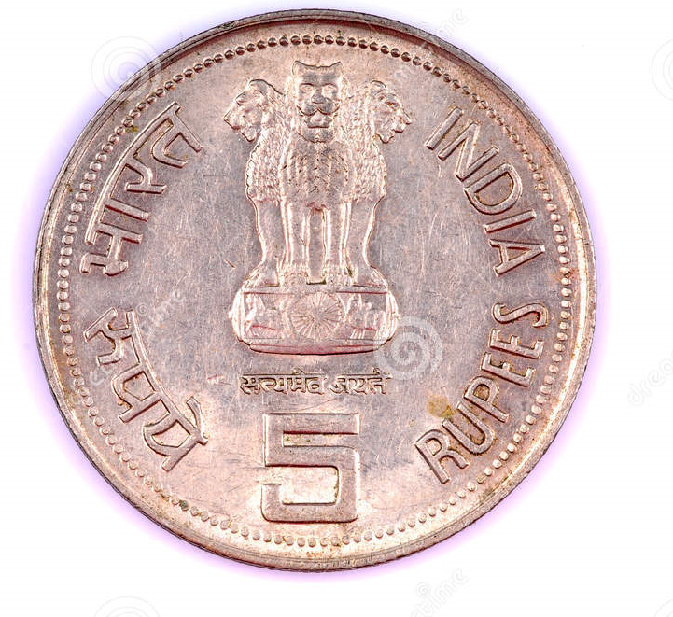
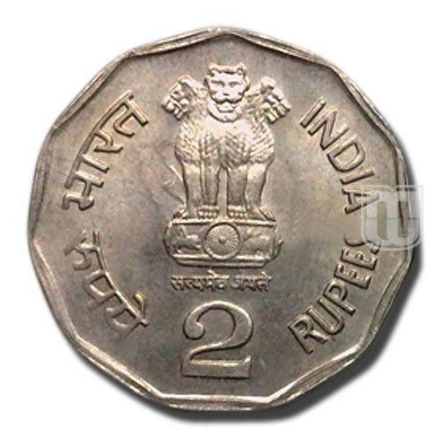
IDENTIFY THE COINS
1 RUPEE
50 PAISE
10 RUPEES
5 RUPEES
2 RUPEES

Slide 4
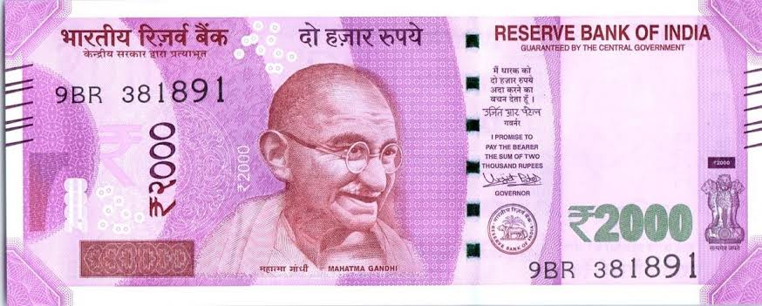
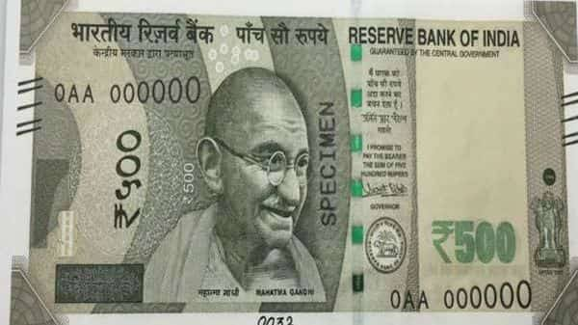
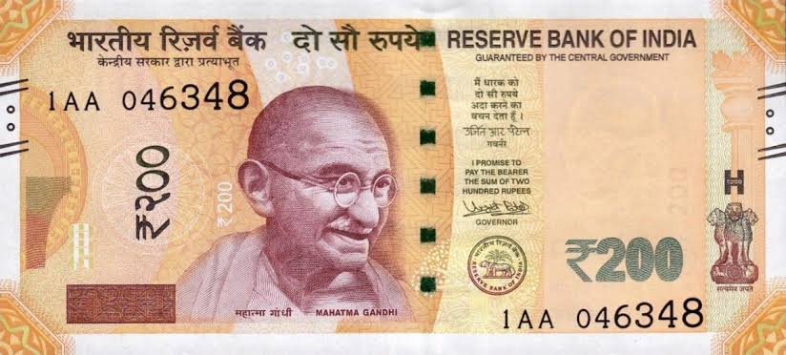
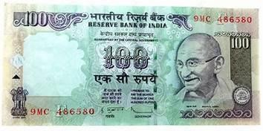
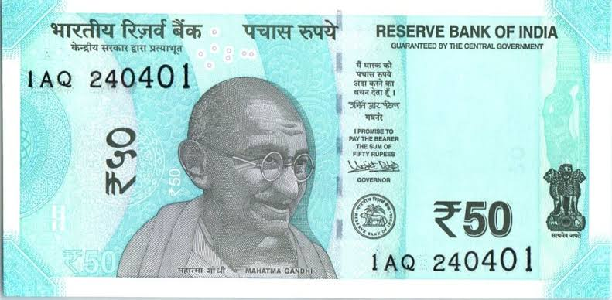
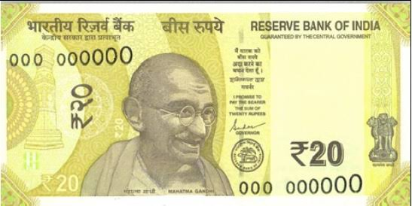
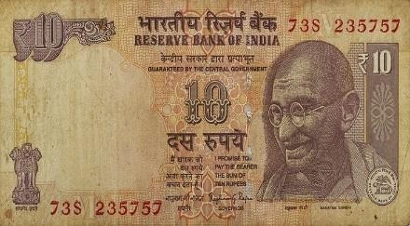
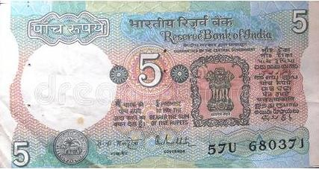
IDENTIFY THE NOTES
2000 rupees
500 rupees
200 rupees
100 rupees
50 rupees
20 rupees
10 rupees
5 rupees

Slide 5






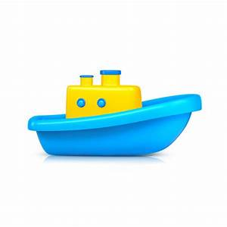
Look at the picture:
30
70
100
60
50
200
How much do these cost ?
30
60
100
200
50
70

Slide 6
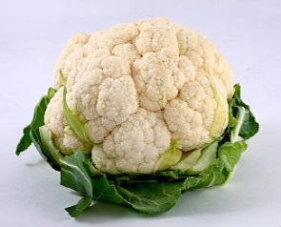
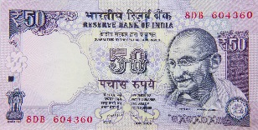


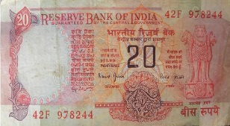

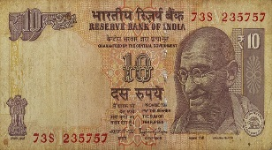


Match the price with the correct money.
20
a.
10
b.
100
c.
50
d.

Slide 7

Let’s write in bk pg no-151

Slide 8
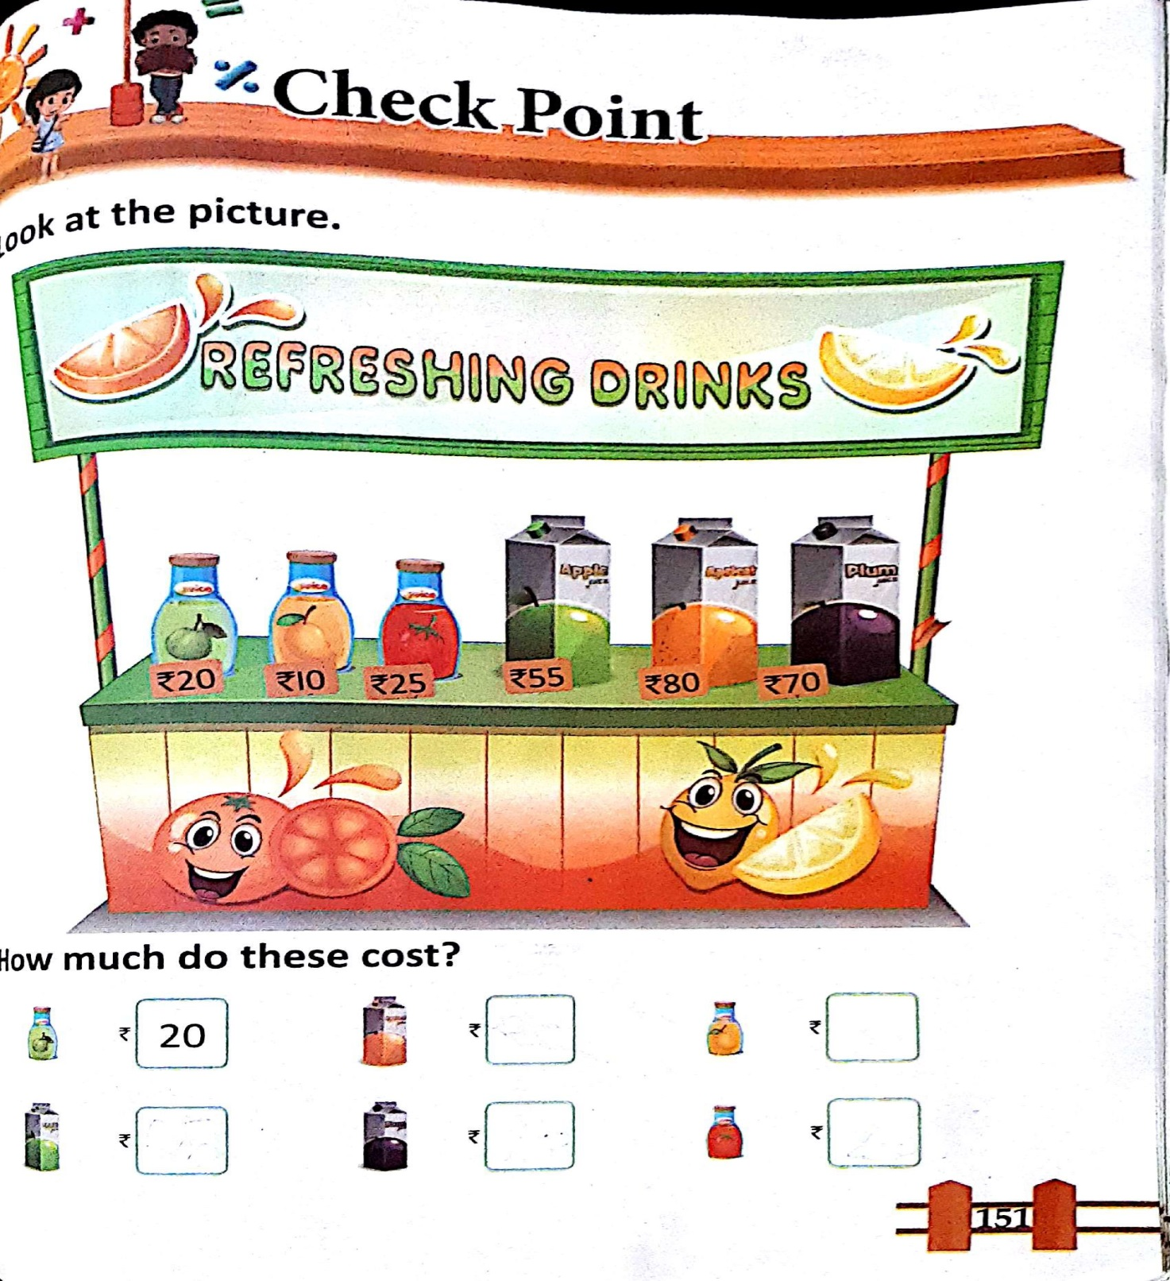
C.W
05/01/22

Slide 9
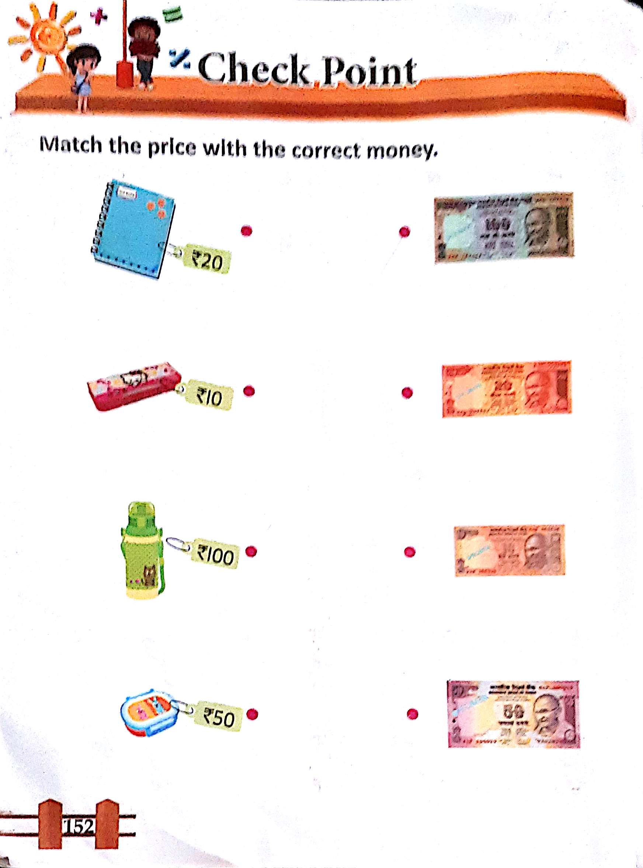
H.W
05/01/22

Slide 10
THANKING YOU
ODM EDUCATIONAL GROUP

