Slide 1

WELCOME TO THE ON LINE CLASS
CLASS-UKG
SUBJECT-MATHS
TOPIC-BEFORE,AFTER AND
BETWEEN NUMBER
(NOTE BOOK WORK)

Slide 2
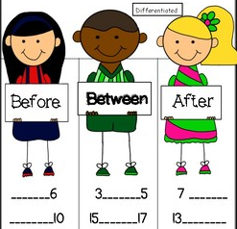
BEFORE, BETWEEN AND AFTER NUMBERS-
5
6
23
24
25
49
50
19
20
37
38
39
36
37

Slide 3

WHAT COMES BEFORE-
19
20
33
34
47
48

Slide 4

WHAT COMES AFTER-
28
29
44
45
37
38

Slide 5


CIRCLE THE AFTER NUMBER-
29
30
35 30 45
34
30
34 12 22
33
48
30
33 19 48
47
40
30
40 30 50
39

Slide 6
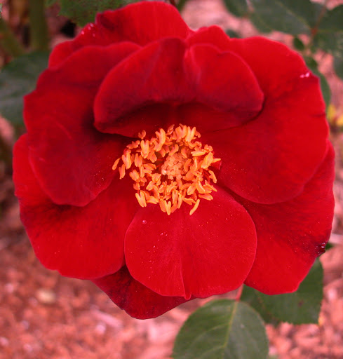
WHAT COMES IN BETWEEN-
45
30
44
29
31
46
33
32
34

Slide 7

SAY THE BETWEEN NUMBER-
40
21
20
39
41
22
49
18
48
50
17
19

Slide 8
WHAT COMES BEFORE ?
CW
5/8/21
___ - 25
___ - 30
___ - 45
WHAT COMES AFTER ?
34 - ____
29 - ____
40 - ____
WHAT COMES IN BETWEEN ?
39 ____ 41
23 ____ 25
47 ____ 49

Slide 9
HW
5/8/21
FILL IN THE BLANKS AND MATCH
35 ____
45
30
40
22
36
____ 46
29 ____
39 ____ 41
21 ____

Slide 10

THANKING YOU
ODM EDUCATIONAL GROUP

