Slide 1


Potentiometer-Principle and its applications to measure P.D and for comparing EMF of two cells
CLASS-XII
SUBJECT : PHYSICS
CHAPTER NUMBER: 03
CHAPTER NAME : CURRENT ELECTRICITY

Slide 2
Potentiometer:
I
+
Principle:
V = I R
= I ρl/A
If the constant current flows through the potentiometer wire of uniform cross sectional area (A) and uniform composition of material (ρ), then
V = Kl or V α l
V
E
A
0
l cm
J
100
A
200
+
300
Rh
B
400
K
V /l is a constant.
The potential difference across any length of a wire of uniform cross-section and uniform composition is proportional to its length when a constant current flows through it.
V
0
l

Slide 3
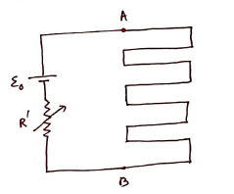

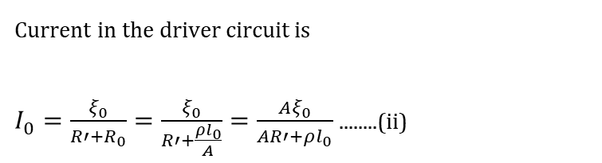

The expression for potential drop per unit length :
It contains a long wire AB of length ($l_{0}$) and uniform cross-section of area A connected across a cell called as driver cell of emf $\left(ξ_{0}\right)$and a variable resistor of resistance R
So the resistance of potentiometer wire is
$R_{0}=ρ\frac{l_{0}}{A}$
Where $ρ$ = resistivity of potentiometer wire
Current in the driver circuit is
$I_{0}=\frac{ξ_{0}}{R′+R_{0}}=\frac{ξ_{0}}{R′+\frac{ρl_{0}}{A}}=\frac{Aξ_{0}}{AR′+ρl_{0}}$ ........(ii)
The potential difference across potentiometer wire is $V_{0}=I_{0}R_{0}$
So potential drop per unit length is K $=\frac{V_{0}}{l_{0}}=\frac{I_{0}R_{0}}{l_{0}}=\frac{I_{0}ρ}{A}$ ( Using equation (i)) ...(iii)

Slide 4
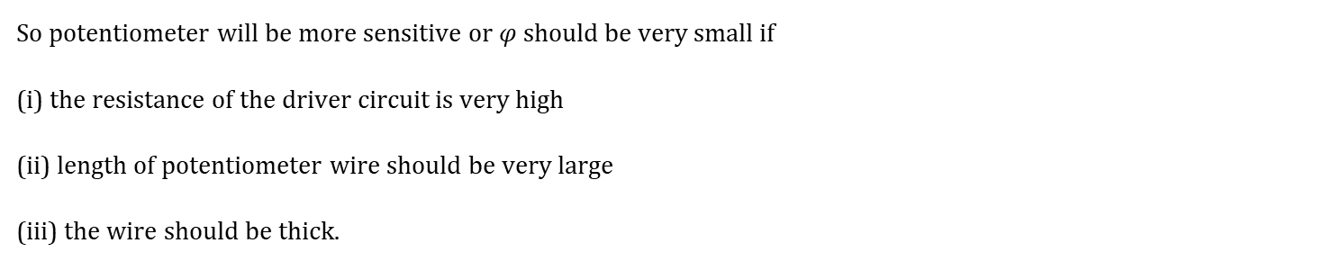
Sensitivity:
It is a measure of how small voltage be measured by the potentiometer . For this $K$ should be very small
As $K$ =$\frac{I_{0}ρ}{A}$ =$\frac{Aξ_{0}}{AR′+ρl_{0}}\frac{ρ}{A}$=$\frac{ρξ_{0}}{AR′+ρl_{0}}$ ( Using equation (ii))
So potentiometer will be more sensitive or $φ$ should be very small if
(i) the resistance of the driver circuit is very high
(ii) length of potentiometer wire should be very large
(iii) the wire should be thick.
The advantage of the potentiometer in comparison to a voltmeter is that potentiometer doesn’t draw any current from the element where the voltmeter draws. So potentiometer measures the exact voltage of the element where the voltmeter measures smaller voltage.

Slide 5
Comparison of emf’s using Potentiometer:
E₁
I
+
R.B
G
The balance point is obtained for the cell when the potential at a point on the potentiometer wire is equal and opposite to the emf of the cell.
+
E₂
E
A
0
l₂
J₂
100
A
200
l₁
J₁
+
Rh
300
E₁ = V_{AJ1} = I ρl₁ /A
E₂ = V_{AJ2} = I ρl₂ /A
B
400
K
E₁ / E₂ = l₁ /l₂
Note:
The balance point will not be obtained on the potentiometer wire if the fall of potential along the potentiometer wire is less than the emf of the cell to be measured.
The working of the potentiometer is based on null deflection method. So the resistance of the wire becomes infinite. Thus potentiometer can be regarded as an ideal voltmeter.

Slide 6
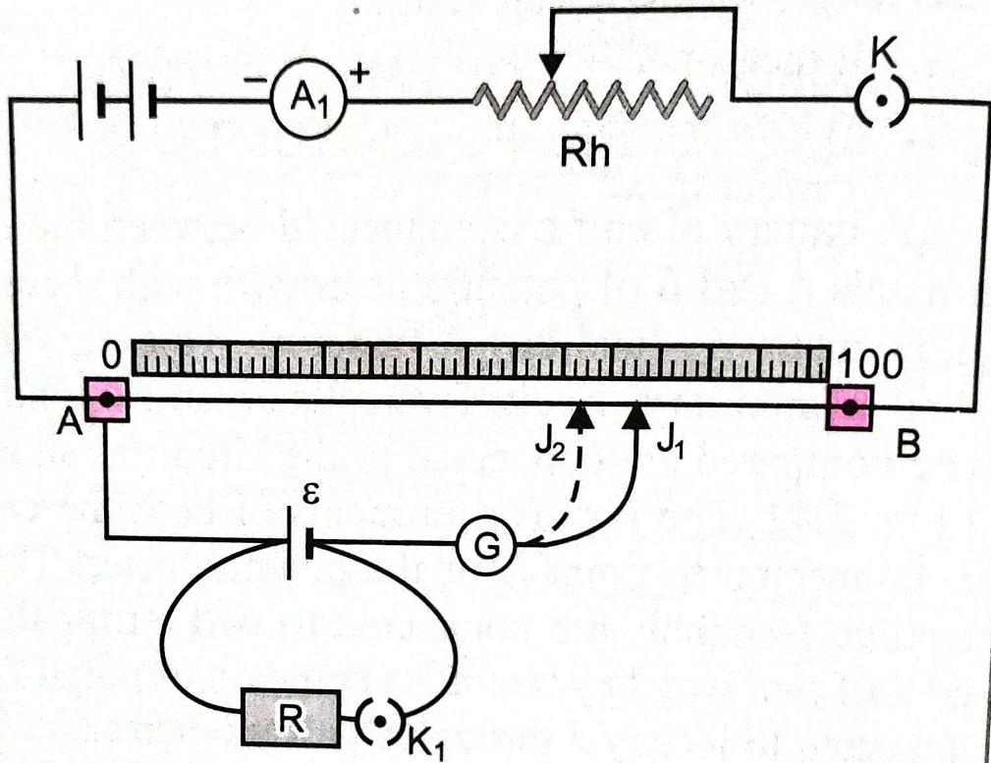
Determination of internal resistance of a cell

Slide 7
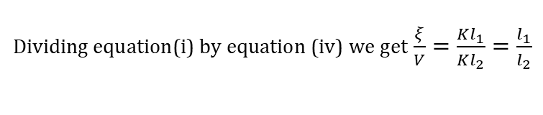

Determination of internal resistance of a cell
When switch K2 is open there is no current in the second circuit at the null point position.
If null point length at this condition is $l_{1}$ ,
then $ξ=Kl_{1}$ ..........(i)
When switch K2 is closed there is a current I through the second circuit.
So potential difference across the cell is
$V=IR=ξ−Ir$ .......(ii)
$⇒ξ=I(R+r)$ .........(iii)
Now null point distance is $l_{2}$. So $V=Kl_{2}$
Dividing equation(i) by equation (iv) we get $\frac{ξ}{V}=\frac{Kl_{1}}{Kl_{2}}=\frac{l_{1}}{l_{2}}$
Now using equations (ii) and (iii)
$\frac{I(R+r)}{IR}=\frac{l_{1}}{l_{2}}$
$⇒\frac{R+r}{R}=\frac{l_{1}}{l_{2}}⇒R+r=\frac{l_{1}}{l_{2}}R⇒r=\frac{l_{1}}{l_{2}}R−R=R\left(\frac{l_{1}}{l_{2}}−1\right)$ r is the internal resistance of the cell and R is the resistance connected across the cell

Slide 8
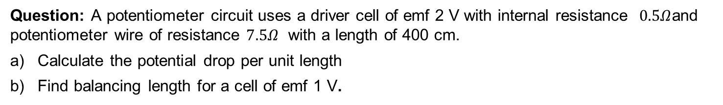
Numerical
Question: A potentiometer circuit uses a driver cell of emf 2 V with internal resistance $0.5Ω$and potentiometer wire of resistance $7.5Ω$ with a length of 400 cm.
Calculate the potential drop per unit length
Find balancing length for a cell of emf 1 V.

Slide 9
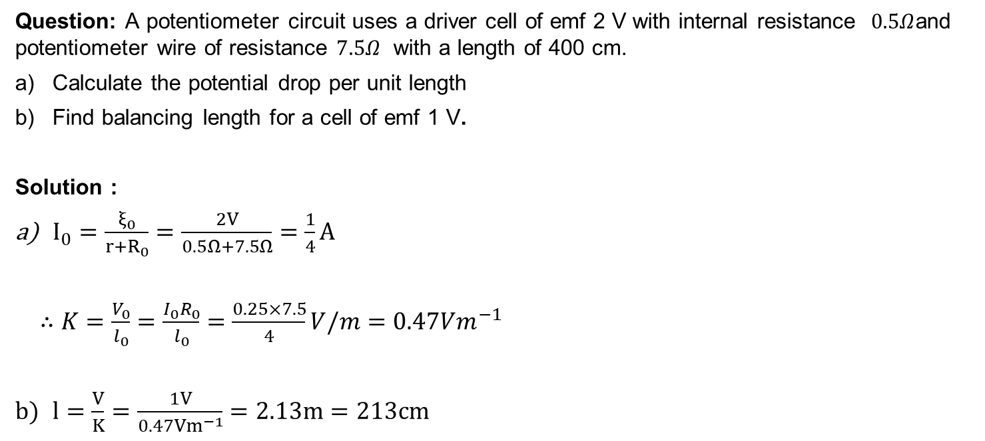
Numerical
Question: A potentiometer circuit uses a driver cell of emf 2 V with internal resistance $0.5Ω$and potentiometer wire of resistance $7.5Ω$ with a length of 400 cm.
Calculate the potential drop per unit length
Find balancing length for a cell of emf 1 V.
Solution :
$I_{0}=\frac{ξ_{0}}{r+R_{0}}=\frac{2V}{0.5Ω+7.5Ω}=\frac{1}{4}A$
$∴K=\frac{V_{0}}{l_{0}}=\frac{I_{0}R_{0}}{l_{0}}=\frac{0.25×7.5}{4}V/m=0.47Vm^{−1}$
$l=\frac{V}{K}=\frac{1V}{0.47Vm^{−1}}=2.13m=213cm$

Slide 10
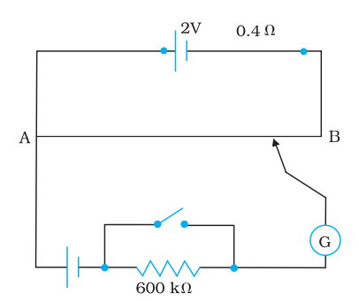
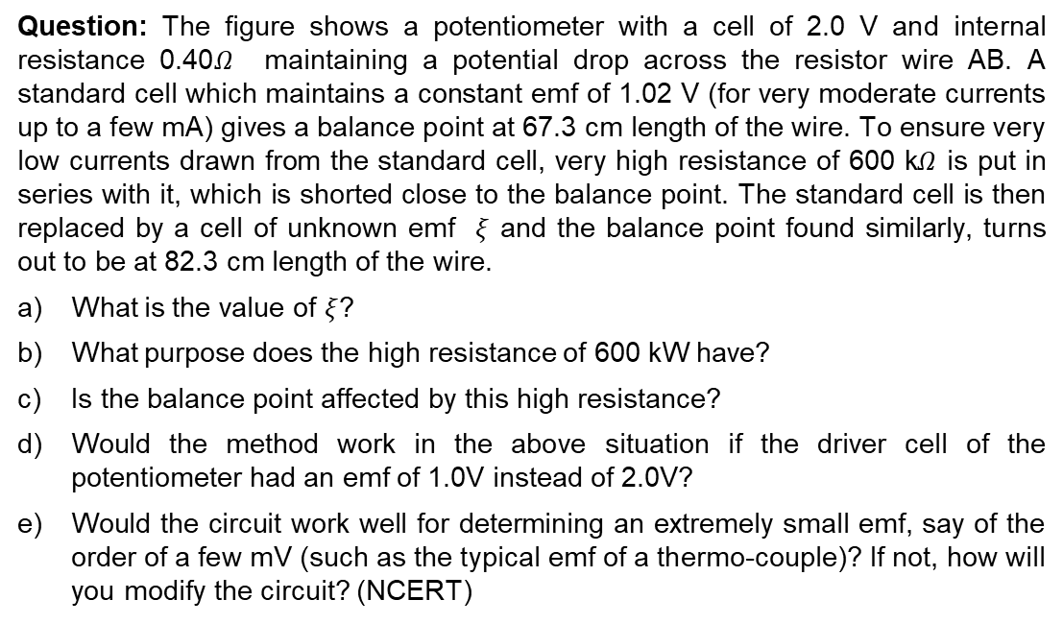
Numerical
Question: The figure shows a potentiometer with a cell of 2.0 V and internal resistance 0.40$Ω$ maintaining a potential drop across the resistor wire AB. A standard cell which maintains a constant emf of 1.02 V (for very moderate currents up to a few mA) gives a balance point at 67.3 cm length of the wire. To ensure very low currents drawn from the standard cell, very high resistance of 600 k$Ω$ is put in series with it, which is shorted close to the balance point. The standard cell is then replaced by a cell of unknown emf $ξ$ and the balance point found similarly, turns out to be at 82.3 cm length of the wire.
What is the value of $ξ$?
What purpose does the high resistance of 600 kW have?
Is the balance point affected by this high resistance?
Would the method work in the above situation if the driver cell of the potentiometer had an emf of 1.0V instead of 2.0V?
Would the circuit work well for determining an extremely small emf, say of the order of a few mV (such as the typical emf of a thermo-couple)? If not, how will you modify the circuit? (NCERT)

Slide 11
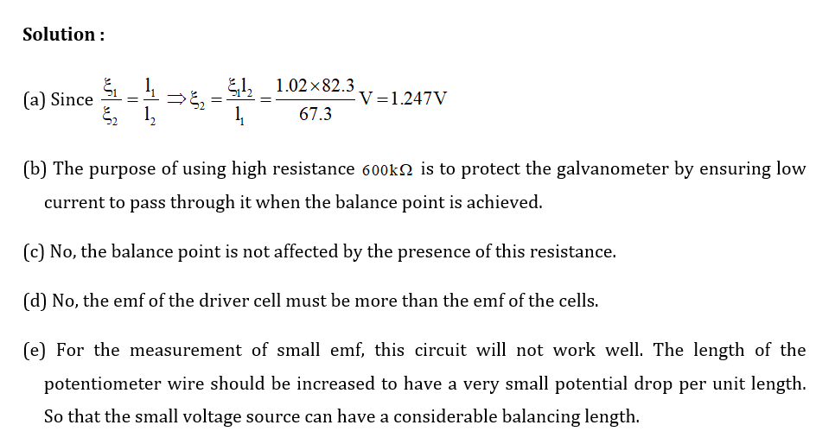
Numerical

Slide 12
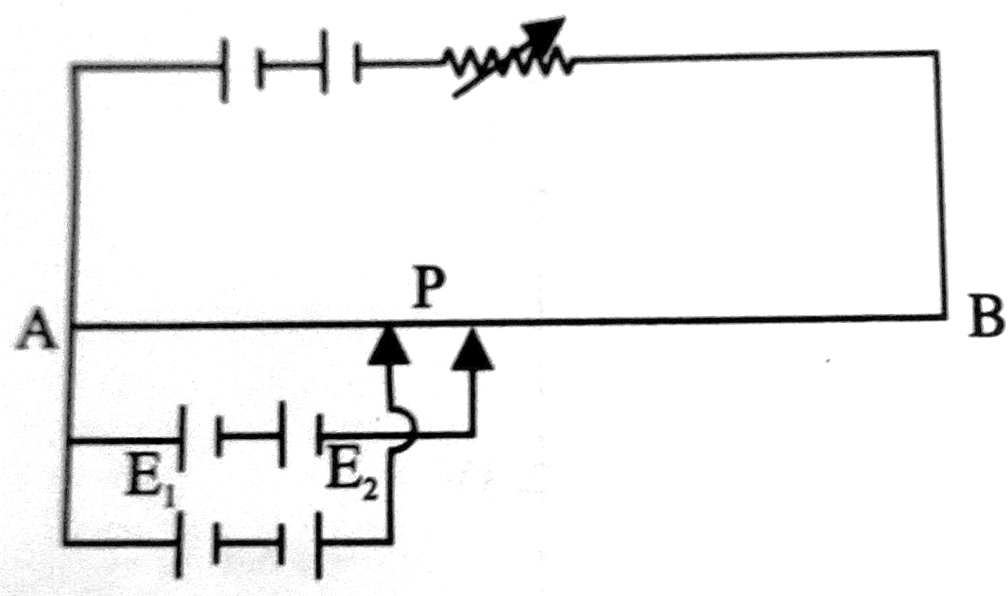
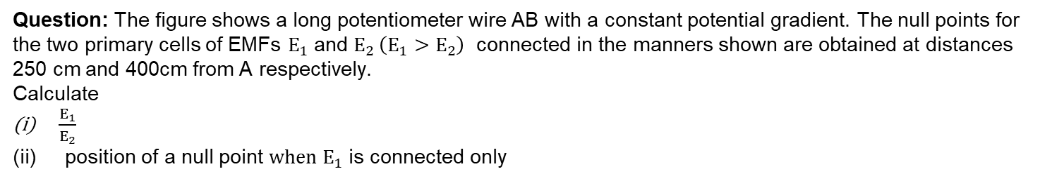
Numerical
Question: The figure shows a long potentiometer wire AB with a constant potential gradient. The null points for the two primary cells of EMFs $E_{1}$ and $E_{2} \left(E_{1}>E_{2}\right)$ connected in the manners shown are obtained at distances 250 cm and 400cm from A respectively.
Calculate
$\frac{E_{1}}{E_{2}}$
position of a null point ${when E}_{1}$ is connected only

Slide 13
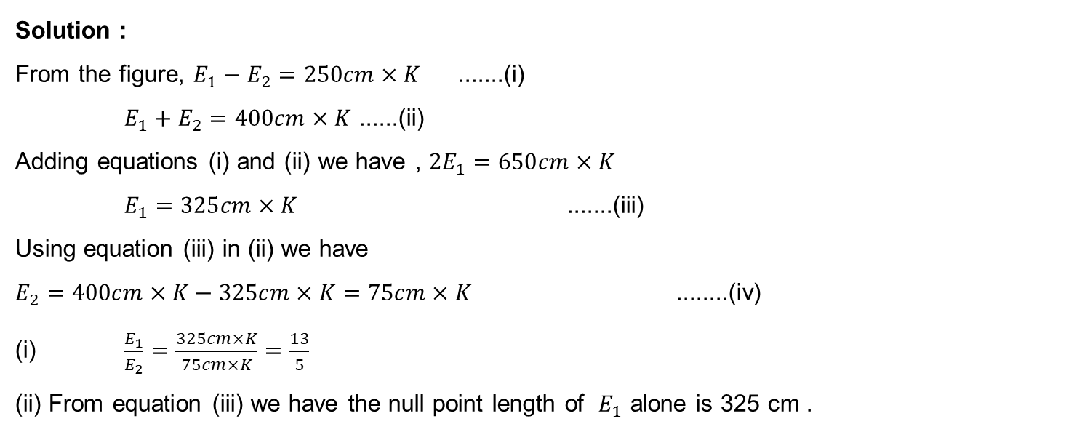
Numerical
Solution :
From the figure, $E_{1}−E_{2}=250cm×K$ .......(i)
$E_{1}+E_{2}=400cm×K$ ......(ii)
Adding equations (i) and (ii) we have , $2E_{1}=650cm×K$
$E_{1}=325cm×K$ .......(iii)
Using equation (iii) in (ii) we have
$E_{2}=400cm×K−325cm×K=75cm×K$ ........(iv)
(i) $\frac{E_{1}}{E_{2}}=\frac{325cm×K}{75cm×K}=\frac{13}{5}$
(ii) From equation (iii) we have the null point length of $E_{1}$ alone is 325 cm .

Slide 14
THANKING YOU
ODM EDUCATIONAL GROUP

