Slide 1


Meter Bridge
CLASS-XII
SUBJECT : PHYSICS
CHAPTER NUMBER: 03
CHAPTER NAME : CURRENT ELECTRICITY

Slide 2
Metre Bridge:
R.B (R)
X
Metre Bridge is based on the principle of Wheatstone Bridge.
G
When the galvanometer current is made zero by adjusting the jockey position on the metre-bridge wire for the given values of known and unknown resistances,
A
B
l cm
J
100 - l cm
K
E
R R_{AJ}
X R_{JB}
R AJ
X JB
R l
X 100 - l
(Since, Resistance α length)
Therefore, X = R (100 – l) ∕ l

Slide 3
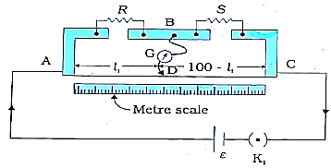
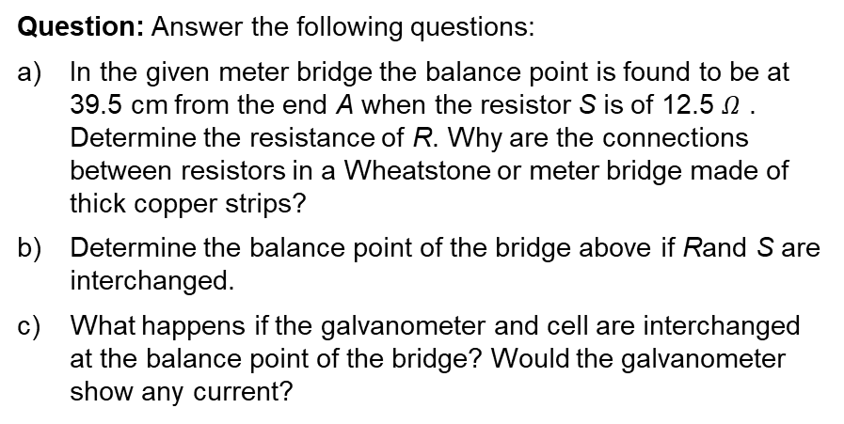
Numerical
Question: Answer the following questions:
In the given meter bridge the balance point is found to be at 39.5 cm from the end A when the resistor S is of 12.5 $Ω$ . Determine the resistance of R. Why are the connections between resistors in a Wheatstone or meter bridge made of thick copper strips?
Determine the balance point of the bridge above if Rand S are interchanged.
What happens if the galvanometer and cell are interchanged at the balance point of the bridge? Would the galvanometer show any current?

Slide 4
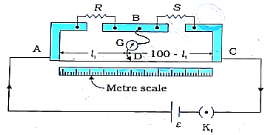
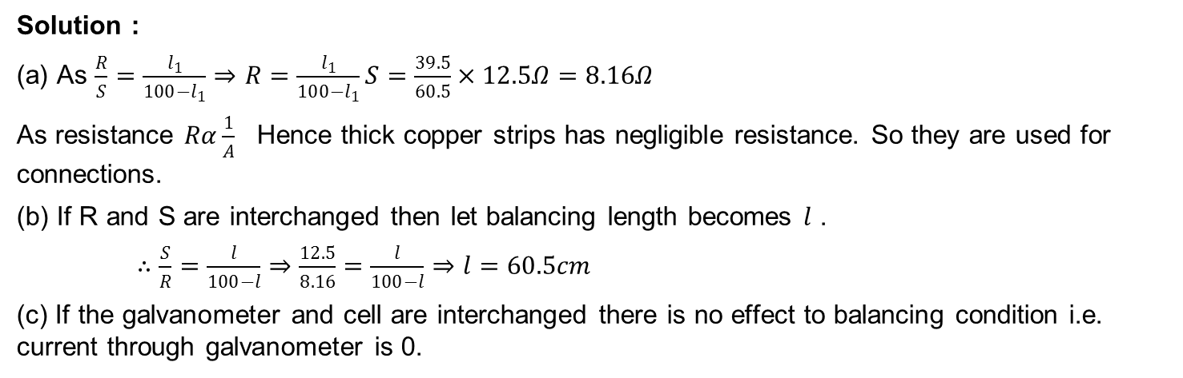
Numerical
Solution :
(a) As $\frac{R}{S}=\frac{l_{1}}{100−l_{1}}⇒R=\frac{l_{1}}{100−l_{1}}S=\frac{39.5}{60.5}×12.5Ω=8.16Ω$
As resistance $Rα\frac{1}{A}$ Hence thick copper strips has negligible resistance. So they are used for connections.
(b) If R and S are interchanged then let balancing length becomes $l$ .
$∴\frac{S}{R}=\frac{l}{100−l}⇒\frac{12.5}{8.16}=\frac{l}{100−l}⇒l=60.5cm$
(c) If the galvanometer and cell are interchanged there is no effect to balancing condition i.e. current through galvanometer is 0.

Slide 5
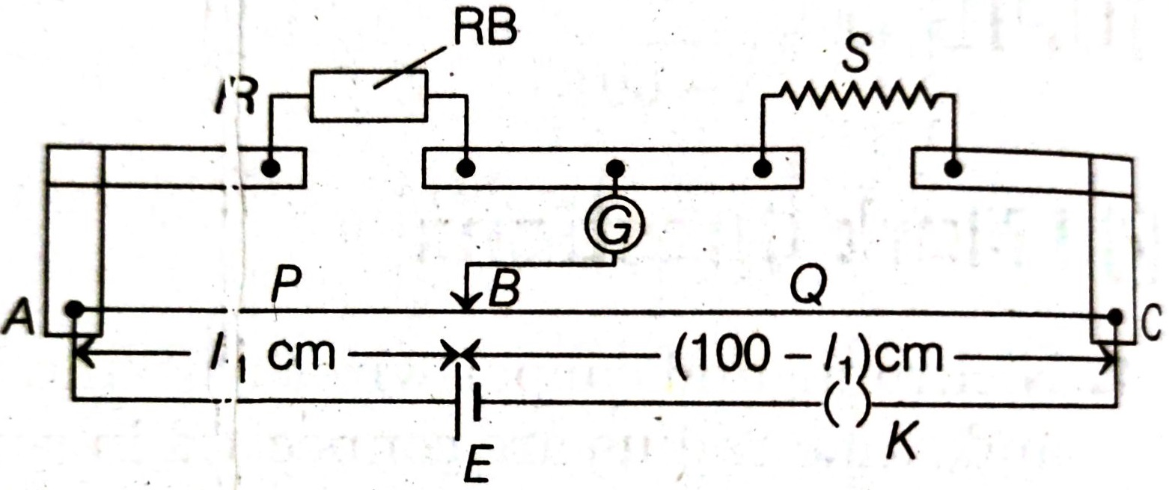
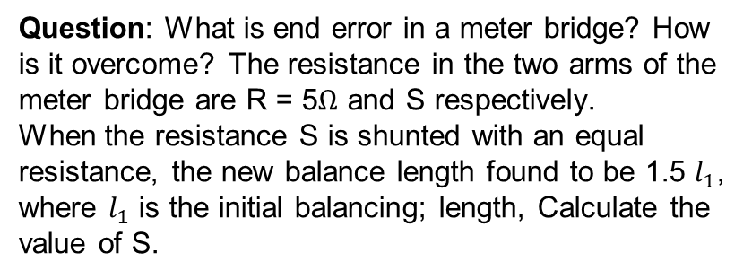
Home Assignment
Question: What is end error in a meter bridge? How is it overcome? The resistance in the two arms of the meter bridge are R = 5$Ω$ and S respectively.
When the resistance S is shunted with an equal resistance, the new balance length found to be 1.5 $l_{1}$, where $l_{1}$ is the initial balancing; length, Calculate the value of S.

Slide 6
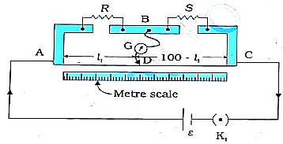
HOME ASSIGNMENT
Question: (a) In the given meter bridge the balance point is found to be at $l_{1}$from the end A. When a resistance X is connected in parallel with S the balance point is found to be at $l_{2}$ from the end A. Obtain an expression for S in term of X, $l_{1}$,$l_{2}$
Question: Answer the following
Why are the connections between the resistor in a meter bridge made of thick copper strips?
Why is it generally preferred to obtain the balance point in the middle of the meter bridge wire?
Which material is used for the meter bridge wire and why?

Slide 7
Potentiometer-Principle and its applications to measure P.D and for comparing EMF of two cells
CLASS-XII
SUBJECT : PHYSICS
CHAPTER NUMBER: 03
CHAPTER NAME : CURRENT ELECTRICITY

Slide 8
I
POTENTIOMETER
+
Principle:
V = I R
= I ρl/A
If the constant current flows through the potentiometer wire of uniform cross sectional area (A) and uniform composition of material (ρ), then
V = Kl or V α l
V
E
A
0
l cm
J
100
A
200
+
300
Rh
B
400
K
V /l is a constant.
The potential difference across any length of a wire of uniform cross-section and uniform composition is proportional to its length when a constant current flows through it.
V
0
l

Slide 9
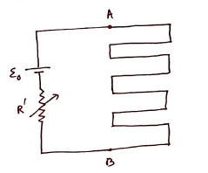

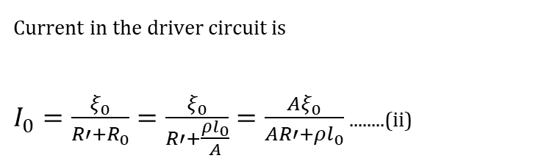

The expression for potential drop per unit length :
It contains a long wire AB of length ($l_{0}$) and uniform cross-section of area A connected across a cell called as driver cell of emf $\left(ξ_{0}\right)$and a variable resistor of resistance $R′$
So the resistance of potentiometer wire is
$R_{0}=ρ\frac{l_{0}}{A}$
Where $ρ$ = resistivity of potentiometer wire
Current in the driver circuit is
$I_{0}=\frac{ξ_{0}}{R′+R_{0}}=\frac{ξ_{0}}{R′+\frac{ρl_{0}}{A}}=\frac{Aξ_{0}}{AR′+ρl_{0}}$ ........(ii)
The potential difference across potentiometer wire is $V_{0}=I_{0}R_{0}$
So potential drop per unit length is K $=\frac{V_{0}}{l_{0}}=\frac{I_{0}R_{0}}{l_{0}}=\frac{I_{0}ρ}{A}$ ( Using equation (i)) ...(iii)

Slide 10
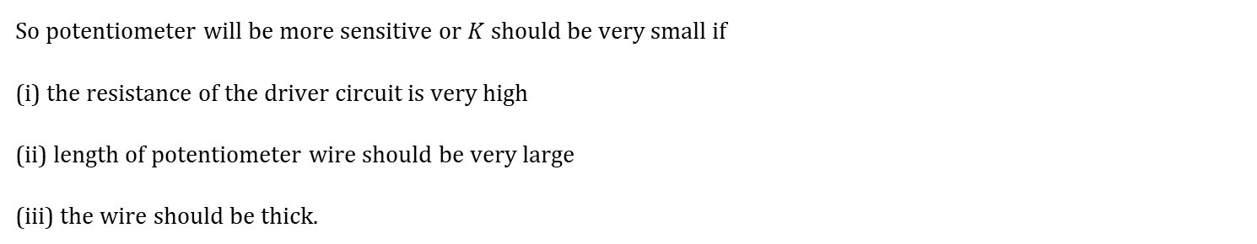

Sensitivity:
It is a measure of how small voltage be measured by the potentiometer . For this $K$ should be very small
As $K$ =$\frac{I_{0}ρ}{A}$ =$\frac{Aξ_{0}}{AR′+ρl_{0}}\frac{ρ}{A}$=$\frac{ρξ_{0}}{AR′+ρl_{0}}$ ( Using equation (ii))
So potentiometer will be more sensitive or $K$ should be very small if
(i) the resistance of the driver circuit is very high
(ii) length of potentiometer wire should be very large
(iii) the wire should be thick.
The advantage of the potentiometer in comparison to a voltmeter is that potentiometer doesn’t draw any current from the element whereas the voltmeter draws. So potentiometer measures the exact voltage of the element where the voltmeter measures smaller voltage.

Slide 11
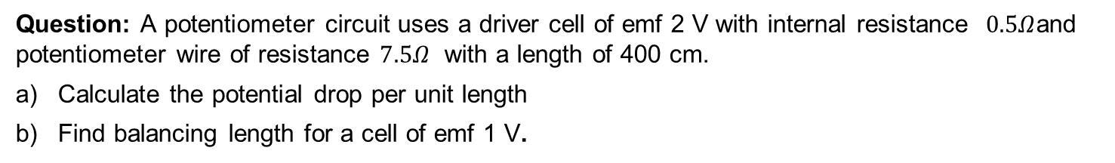
Numerical
Question: A potentiometer circuit uses a driver cell of emf 2 V with internal resistance $0.5Ω$and potentiometer wire of resistance $7.5Ω$ with a length of 400 cm.
Calculate the potential drop per unit length
Find balancing length for a cell of emf 1 V.

Slide 12
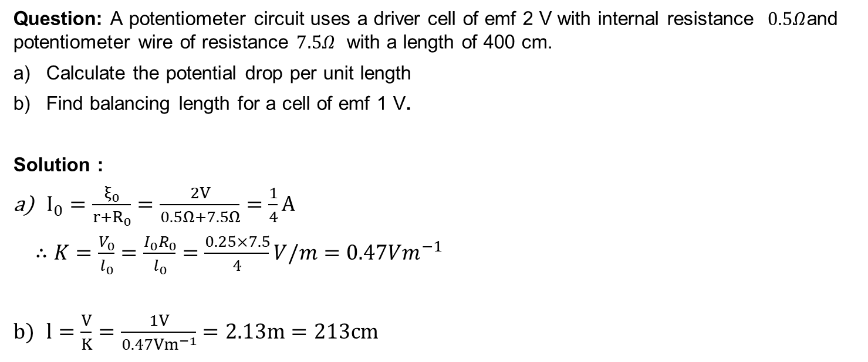
Numerical
Question: A potentiometer circuit uses a driver cell of emf 2 V with internal resistance $0.5Ω$and potentiometer wire of resistance $7.5Ω$ with a length of 400 cm.
Calculate the potential drop per unit length
Find balancing length for a cell of emf 1 V.
Solution :
$I_{0}=\frac{ξ_{0}}{r+R_{0}}=\frac{2V}{0.5Ω+7.5Ω}=\frac{1}{4}A$
$∴K=\frac{V_{0}}{l_{0}}=\frac{I_{0}R_{0}}{l_{0}}=\frac{0.25×7.5}{4}V/m=0.47Vm^{−1}$
$l=\frac{V}{K}=\frac{1V}{0.47Vm^{−1}}=2.13m=213cm$

Slide 13
Comparison of emf’s using Potentiometer:
E₁
I
+
R.B
G
The balance point is obtained for the cell when the potential at a point on the potentiometer wire is equal and opposite to the emf of the cell.
+
E₂
E
A
0
l₂
J₂
100
A
200
l₁
J₁
+
Rh
300
E₁ = V_{AJ1} = I ρl₁ /A
E₂ = V_{AJ2} = I ρl₂ /A
B
400
K
E₁ / E₂ = l₁ /l₂
Note:
The balance point will not be obtained on the potentiometer wire if the fall of potential along the potentiometer wire is less than the emf of the cell to be measured.
The working of the potentiometer is based on null deflection method. So the resistance of the wire becomes infinite. Thus potentiometer can be regarded as an ideal voltmeter.

Slide 14
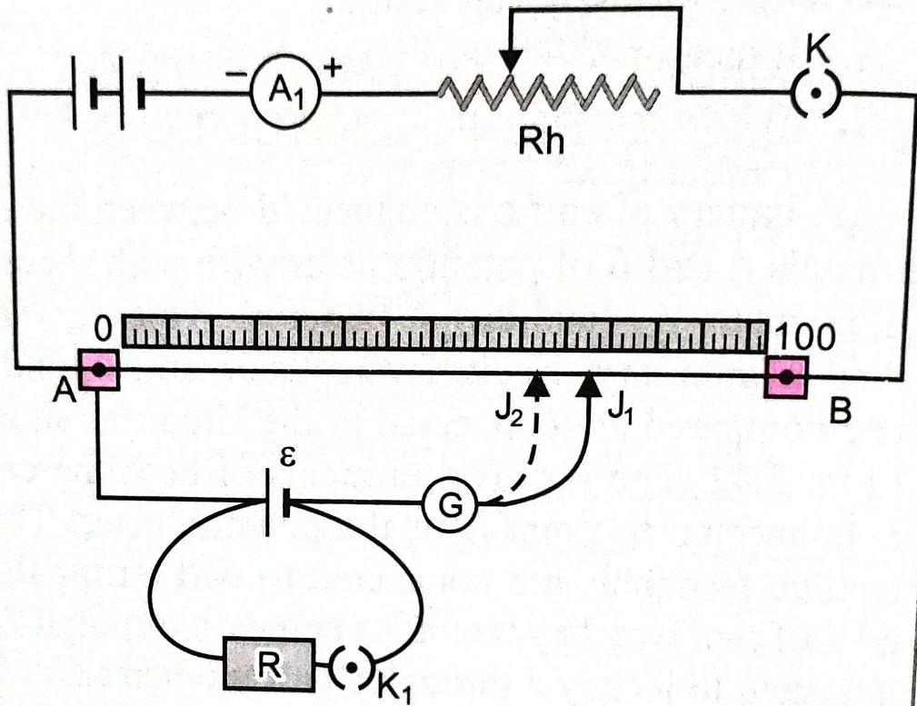
Determination of internal resistance of a cell

Slide 15
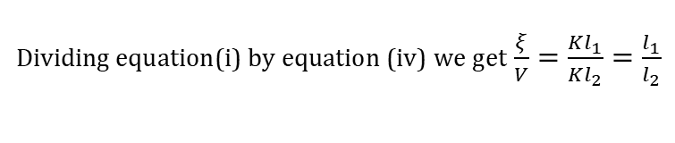

Determination of internal resistance of a cell
When switch K2 is open there is no current in the second circuit at the null point position.
If null point length at this condition is $l_{1}$ ,
then $ξ=Kl_{1}$ ..........(i)
When switch K2 is closed there is a current I through the second circuit.
So potential difference across the cell is
$V=IR=ξ−Ir$ .......(ii)
$⇒ξ=I(R+r)$ .........(iii)
Now null point distance is $l_{2}$. So $V=Kl_{2}$
Dividing equation(i) by equation (iv) we get $\frac{ξ}{V}=\frac{Kl_{1}}{Kl_{2}}=\frac{l_{1}}{l_{2}}$
Now using equations (ii) and (iii)
$\frac{I(R+r)}{IR}=\frac{l_{1}}{l_{2}}$
$⇒\frac{R+r}{R}=\frac{l_{1}}{l_{2}}⇒R+r=\frac{l_{1}}{l_{2}}R⇒r=\frac{l_{1}}{l_{2}}R−R=R\left(\frac{l_{1}}{l_{2}}−1\right)$ r is the internal resistance of the cell and R is the resistance connected across the cell

Slide 16
THANKING YOU
ODM EDUCATIONAL GROUP

