Slide 1


Types of Functions
SUBJECT : MATHEMATICS
CHAPTER NUMBER:1
CHAPTER NAME :RELATIONS AND FUNCTIONS

Slide 2
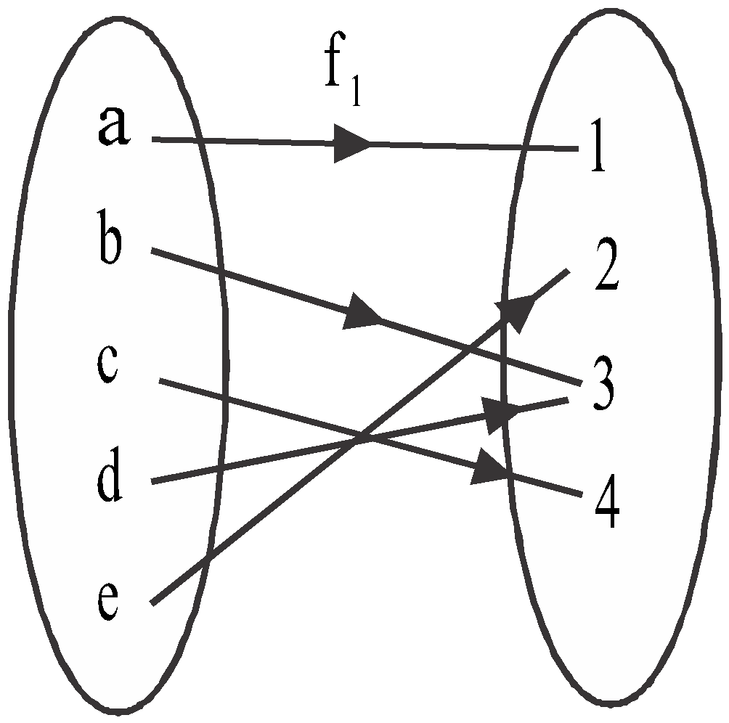
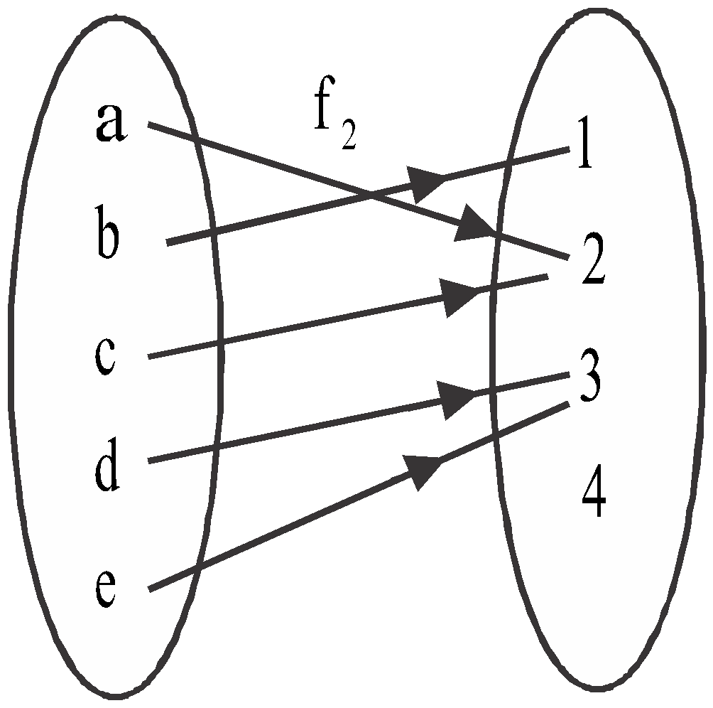
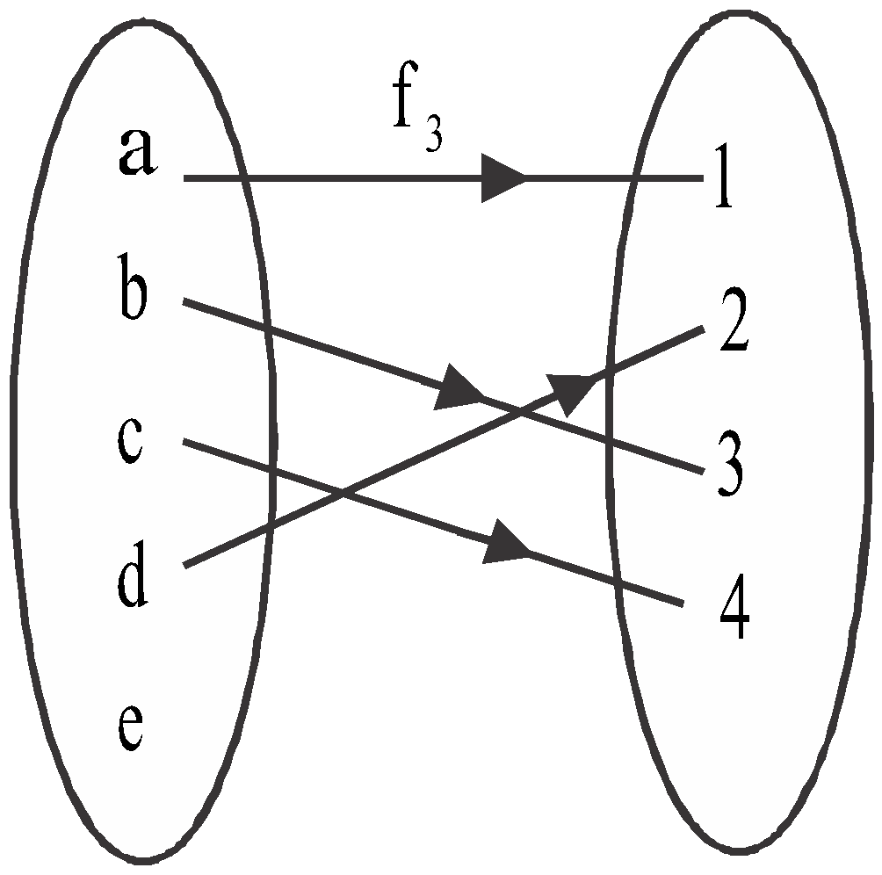
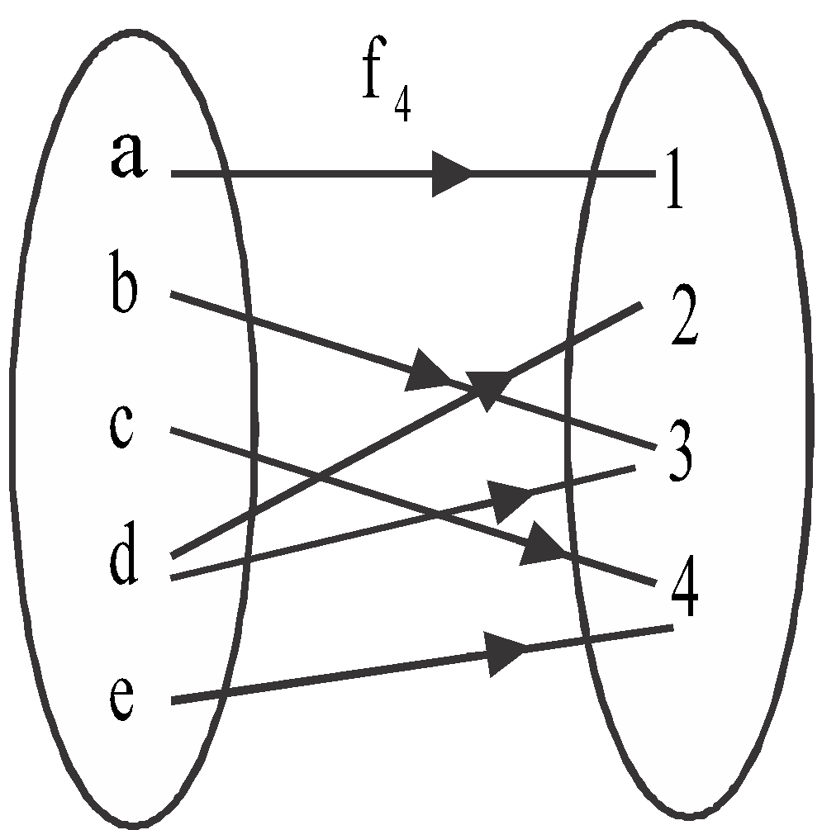
Function
Function from set A to set B:- Let A and B be two non empty sets, then a function f from set A to set B is a rule (or map or correspondence) which associates each element of set A to exactly one element of set B. If f is a function from set A to set B, then we denote it by .
Example:-
Check whether the maps in following diagram are functions or not.
(i) (ii) (iii) (iv)

Slide 3
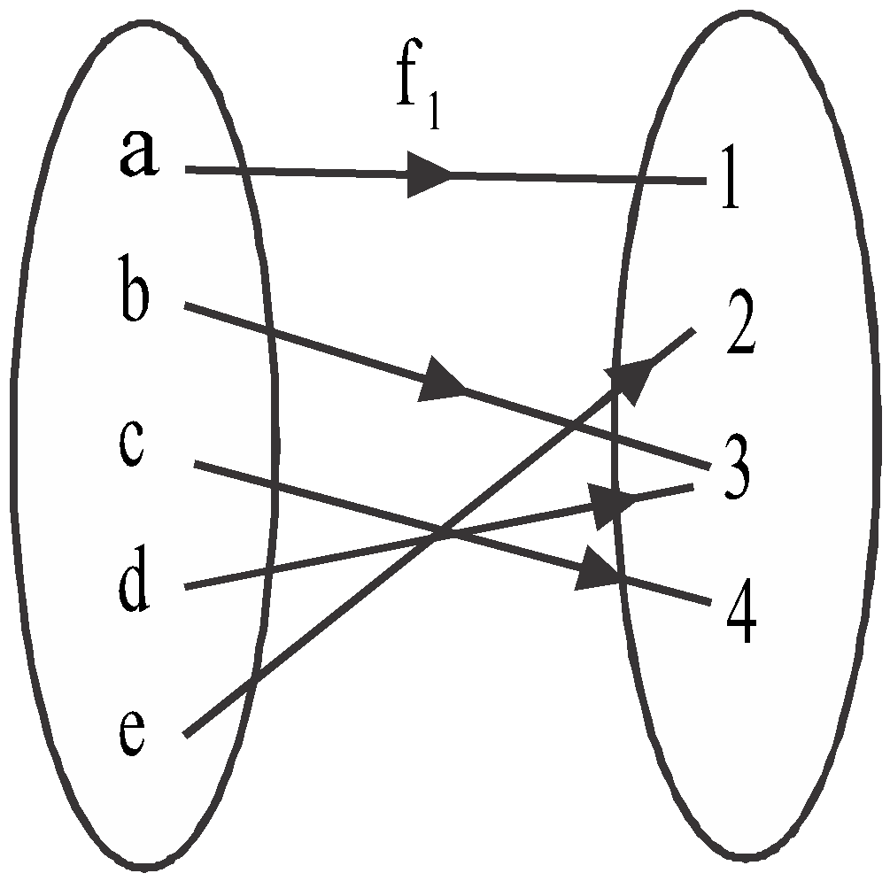
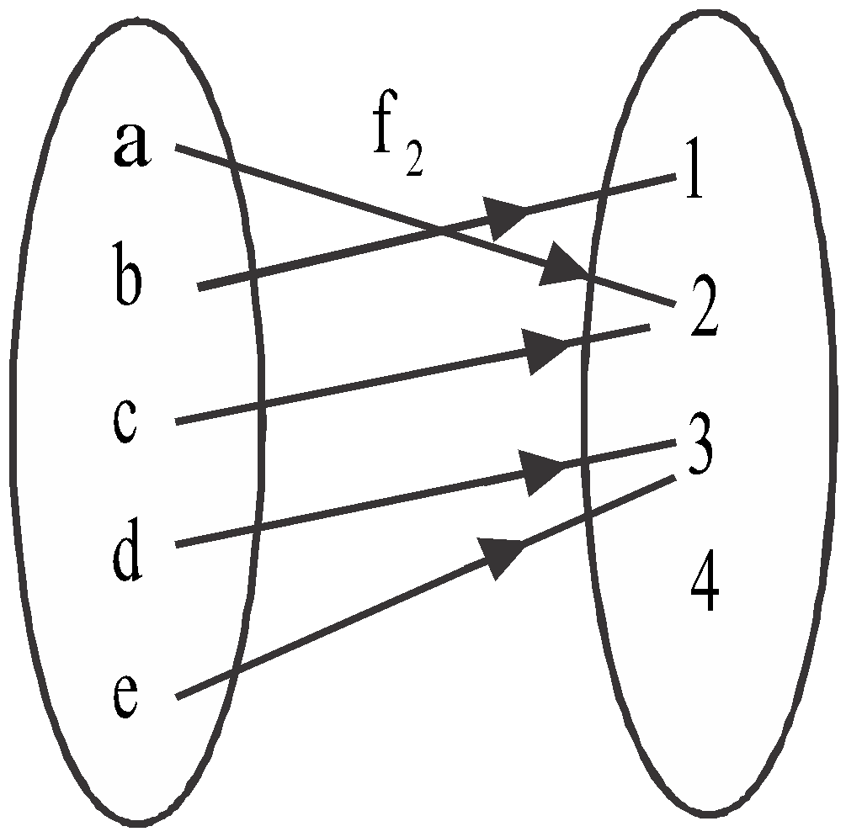
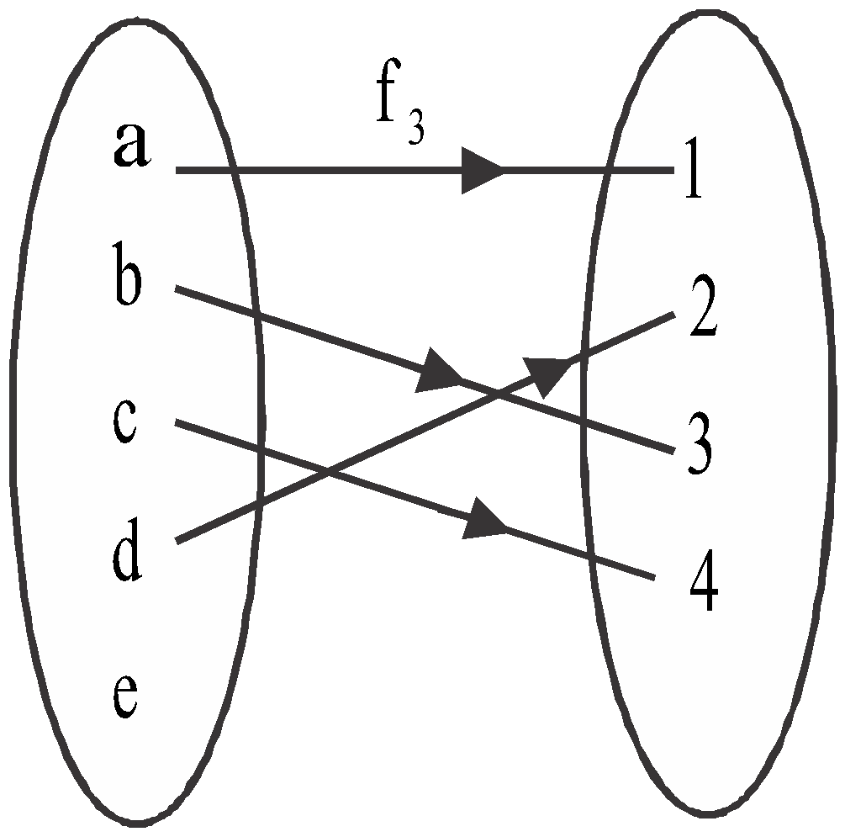

Example:-
Check whether the maps in the following diagrams are functions or not.

Slide 4
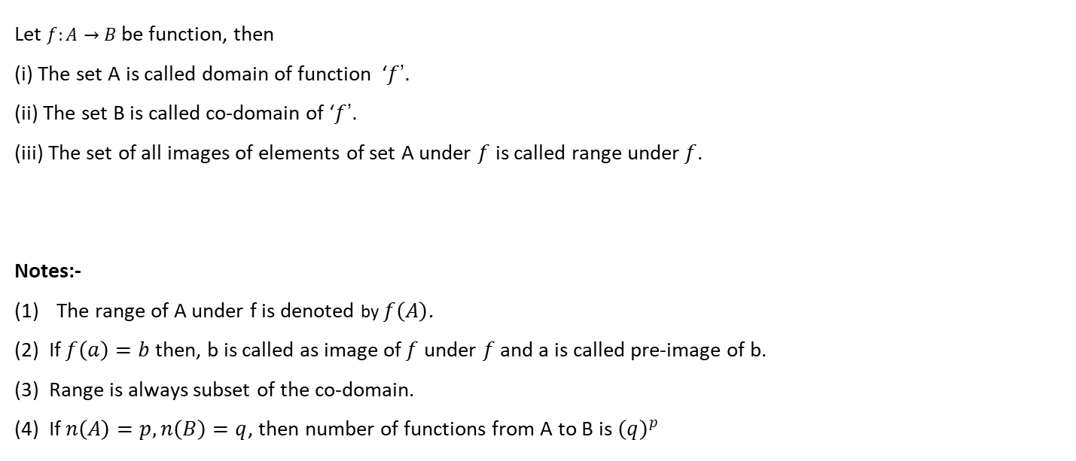
Domain, Co-domain and Range of a Function:-

Slide 5
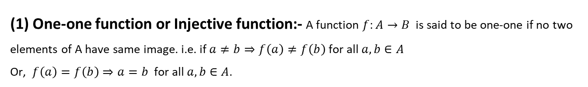
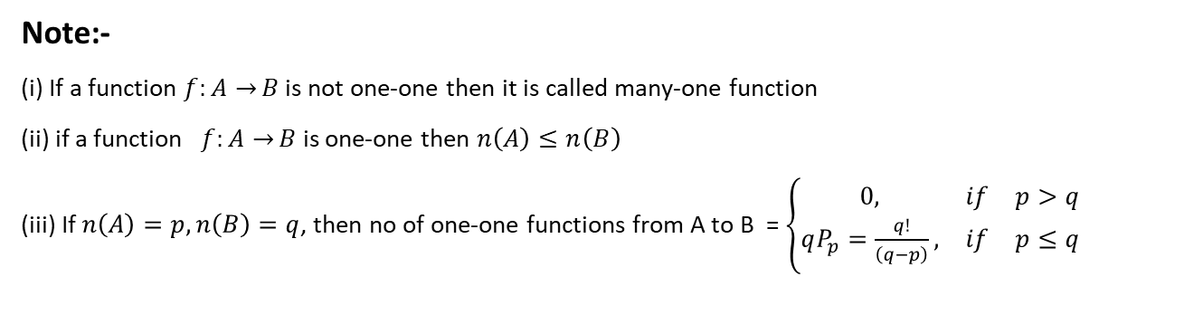
Types of Functions

Slide 6
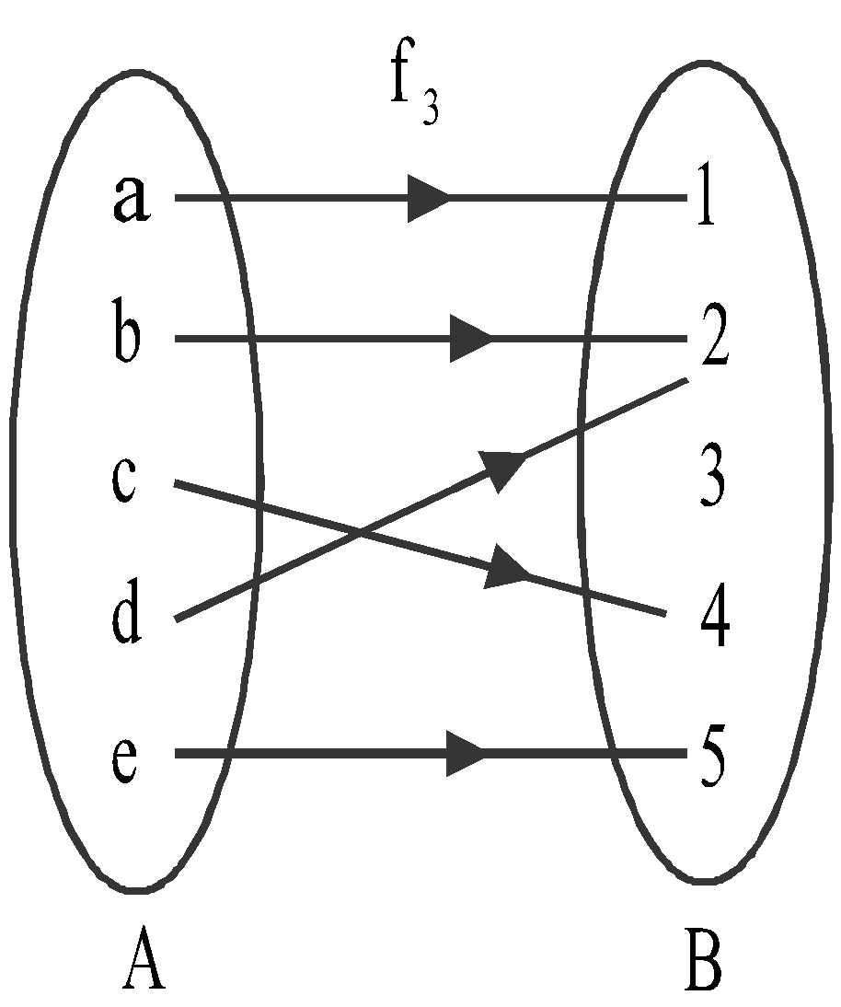
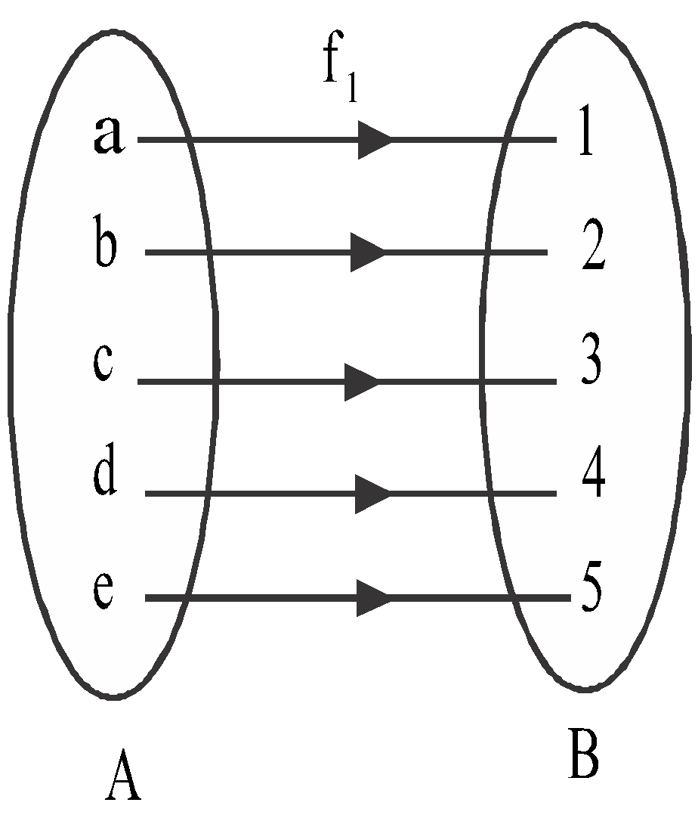
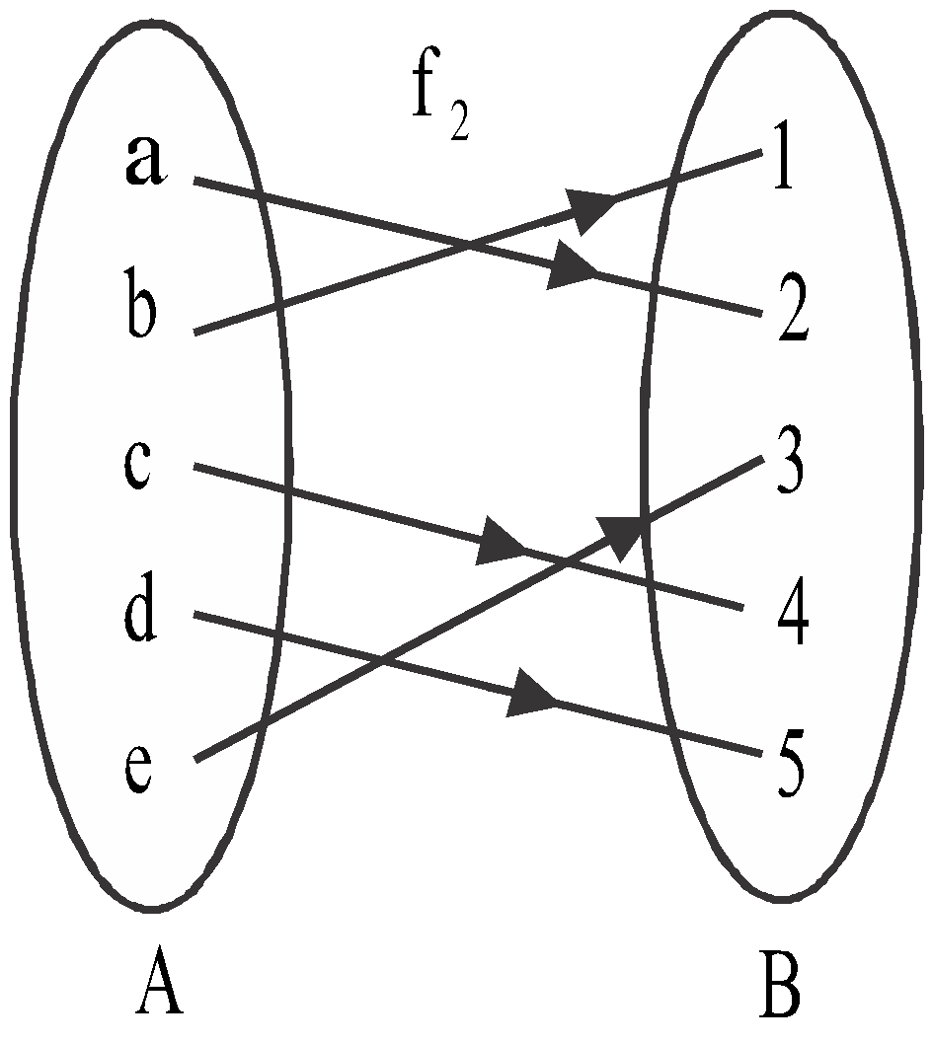
EXAMPLE:
Check whether the functions in the diagram are one-one or not.
(i) (ii) (iii)

Slide 7
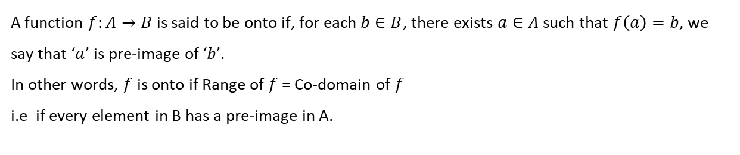
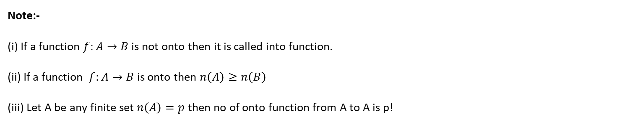
(2) Onto Function or Surjective Function

Slide 8
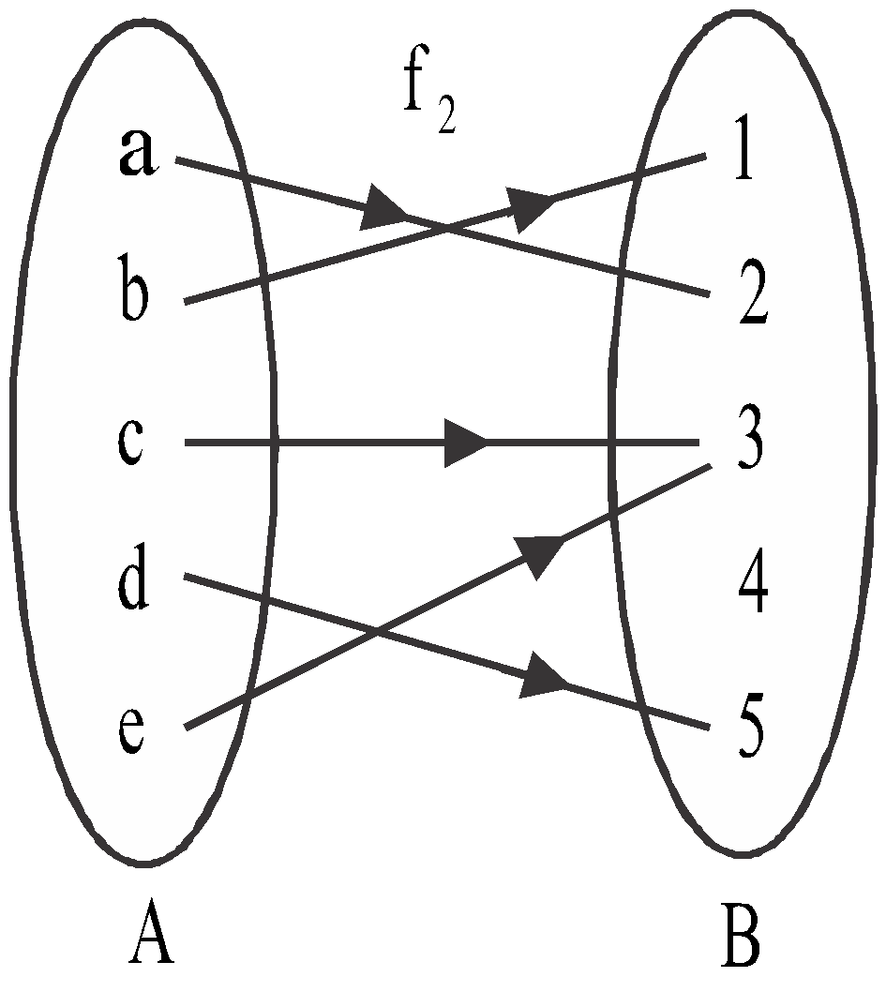
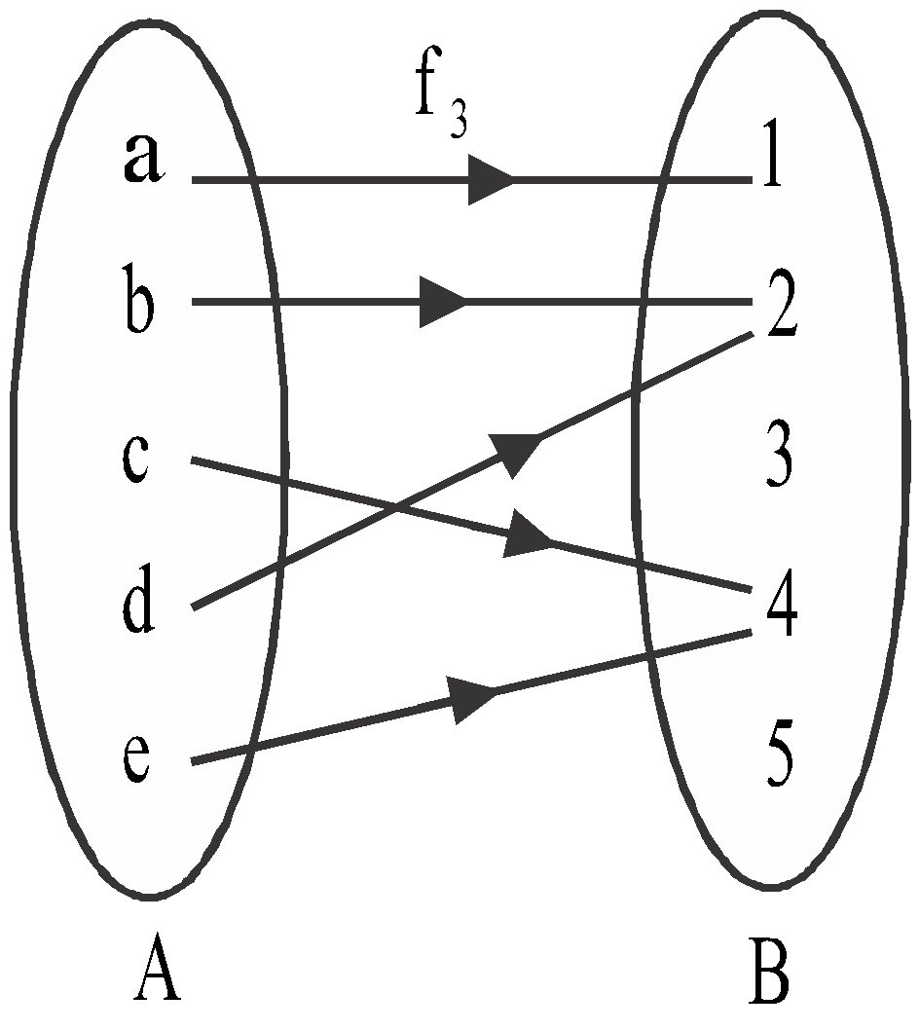
EXAMPLE:
Check whether functions in the figure are onto?
(i) (ii) (iii)

Slide 9
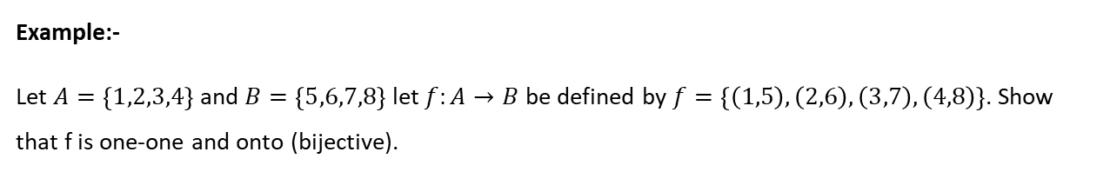
(3) Bijective Function

Slide 10
EXAMPLE:

Slide 11

EXAMPLE:

Slide 12
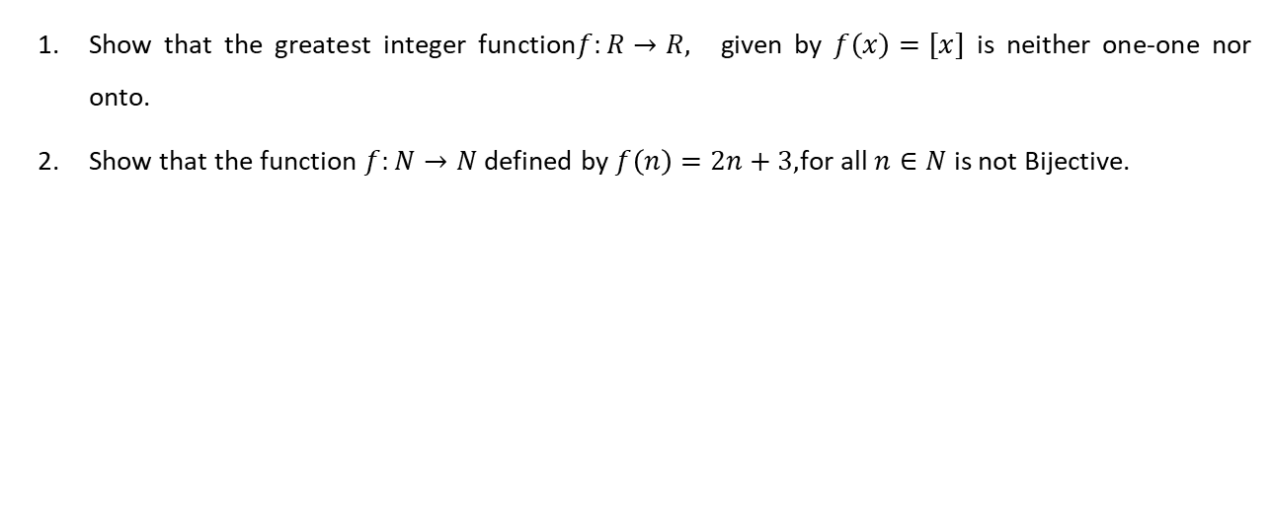
Assignments

Slide 13
THANKING YOU
ODM EDUCATIONAL GROUP

