Slide 1


INDIGO
LOUIS FISCHER
SUBJECT : (ENGLISH)
CHAPTER NUMBER:5
CHAPTER NAME : INDIGO

Slide 2
LEARNING OUTCOME
Students get acquainted with the “INDIGO SHARECROPPING” Historical background and legal vocabulary.
Students can be able to understand the role of a leader.
Students can infer the importance of rights and Justice.
Students can know the sufferings and contributions of freedom fighters and freedom from fear is a prerequisite for justice.
To inculcate various skills required for the task.
Students can take initiative with a sense of responsibility and confidence to fight back with any oddities in their life.

Slide 3
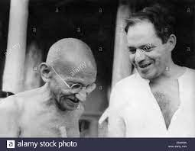
ABOUT THE AUTHOR
Louis Fischer was born in Philadelphia on 29 February 1896.
He served as a volunteer in the British Army but made his career as a journalist and worked for different newspapers.
He wrote for The New York Times, The Saturday Review and for European and Asian Publications.
He was also a member of the Faculty at Princeton University.
An American journalist Mr Louis Fischer came to India in May 1942.
The following is an excrept from his book- The life of Mahatma Gandhi.

Slide 4
VIDEO LINKS
https://www.youtube.com/watch?v=nX_z1tWy18o
Revisiting Champaran Satyagraha
https://www.youtube.com/watch?v=Kg8IidoHADg
Champaran Agitation from Gandhi Movie

Slide 5
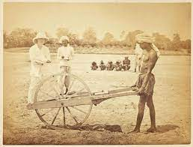
THEME
Effective leadership can solve any kind of problem.
Colonial rule of Britishers.
Great injustice due to Landlord system in Bihar.
War against Atrocities.
Victory of Civil Disobedience.
A lesson learnt from Gandhiji on Self-Relience.
Struggle for noble cause never goes unrewarded.

Slide 6
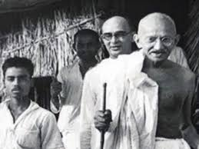
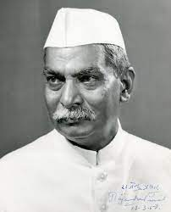
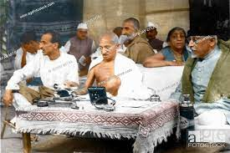
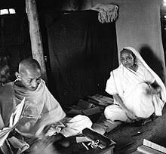
CHARACTERS
Mahatma Gandhi- Indian National Leader
Raj Kumar Sukla- A sharecropper in Champaran, Bihar
Rajendra Prasad- A lawyer and later the President of India
J.B.Kriplani- A professor in Art college, Muzaffarpur, Bihar
Prof. Malkani- A teacher in a government college.
Sir Edward Gait- Lieutenant Governor
Charles Freer Andrews- A follower of Gandhi
Kasturba- Wife of Mahatma Gandhi
Devdas- Youngest son of Gandhi

Slide 7
INTRODUCTION TO THE CHAPTER
The story is based on the interview taken by Louis Fischer of Mahatma Gandhi.
He visited him in 1942 at his ashram- Sevagram where he was told about the Indigo Movement started by Gandhiji.
The story revolves around the struggle of Gandhi and other prominent leaders in order to safeguard sharecroppers from the atrocities of landlords.
They led a miserable life and were forced to grow indigo according to an agreement.
They suffered a great injustice due to the landlord system in Bihar.
Gandhi waged a war against their atrocities and brought justice to the poor peasants.

Slide 8
CHAPTER ANALYSIS……. (PGNO-47-49)
This story describes Gandhi’s struggle for the poor peasants of Champaran.
Raj Kumar Shukla- A poor sharecropper from Champaran wishing to meet Gandhiji.
Raj Kumar Shukla – illiterate but resolute, hence followed Gandhiji to Lucknow, Cawnpore, Ahmedabad, Calcutta, Patna, Muzzafarpur and then Camparan.
In those days most of arable land in the Champaran district was divided into large estate owned by Englishmen and worked by Indian tenants.
The chief commercial crop was Indigo.
The landlords compelled all tenants to plant 15% of their Indigo and surrender the entire Indigo harvest as rent.
This was done by long term contract.

Slide 9
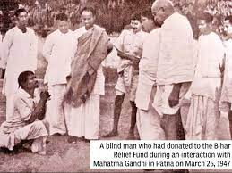
CHAPTER ANALYSIS…… (PAGE NO- 48 &49)
Servants at Rajendra Prasad’s residence thought Gandhiji to be an untouchable.
He decided to go to Muzzafarpur first to get detailed information about Champaran sharecropper.
Sent telegram to J B Kriplani & stayed in Prof Malkani’s home –a government servant.
At that time Indians were afraid of showing sympathy to the supporters of home rule.
The news of Gandhiji’s arrival spread –sharecroppers gathered in large number to meet their champion.
Gandhiji chided the Muzzafarpur lawyer for taking high fee.

Slide 10
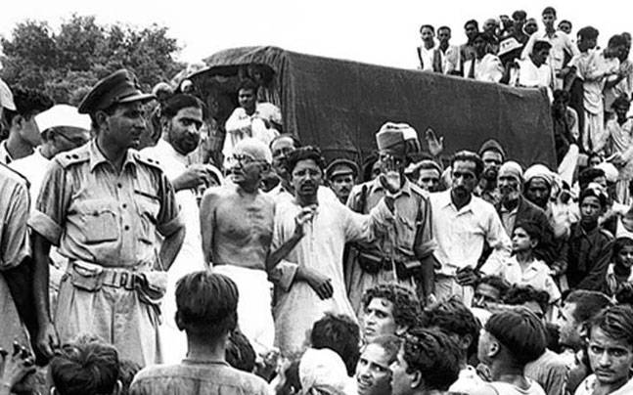
CHAPTER ANALYSIS……. (PAGE NO.- 49)
Champaran district was divided into estate owned by English people, Indians only tenant farmers.
Landlords compelled tenants to plant 15% of their land with indigo and surrender their entire harvest as rent.
In the meantime Germany had developed synthetic indigo.
British landlords freed the Indian farmers from the 15% arrangement but asked them to pay compensation.
Many signed, some resisted engaged lawyers, and landlords hired thugs.

Slide 11
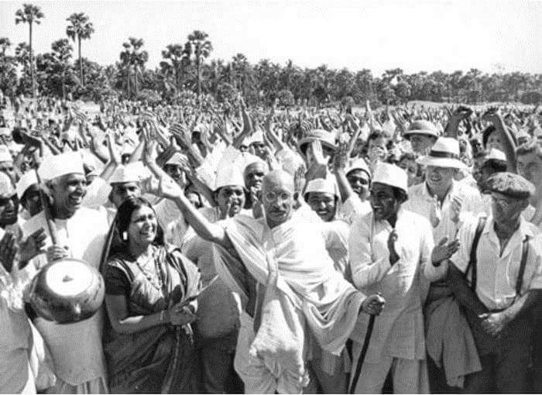
CHAPTER ANALYSIS……. (PAGE NO.- 49 -52)
Gandhiji reached Champaran –visited the secretary of the British landlord association to get the facts but denied as he was an outsider.
Gandhiji went to the British Official Commissioner who asked him to leave Tirhut , Gandhiji disobeyed.
Visited maltreated villagers, stopped by the police superintendent but disobeyed the order.
Gandhiji released without bail Civil Disobedience triumphed.
Gandhiji agreed to 25% refund by the landowners, it symbolised the surrender of the prestige

Slide 12
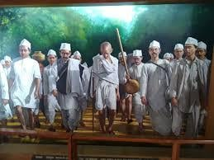
CHAPTER ANALYSIS (PAGE NO.- 53 &54)
He stressed on counseling as this would give the peasants enough confidence to fight their fear.
He managed to get justice after a year long battle for the peasants.
Gandhiji worked hard towards social economic reforms, elevated their distress aided by his wife, Mahadev Desai, Narhari Parikh.
He also made arrangements for the education, health, and hygiene for the families of the poor peasants.
Gandhiji taught a lesson of self reliance by not seeking help of an English man Mr. Andrews.
He gave them the lesson of self-reliance.

Slide 13
DIFFICULT WORDS
Convention: agreement Delegates: Representatives Peasant: small farmer Emaciated: thin Champaran: A place in Bihar
Sharecroppers: a tenant farmer who gives a part of each crop as rent. Resolute: determined
Committed: dedicated Accompanied: go somewhere with (someone) as a companion or escort Cawnpore: British name for the city of Kanpur
Tenacity: determination Haunches: thighs Boarded: get on, enter Yeoman: a man who cultivates a small piece of land Pestered: bother, harass Permitted: allowed
En route: on the way Imparting: pass on, giving

Slide 14
DIFFICULT WORDS
Extraordinary: exceptional, remarkable Harbour: here, entertain Sympathy: support, pity Advocate: supporter, protector Advent: arrival Conveyance: transportation
Chided: criticize, scold Conclusion: result, end of something Fear stricken: afraid Arable: land suitable for farming Tenants: occupants paying rent in cash or kind Estate: property Compelled: forced Surrendered: to give in Contract: agreement Indigo: plant that produces a blue color
Irksome: irritating Resisted: opposed, to be against something Thugs: cheats

Slide 15
DIFFICULT WORDS
Proceeded: begin a course of action Bully: trying to harm others considering them to be weak Forthwith: immediately, at once
Multitude: a large number of people Investigations: inquiries Maltreated: ill treat
Baffled: confused Prosecutor: Lawyer or barrister Postpone: delay Apparently: seemingly, evidently
Throbbed: produced a lot of vibrations due to a huge crowd Investigators: the inspectors Vehement: showing strong feeling; forceful, passionate, or intense.
Pacifist: Peace maker Vehemently: in an intense manner Self Reliance: self sufficiency, self support prop: support

Slide 16

QUESTIONS
1.Why did Gandhiji agree to the planters’ offer of a 25 percent refund to the farmers?
2.How was Gandhiji able to influence the lawyers at Champaran?
3.How did Gandhiji help the peasants of Champaran?
4.Why did the servants think Gandhiji to be another peasant?
5.Why did Gandhiji agree to the planters’ offer of a 25% refund to the farmers?
6.What made Gandhiji demand 50% refund from the British landlords?
7.Why did Gandhiji accept 25 percent compensation?
8.“The battle of Champaran is won.” When and why did Gandhiji exclaim this?
9.What were the terms of the indigo contract between the British landlords and the Indian peasants?
10.Why was Gandhiji opposed to C.F. Andrews helping him in Champaran?
11.Describe the difficulties faced by Gandhi at Champaran
?
12.How was the Champaran incident a turning point in Gandhiji’s life?

Slide 17
THANKING YOU
ODM EDUCATIONAL GROUP

