Slide 1


INTRODUCTION and CONCLUSION
Time travel, Psychiatric experience Q&A
SUBJECT : (ENGLISH)
CHAPTER NUMBER:1
CHAPTER NAME : THE THIRD LEVEL BY JACKFINNEY

Slide 2
LEARNING OUTCOMES
Students will be able to-
Summarise the story in a gap-filling exercise. (Understand)
Recall the essential points of the story through a questionnaire, fill-in, reference to the context and MCQ quiz. (Remember)
Write the character sketch of Mr Charley with the help of the STEAL characterisation technique. (Create)
Infer the meaning of some important statements in the story writing a short note on them. (Analyze)
Debate if Charlie has visited the third level by writing a short note on it. (Evaluate)

Slide 3
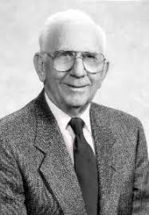
A FEW FACTS ABOUT THE WRITER JACK FINNY
An American Author
Worked for an advertising agency
He died in California at 84 (1995)
Works –science fiction and thrillers, including “The Body Snatchers” and “Time and Again”

Slide 4

THEME OF THE LESSON:
Escapism ... A psychological refuge from the grim realities
Interaction of time, an illusion
Reality versus fantasy
Time intersection… an emotional predilection
Search for happiness in life
Role of a friend in getting peace and happiness
Desire to stay in past for peace, security, serenity

Slide 5
BACKGROUND INFORMATION ON THE LESSON
In the spirit of Fiction, connecting to time travel
It was a world when people hadn’t seen two of the bloodiest wars (I & II) in the history of mankind.
Charlie, perhaps taxed by the worldly miasma, fantasizing a suggestive escape.
An anecdotal narrative.

Slide 6
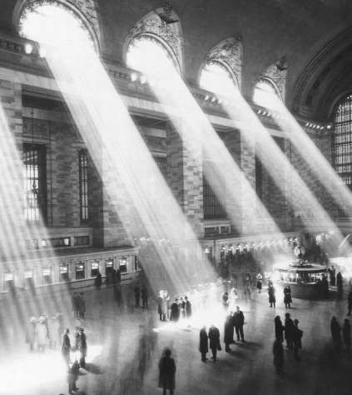
Setting of the story: Grand Central Station
Grand Central Station officially opened on February
2, 1913. So it has already celebrated its centenary.

Slide 7


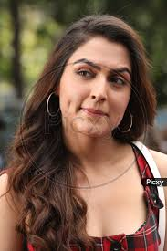
CHARACTERS INVOLVED
* Predominantly Three Characters –
1. Charley
- the protagonist - highly imaginative and sensitive - unable to cope u with tension and worries - ‘waking dream wish fulfilment.
2. Sam Weiner, the psychiatrist - is true to his profession - a competent psychiatrist- He finally discovers the third level 3. Louisa - ----Loving wife of Charley - she is simple minded women

Slide 8
INTRODUCTION
The Third Level by Jack Finney is about the harsh realities of war.
War has irreversible consequences thus leaving people in a state of insecurity.
It is also about modern-day problems and how common man tends to escape reality by various means.
In this story, a man named Charley hallucinates and reaches the third level of the Grand Central Station which only has two levels.

Slide 9
CONTENTS OF THE THIRD LEVEL
“The Third level”- conceptual clarity
And the Lesson B E G I N S…
THE Presidents of the New York Central and the New York, New Haven and Hartford railroads will swear on a stack of timetables that there are only two.
Contradictory versions on the existence of THE Third Level
Charlie continues convincing...

Slide 10
NARRATOR CHARLEY’S EXPERIENCES BROUGHT FORWARD…
Charlie confirms Three levels at Grand Central Station.
Talks to Psychiatrist friend- Sam Weiner on the issue.
Sam’s explanation in terms of psychological theory.
Charlie’s wife is made scary
... the modern world is full of insecurity, fear, war, worry and all the rest of it, and that I just want to escape
Narrator’s hobby of Stamp Collecting, as a refuge from reality
Writer contradicts Sam on grandfather’s example.
- The idea of First-day covers in stamp collecting
Charlie continues convincing...

Slide 11
NARRATOR CHARLEY’S EXPERIENCES BROUGHT FORWARD…
-The real-crux experience- -One day, wanted to take the subway from Grand Central to home as he was late.
- Reached the First Level & then the second and in the subway got lost. - Experienced previous such occasions also - Many outlet routes from grand Central (ref. To Roosevelt Hotel, Forty-Six street, Times Square, Central Park )
... Sometimes I think Grand Central is growing like a tree, pushing out new corridors and staircases like roots.

Slide 12
NARRATOR CHARLEY’S EXPERIENCES BROUGHT FORWARD ...
- After passing through a tunnel, reached the third Level - Experienced unusual sight relating to people and the place
- The newspaper “The World” revealed the date to be 11th June 1894.
- Peculiar experience at the ticket booking counter.
- Description of Galesburg, Illinois.
- Return of Charlie from the Third Level - Three hundred dollar encashment for old notes.

Slide 13
NARRATOR CHARLEY’S EXPERIENCES BROUGHT FORWARD…
- Discovered a First-day cover addressed to his grandfather at Illinois address, dated July 18, 1894. - The Letter was written by Sam, inviting Charlie and Luisa to come to Illinois, where he had settled with his new business. - Sam had encashed $800 at old currency store and had started a new business of hay, feed and grain.

Slide 14
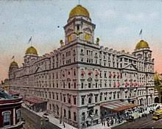
MODERN LOOK OF GRAND CENTRAL RAILWAY STATION, NEW YORK

Slide 15
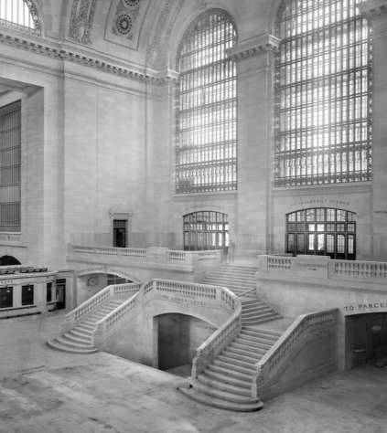
This is a view of the balcony in Grand Central Station taken between 1913 and 1930.
This is where the Apple Store is located today.

Slide 16
THE MORAL OF THE STORY
In today's busy and overburdened life every individual wants some recreation and relaxation.
This relaxation is possible only in his dreams and not in real life
So in the prose the shadowy eerie world that lies somewhere between dreams, desires and reality is what ‘Jack Finney’ calls 'THE THIRD LEVEL'

Slide 17
COUNCLUSION
All in all, The Third Level brings us to the conclusion that people find it hard to make peace with unpleasant things they come across in life.
The story further makes the reader realize that the past and future are real illusions.
They exist in the present, which is all there is.

Slide 18
BROWSING THROUGH VOCABULARY
A few words of the lesson
Stack- a pile of objects Timetables- a book on the departure and arrival times of trains Waking dream- daydream Wander- roam Refuge- escape
Suburban- residential Ducked- lower the head or body quickly Arched- curved Bumping- run into something
Vest- a garment worn on the upper part of the body Snapped- break suddenly and completely Locomotive- a powered railway vehicle for pulling trains Fussing- show unnecessary or excessive concern about something

Slide 19
May I check up your Comprehension?
A few simple questions for you to answer-
1. What does Third Level refer to?
2. How did Charley reach the Third level?
3. What was the reaction of the Clerk at the ticket counter?
4. What preparations did Charley make to go to Galesburg?
5. What made Louisa, Charley’s wife, believe that the existence of the third level was a reality?
6. Could Charlie go to the Third Level again to buy tickets for him and his wife?
7. What impression do you gain on Charlie’s experience?

Slide 20
THANKING YOU
ODM EDUCATIONAL GROUP

