Slide 1


INTRODUCTIO and CONCLUSION
Pride of power, Ruthless killing of animals
SUBJECT : (ENGLISH)
CHAPTER NUMBER: 2
CHAPTER NAME : THE TIGER KING BY KALKI

Slide 2

LEARNING OUTCOMES
Students will be able to justify the title “The Tiger King."
Students will encourage readers with the ability to fight and overcome challenging situations and overwhelming terror.
Students will learn about Satire as a literary device- using a combination of humour and sarcasm to fulfil the exercise of criticizing social follies
Students will be able to validate the parental authority and reaffirm the importance of one’s own identity even in the face of public criticism

Slide 3
VIDEO LINKS
https://youtu.be/nhSipS4d5og
https://youtu.be/aUrnZQbPIkQ

Slide 4
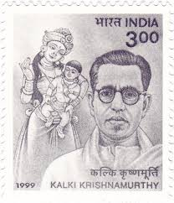
A FEW FACTS ABOUT THE WRITER
KALKI
Ramaswamy Krishnamurthy
(9th Sep. 1899 – 5th Dec. 1954)
Penname -Kalki
An Indian; Tamil writer
Notable works: Ponniyin Selvan, Sivagamiyin Sabadham
Notable Awards: Sahitya Akademi Award for Alai Osai
Was a Journalist, Poet, Critic and freedom Activist
Was named after "Kalki“- the tenth and last Avatar of the Hindu God Vishnu.
Died in Chennai on 5th Dec. 1954 at 55 years from tuberculosis.

Slide 5
THEME OF THE LESSON:
A satire on the conduct of people in power
The transience of life and power... Inevitability of destiny
Autocratic nature & follies of kings during British time
The haphazard killing of one species, adversely affecting the ecological balance
Astrologer’s prophecy
The inhuman, callous attitude of the people towards wildlife

Slide 6
BACKGROUND INFORMATION ON THE LESSON
The Tiger King
A political satire on the conceit of those in power
The selfish pursuit of rulers without interest in public welfare during British time
It’s a story about the transience of life, of power to reverberate the maxim: “Too many sips between the cup and the lip”.

Slide 7
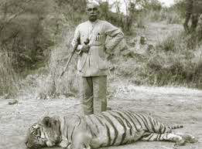
SETTING OF THE STORY: THE TIGER KING
The story revolves around a King whose death by a tiger had been foretold when he was born.
He tries to reverse the fate spelt out for him.
The author uses thinly-veiled satire to walk the readers through the King's attempts which later prove futile humorously.

Slide 8
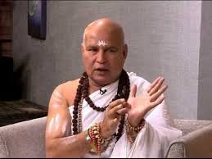
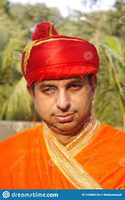
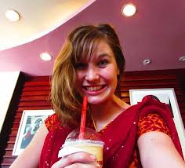
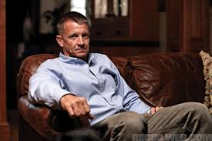
CHARACTERS INVOLVED
The Tiger King: -
- a hero of the story, with a long name
Crown prince:
- a ten-day-old baby
- later became the Maharaja
Chief Astrologer:
- a royal foreteller of the state
A British high ranking officer & his Secretary
Dewan:
- Chief Administrative Office of Maharaja
Duraisani: - wife of the British officer

Slide 9
          INTRODUCTION
Kalki takes his readers to the days of autocratic and eccentric kings.
These kings lived under the thumb rule of Britishers, hence they fear them.
To make the story mysterious Kalki has added a supernatural element in the story.
The story 'The Tiger King' is satire on the conceit of those in power.

Slide 10
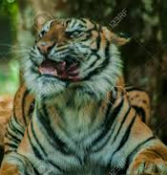
CONTENTS OF “THE TIGER KING”
‘The Tiger King’... Why so named?
And the Lesson B E G I N S…
Part-I ... The King’s childhood Miracle
Introduction to the king having a peculiar name...
THE Maharaja of Pratibandapuram is the hero of this story. He may be identified as His Highness Jamedar-General, Khiledar-Major, Sata Vyaghra Samhari, Maharajadhiraja Visva Bhuvana Samrat, Sir Jilani Jung Jung Bahadur, M.A.D., A.C.T.C., or C.R.C.K. But this name is often shortened to the Tiger King. [Page-8: Vistas]
… Kalki continues further …

Slide 11
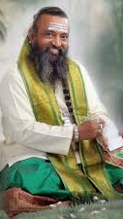
NARRATOR’S INFORMATION BROUGHT FORWARD…
When born, the astrologers predicted that that one day the king would die.
The miraculous talking by the King on 10th day of birth
The manner of his death was asked by the infant king.
‘‘All those who are born will one day have to die.
We don’t need your predictions to know that.
There would be some sense in it if you could tell us the manner of that death,’’ [Page-9: Vistas]
Chief Astrologer’s reply: ...
‘‘The prince was born in the hour of the Bull.
The Bull and the Tiger are enemies, therefore,
death comes from the Tiger.” [Page-9 : Vistas] … kalki continues further …

Slide 12
Narrator’s information brought forward…
Part-II ... The Prince is Coronated as King
The young prince grew stronger, fully anglicized because he...
…drank the milk of an English cow, was brought up by
an English nanny, tutored in English by an Englishman,
saw nothing but English films — exactly as the crown
princes of all the other Indian states did. [ Page-10: Vistas]
At 20, was coroneted.
Took up hunting; was overjoyed after killing the 1st tiger.
The Astrologer warned him of the 100th tiger, the fatal one.
‘‘What if the hundredth tiger were also killed?’’
‘‘Then I will tear up all my books on astrology, set fire to them, and…’’
‘‘I shall cut off my tuft, crop my hair short and become an insurance agent,’’ the astrologer finished. [Page- 11: Vistas]
… Kalki continues further …

Slide 13
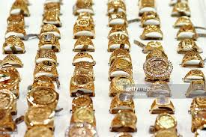
NARRATOR’S INFORMATION BROUGHT FORWARD…
Part-III … Hurdles for Maharaja
- Tiger killing brought for problems for the king.
There were times when the bullet missed its mark, the tiger
leapt upon him and he fought the beast with his bare hands.
Each time it was the Maharaja who won. [ Page-11: Vistas]
A British Officer (Durai) posed another threat.
- Wanted permission for tiger hunting, but the king refused.
- Displeasing Durai meant losing the throne.
- Pleased Duraisani with 50 diamond rings & saved the state.
…In two days a bill for three lakh of rupees came from the
British jewellers. The Maharaja was happy that though he
had lost three lakh of rupees, he had managed to retain his
kingdom. [ Page-12 : Vistas]
… Kalki continues further …

Slide 14
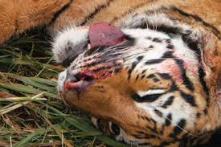
Narrator’s information brought forward…
NARRATOR’S INFORMATION BROUGHT FORWARD…
Part-IV: Tiger-Killing spree continues
with new exploration
Continuation of killing spree by the king for 10 long years
Killed-tiger tally reached70, exhausting tiger population in the
state.
New avenue explored to kill the balance 30, by remarriage from an
another state.
The ultimate tally now escalates to 99.
…Maharaja Jung Jung Bahadur killed five or six tigers
each time he visited his father-in-law. In this manner,
ninety-nine tiger skins adorned the walls of the reception
hall in the Pratibandapuram palace. [ Page-13: Vistas]
… Kalki continues further …

Slide 15
NARRATOR’S INFORMATION BROUGHT FORWARD…
Part-V: The ultimate dawns in …Death of the king
Great difficulty experienced in finding the hundredth tiger.
By this time the tiger farms had run dry even in his
father-in-Iaw’s kingdom. It became impossible to
locate tigers anywhere. Yet only one more was needed. [Page-14: Vistas]
The episode of missing sheep in the hillside village.
The initial happy king turns furious & punishes villagers.
The Dewan buys an old tiger from Madras zoo for the king.
Celebration of son’s birthday with a wooden toy
- spike of raw toy injures the king… condition worsens
- Madras doctors’ treatment fails…King dies by 100th tiger, though wooden.
… Kalki concludes here …

Slide 16
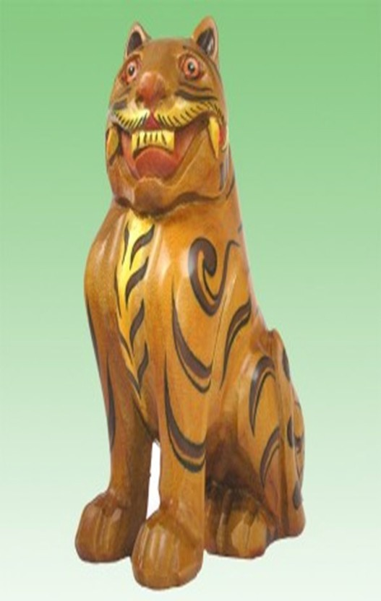
THE MIGHT OF WOODEN CRAFT...
THE DRACONIAN
WOODEN TIGER
The fateful hundredth tiger, though wooden one, was the cause of the Maharaja’s death.
Proved the prediction of the astrologer correct.

Slide 17
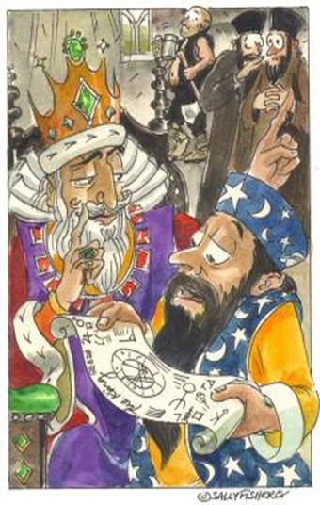
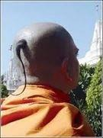
THE EMBEDDED HUMOUR IN THE STORY
Funny elements are...
- A ten-day-old child speaks out fluently
- king’s belief to change his destiny and the astrologer’s acceptance of the challenge on his tuft-strength to be an insurance agent.
- conversation between the king and Dewan about king marrying a tiger and his ancestors being ‘married to swords’ generates a lot of humour.
- Dewan’s carrying of the tiger in a vehicle with his wife to the jungle
- The tiger offering itself to the king to be shot dead
- The king celebrating his victory over the destiny

Slide 18
CONCLUSION OF THE CHAPTER- “THE TIGER KING”
The ending of the story "The Tiger King" makes its readers acquitted with the moral of the story.
In the end, all the pride and presence of power also do not help the King in escaping death.
Another thing which gets highlighted is that death is inevitable.
The King wanted to show his powers over the inevitable death.

Slide 19
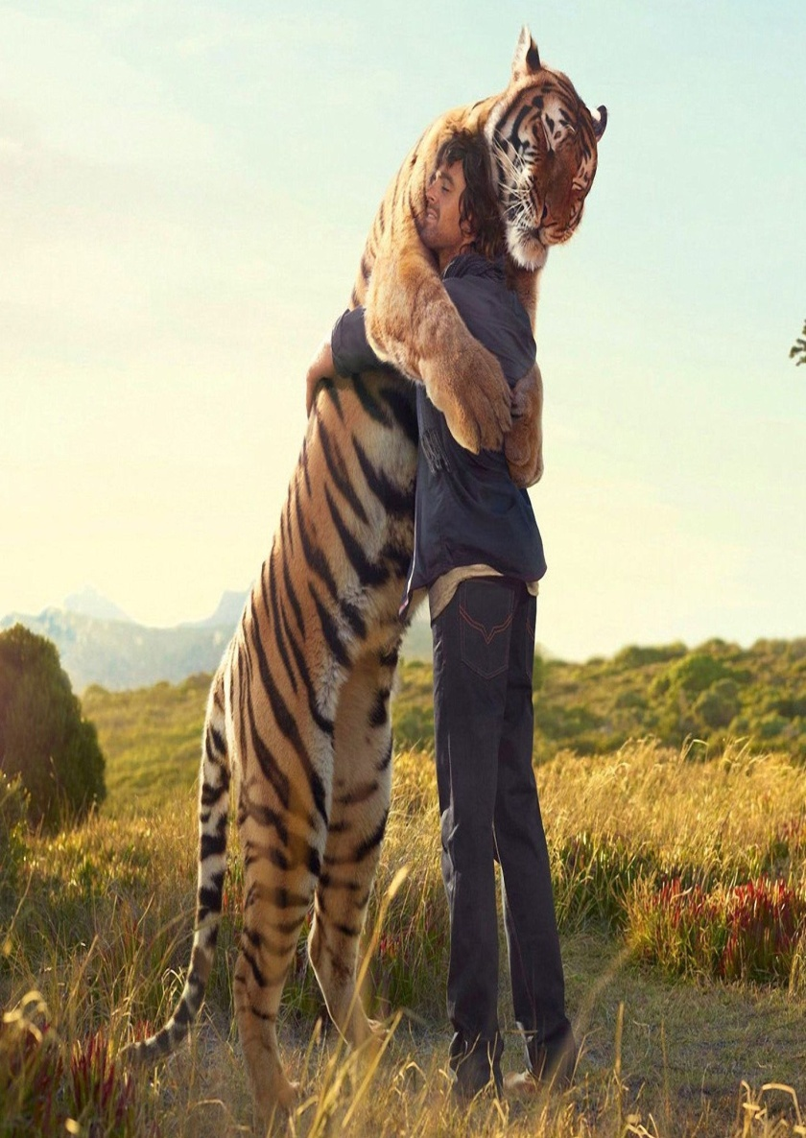
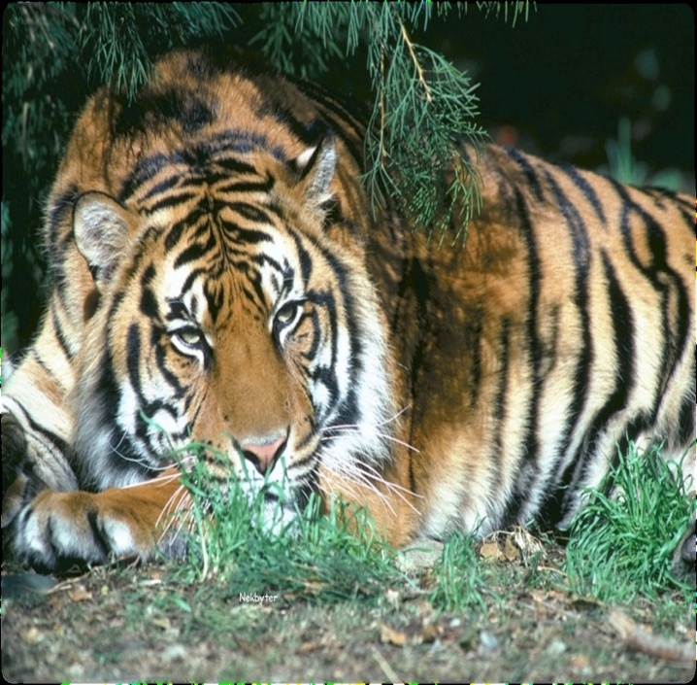
MESSAGE OF THE LESSON
-The gift of nature should be preserved and not decimated.
- Individual responsibilities must be discharged faithfully.

Slide 20
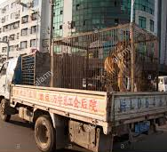
BROWSING THROUGH VOCABULARY
A few words and their meanings
Indomitable : undefeatable
Demise : death
Foretold : predicted
Transfixed : motionless
Stupefaction : shock
Enunciated : say clearly
Incredible : unbelievable
Hara-kiri : a ritual of suicide practised in Japan.
Brandishing : threaten
Babble : to talk in a silly way
Shuddering : tremble with fear
Adorned : decorated
Anxiety : curiosity

Slide 21
CHECK UP YOUR COMPREHENSIVE CLARITY OF THE LESSON
A few simple questions for you to answer-
Who is the hero of the story “The Tiger King”? How may he be identified?
What does the author consider imperative right at the start?
Which matter about the tiger king is of extraordinary interest?
What was the great miracle that took place and what was its result?
What did the infant born just ten days ago tell the wise astrologers?
How did the chief astrologer react to the infant prince’s observation?
How did the crown prince Jung Jung Bahadur grow up?
How does the author satirize the upbringing and the education of the crown prince’s of the Indian states?
What led the Maharaja to start on a tiger hunt?
What is the message of the story??

Slide 22
THANKING YOU
ODM EDUCATIONAL GROUP

